Slide 1
The slides for this presentation and a top tips sheet are all available for download on our website: https://HampshireCAMHS.nhs.uk
This session has also been filmed and is available to watch on our website.
You will find this on the Videos page and in the relevant Mental Health issue page.
Please do your feedback form as it helps us to keep sessions relevant and useful.

Slide 2
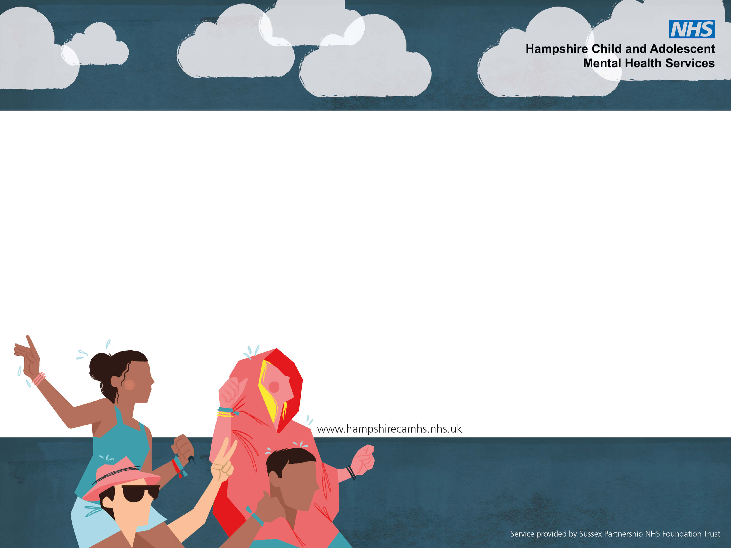
Supporting yourself to support your child

Slide 3
Today’s session will cover
Why do you need to support yourself
The challenges with supporting yourself
Strategies to support yourself to support your child
Resources

Slide 4
The aim of today
To give you:
Help and Ideas
Comfort and Hope
A Reminder
What we won’t be focusing on:
Specific mental health problems for you and your child.
A professional focus
Notes:
What we wont be focusing on – not focusing on specific mh problems, however, provide resource and links.

Slide 5
Why are we talking about this?
Notes:
Its important, your important and you are key to your children overcoming mental health difficulties.
Stats on child mental health difficulties – 1in 6
There is a lack of research, resources and support right now
Our current campaign on parent and carer wellbeing

Slide 6
What can it be like supporting a child with mental health problems
Pixar Inside Out A Family Dinner Scene - YouTube
Notes:
.
Ask audience to think about and discuss.

Slide 7
It can be emotional
It can be lonely, strain our relationships with others and make communication difficult
It can be confusing, tiring, frustrating and challenging
It can be de-skilling which can lead to shame and guilt
It can impact the whole family
It can stop you doing what you need to do and want to do

Slide 8
Why does it feel this way?
Our emotions are helpful.
Emotions help us communicate to one another - we are biologically wired to be on the lookout for others' emotions to respond quickly and effectively
Emotions help us connect – we are biologically wired to feel what others feel
Caregivers form a strong attachment and emotional bond to their child - This continues throughout life and helps keep the child close to their caregiver to improve a child’s chance of survival.
Therefore, when your child is emotionally struggling you will likely struggle too.
IT’S NORMAL!

Slide 9
What causes child mental health difficulties?
Genetics
Temperament
Adverse, stressful and specific life events
Learning from others
A build up overtime
Coping skills
Notes:
Often what also causes parents stress and may parents will question their influence and responsibility? We don’t have to know to be able to make it better

Slide 10
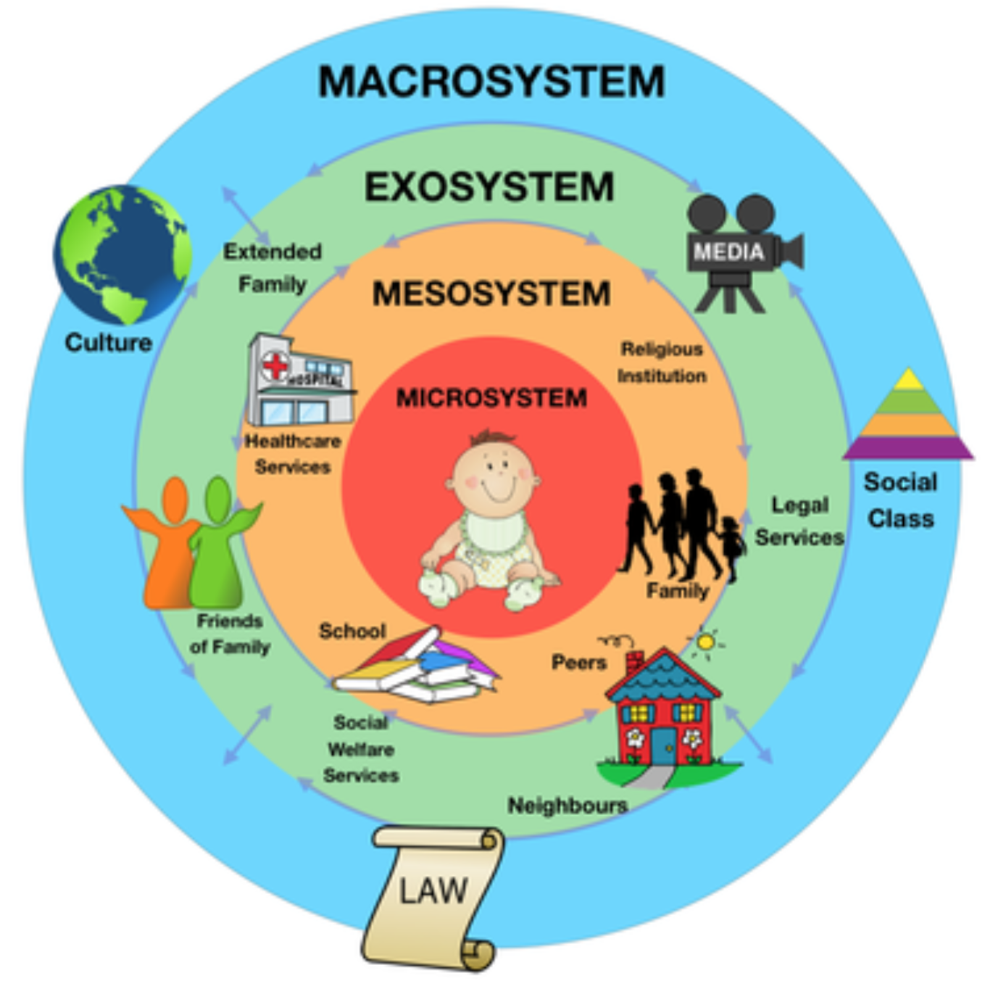
The system around a child:
Can impact children’s mental health
Can support children to overcome mental health difficulties
Parents and carers are key to supporting children to overcome mental health difficulties, you know your child best!

Slide 11
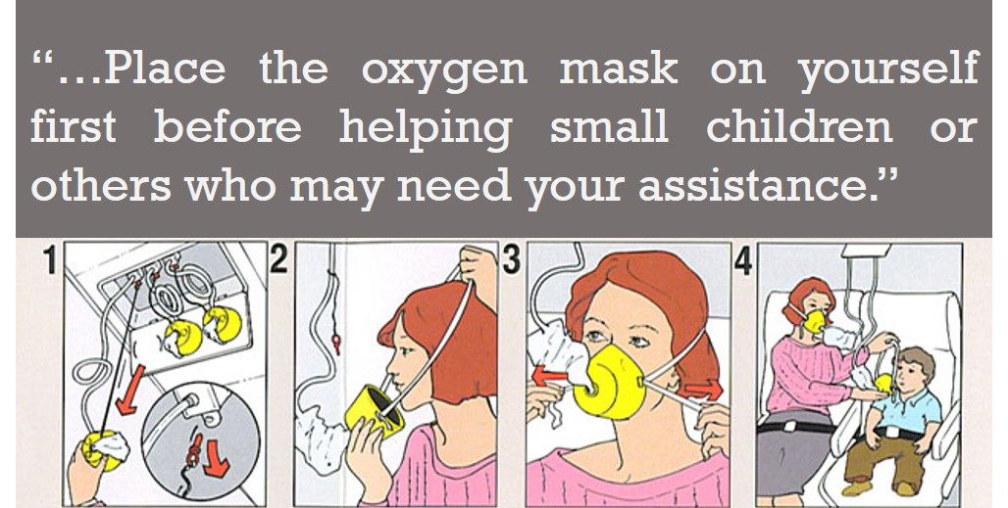
However, it is hard, and you need to look after yourselves to look after your child….

Slide 12
The barriers to parent wellbeing
Being a parent and carer is hard in normal circumstances
There is a lack of recognition, space and permission
Parental stigma
Cultural challenges
Our beliefs of supporting our wellbeing, experiences of support and parenting
The challenges in the system when seeking support
Life is busy. Parents might have their own wellbeing challenges and current challenges in life i.e.. covid, work, relationship and financial challenges.
Notice what comes up for you today – What you think, how you feel and your response….

Slide 13
What can you do to support your own wellbeing?
Notes:
You already have lots of skills
Make adaptions for yourself and your child, everyone is in different circumstance and different parts of the journey
They need to be simple to be effective
This is just an intro

Slide 14
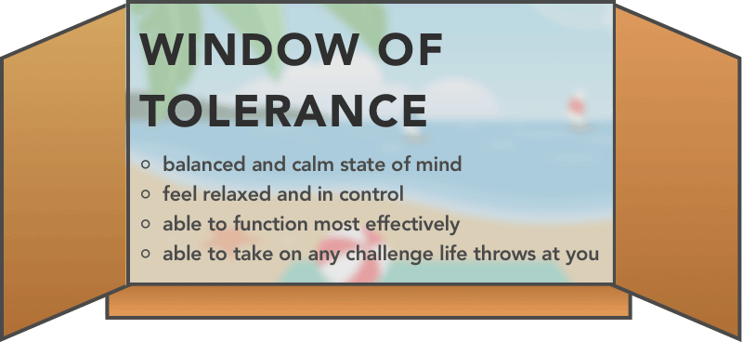
Thinking part of your brain switches off!
Hypo-aroused shut down, numb, passive, withdrawn, frozen, shame, guilt
Hyper- aroused hypervigilant, fight/flight, tired, guilt, irritability, frustration
When you parent well and use your best strategies
When you are at your best and can support yourself well
When you can support your child best

Slide 16
THE BASICS

Slide 17
Supporting your basic needs (i.e. eating, sleeping, medication) are fundamental to help you better support someone else
Find time for small breaks and space to reflect
Prioritise small moments for self-care,
it has got to be simple!
Problem solve: Focus on what you can
control
Pace what you do where possible
Be kind to yourself if you can’t do these
Notes:
if able to do as parent able to do more with child
(back to basics)

Slide 18
STOP
Stop, Take a breath, Observe and Practice what works
(Regulate yourself first and come back to your window of tolerance)

Slide 19
STOP!
Stay calm and step away if needed

Slide 20
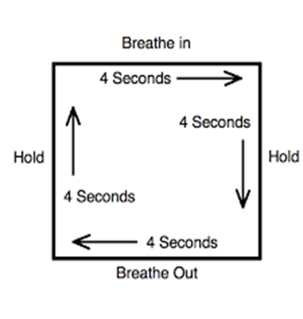
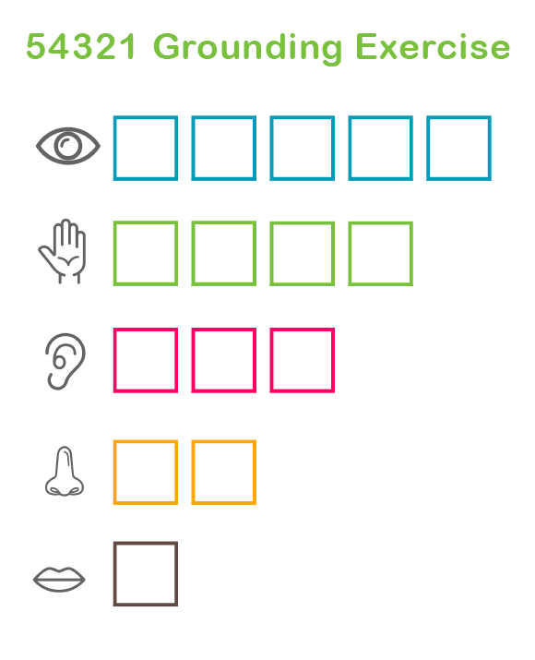
TAKE A BREATH
Breathing and grounding ourselves overrides the body’s stress response and brings the rational thinking part of the brain back on line.
We need to come back to our senses

Slide 21
OBSERVE & PRACTICE WHAT WORKS
How you are feeling
How stressed are you?
Thinking habits
Are you self-critical, catastrophising, comparing, how accurate are they?
Body sensations
Where are you holding tension and your breath?
Ways of coping
Are they helpful ways of coping with stress?
Triggers
What increases your cup?

Slide 22
SELF SOOTHE
(Bring and keep your stress cup down!)
Threat
Drive
Soothe

Slide 23
Engage in activities that help you self-soothe
Activities that use your 5 senses
Things you enjoy and give you a sense of achievement
Activities in line with your values
Mindful activities
Connect with others
Small pleasures that distract, refocus and help you reframe
Activities that enhance gratitude
ANY IDEAS…?

Slide 24
TIPS TO SELF-SOOTHE AS A PARENT
Be realistic
Make them small and make adaptions
Fit them into what you are already doing
Consider how can you prioritise this and persevere
Ask others to help
Develop you own coping and self-soothe box

Slide 25
SELF-COMPASSION
(Show yourself empathy and kindness)

Slide 26
‘Other’s will judge me’,
‘I’m not good enough’
SHAME
SELF-DOUBT
‘ I can’t do this’
‘It’s my fault’
‘I should do better and more’
GUILT
ANGER
‘Why us?’ ‘It’s not fair’
SELF-COMPASSION IS KEY

Slide 27
TIPS TO SELF-COMPASSION
Notice critical thoughts and self-doubt
Acknowledge what cannot be changed and how you feel about it
Focus on your own strengths and small wins
Be kinder to yourself where possible
It’s been hard to meet my basic needs at the moment so I might get things wrong
It's ok to get things wrong, I can take a step back and repair difficulties with your child when things are calm.
What would I say to your child or a friend?
Allow yourself to be sad
Set realistic goals, focus on hope and the future
Seek professional help if needed
There are some great apps that can help you to do this

Slide 28
WITH YOUR CHILD
(Supporting yourself and them)

Slide 29
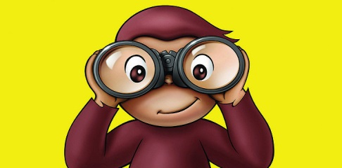
Support basic needs together
Remember your basic parenting skills and PACE to make yourself and your child feel safe
Set clear boundaries and untangle yourself
Mend difficulties when things are calm
PLAYFULNESS
ACCEPTANCE
CURIOSITY
EMPATHY

Slide 30
Problem solve difficulties together
Identify, ask, explore, learn
Set family goals, celebrate small successes and strengths
Set aside problem free time together
These strategies can work for both of you, model them and practice together!

Slide 31
REMEMBER:
Looking after a child with mental health difficulties can be hard
Stop, self-soothe and be kind to yourself
You are not alone and it is ok to ask for help
Don’t forget your parenting skills
Looking after yourself is important!
Notes:
Help

Slide 32
RESOURCES

Slide 33
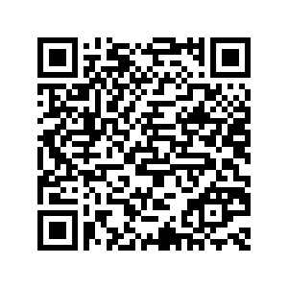

Slide 34
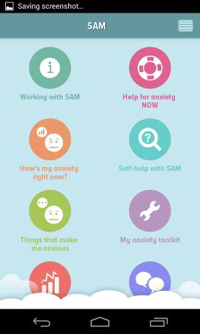
Mindshift
Headspace
ACT Companion: Happiness Trap
Bloom
Self-help for anxiety management (SAM)
Worry Box
What’s up – The Mental Health App
Please see our leaflets at the CAMHS stand for more details and our website
Various APPs

Slide 35
Thank you for listening
Notes:
Help

Slide 36
The slides for this presentation and a top tips sheet are all available for download on our website: https://HampshireCAMHS.nhs.uk
This session has also been filmed and is available to watch on our website.
You will find this on the Videos page and in the relevant Mental Health issue page.
Please do your feedback form as it helps us to keep sessions relevant and useful.

