Slide 1
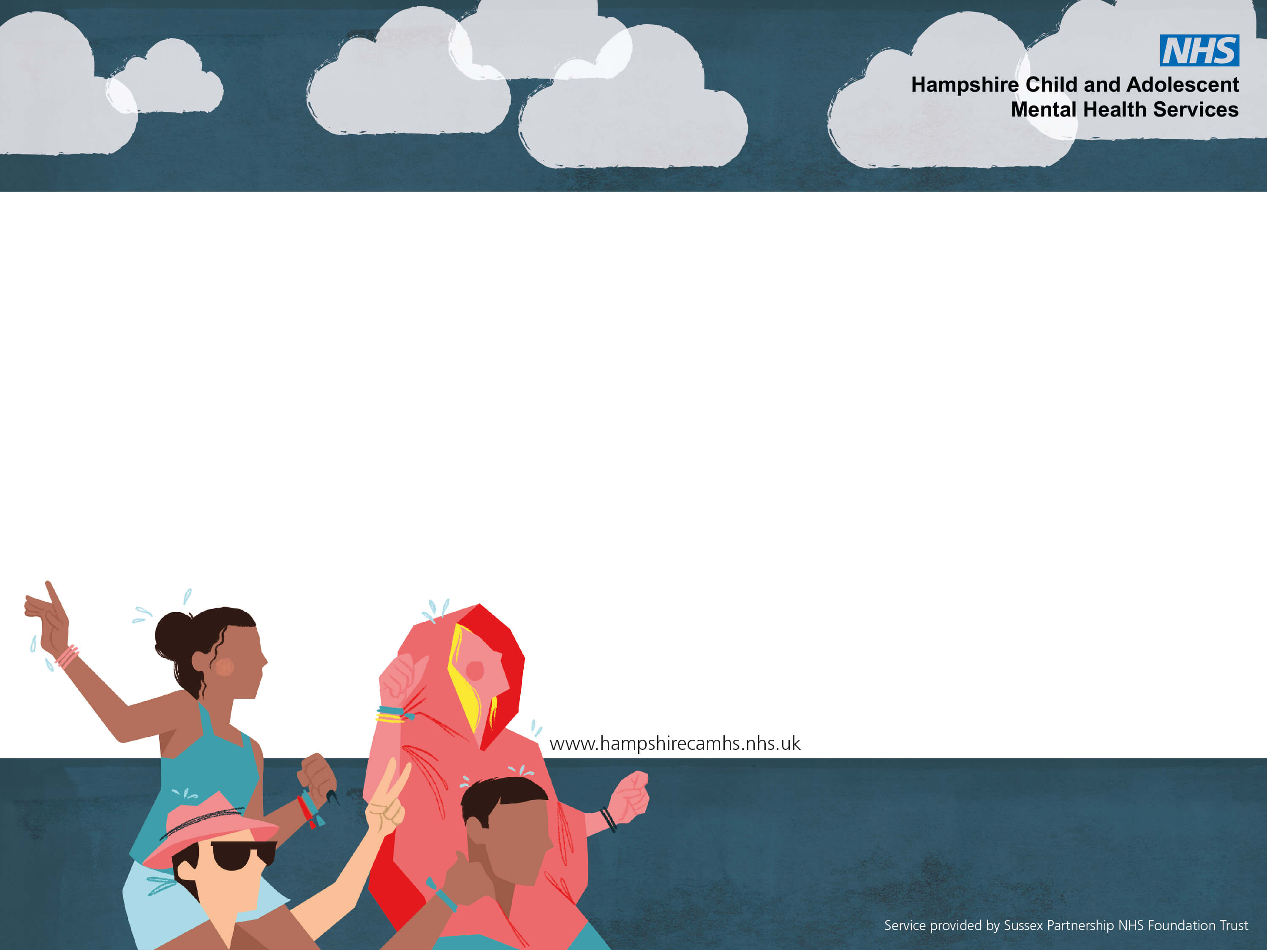
CARE Skills
Coping And Resilience Education

Slide 2
Overview
What is coping and resilience
Skills for understanding and developing coping and resilience
- Identifying and understanding emotions
- Goals
- Coping strategies
Skills and resources
More help & support

Slide 3
What do we mean?
Coping: The ability to respond to a challenging situation in a helpful way without becoming overwhelmed
Resilience: The ability to recover from or withstand difficulties (in emotional experiencing) in a way that is not harmful
Notes:
It doesn’t necessarily feel good to be coping – its hard, we may want to escape the situation
-

Slide 4
What do we need?
Coping: flexibility and problem solving skills. Ability to access support from others
Resilience: personal resources for being able to understand and respond to our emotional needs. A ‘full bucket’ filled from connection, activity, purpose, compassion
Notes:
It doesn’t necessarily feel good to be coping – its hard, we may want to escape the situation
-

Slide 5
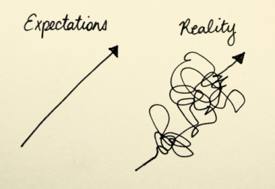
Expectations vs reality of life
We all experience suffering at some time
Notes:
Expectations that young people have of themselves, of others supporting them and of services
Expectations adults have of young people, of themselves and of services
Expectations services have
Expectations versus reality

Slide 6
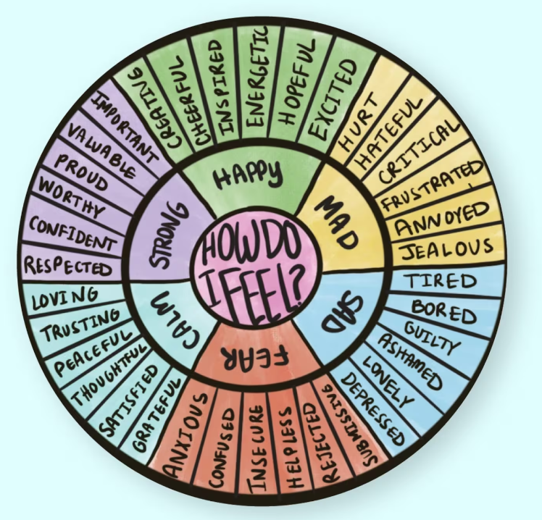
Identifying emotions
Easier said than done
A skill to be learned and practiced
Body sensations
Triggers
What does that look like for me? (e.g. crying when frustrated)

Slide 7
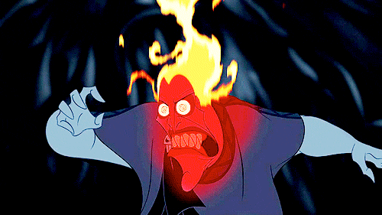
Understanding our emotional states
Thermometer
The Fizz
Beach Ball
Notes:
Often young people are labile in mood and find it hard to identify, express or communicate thoughts and feelings, particularly when distressed
Emotional states can change quickly
Using thermometer ratings (scores out of 10) to monitor changes can be helpful
Use analogy of bottle of coke being shaken up to highlight emotional explosivity and how to you might manage this- i.e., wait for things to calm down before trying to open up
Use beach ball analogy to think about often Yps carry around a lot of stressors and they cant always see the wood through the trees- need to find ways of helping them to manage their beach ball whilst maintaining control, in a safe way
Behaviour is functional
Emotions are complex- primary versus secondary emotions

Slide 8
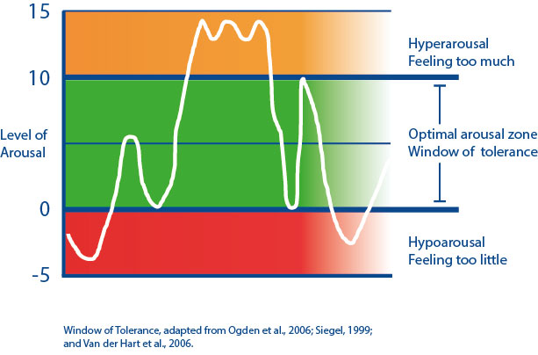
Window of Tolerance

Slide 9
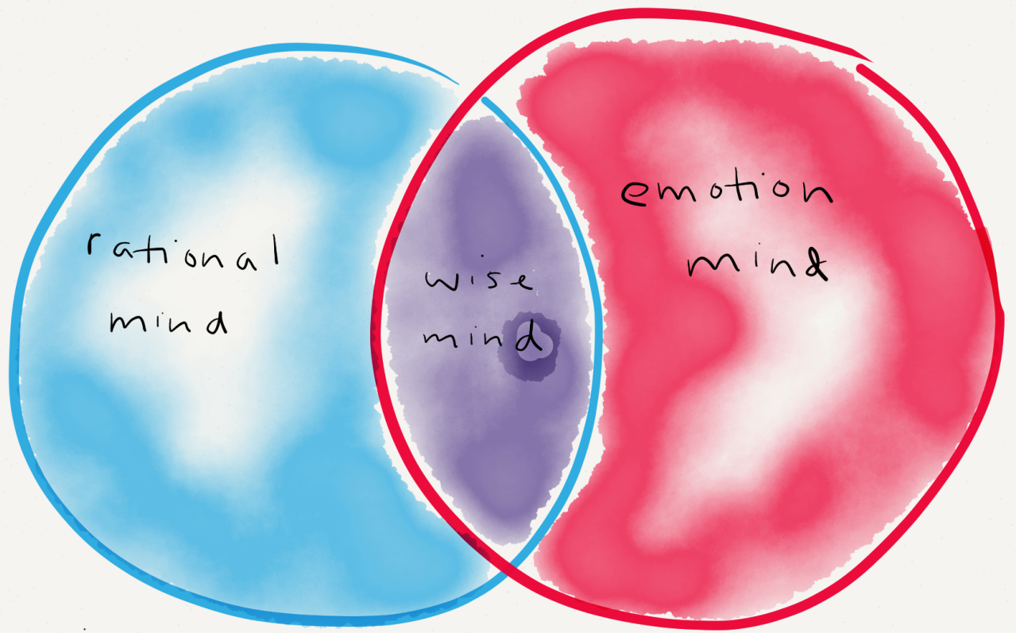
Approaches situations intellectually
Uses logic and past experiences
Uses facts and research
Focused
Cold, icy, detached
Void of emotion
Behaviour driven by emotions
Reactive impulsive- no thought to consequences
Rational logical thinking or talking not possible
Red hot
Intuitive thinking
Balance between rational and emotional mind
- “I feel this, I know that so I will do X”

Slide 10
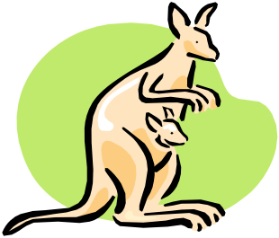
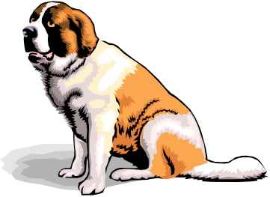
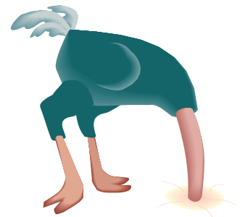
Carer Reactions
Carer Emotions

Slide 11
Helpful Suggestions
Role modelling
Seek support and advice (supervision for professionals)
Share information; joint approaches to supporting a young person
Even though it is distressing to see a YP in distress, it is important they have choice and responsibility for how they behave, respond and manage to distress
Establish whether the YP is known to services and has a crisis/ relapse plan

Slide 12
Less helpful responses
Don’t make promises you can’t keep (including not to tell anyone else what has been disclosed)
Don’t ask a young person to make promises they can’t keep (such as promising not to hurt themselves again)
Ask lots of open ended questions or enter into long, length, logical debates about why someone should or shouldn’t do something
Ask why
Assume you know what is going on and how the young person is feeling or wanting

Slide 13
Creativity
Connect
Self
Care
Valued living
Compassion
Purpose
Activity
Notes:
Hobbies/ interests- build self-esteem, mastery, efficacy, esteem, confidence, social skills
Sports- good for mind and body
School- education, personal development
Relationships- with adult caregivers and peers; belonging, meaning, care, nurture
Enjoyment, fun, creativity, expression, taking part
Not about success or achievement necessarily
Jar and Hot Chocolate

Slide 14
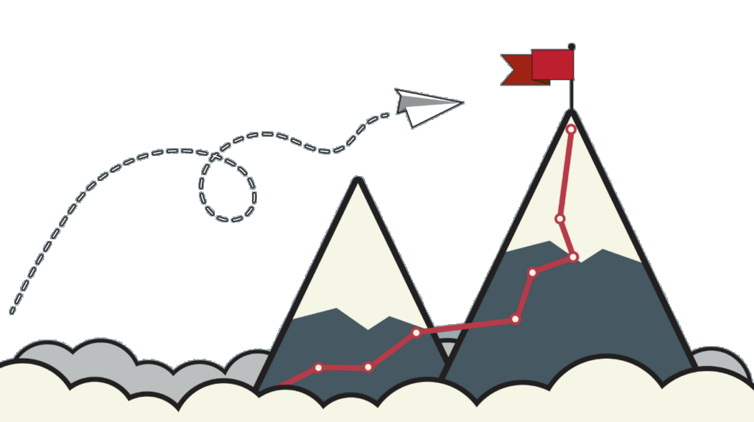
Goals and Problem Solving
Values
Coping ahead plan
Communicating needs
Notes:
Coping ahead plans

Slide 15
A-Z coping and coping cards – tolerating distress when you cant change the situation straight away
https://youtu.be/5EXpkVw3fh0

Slide 16
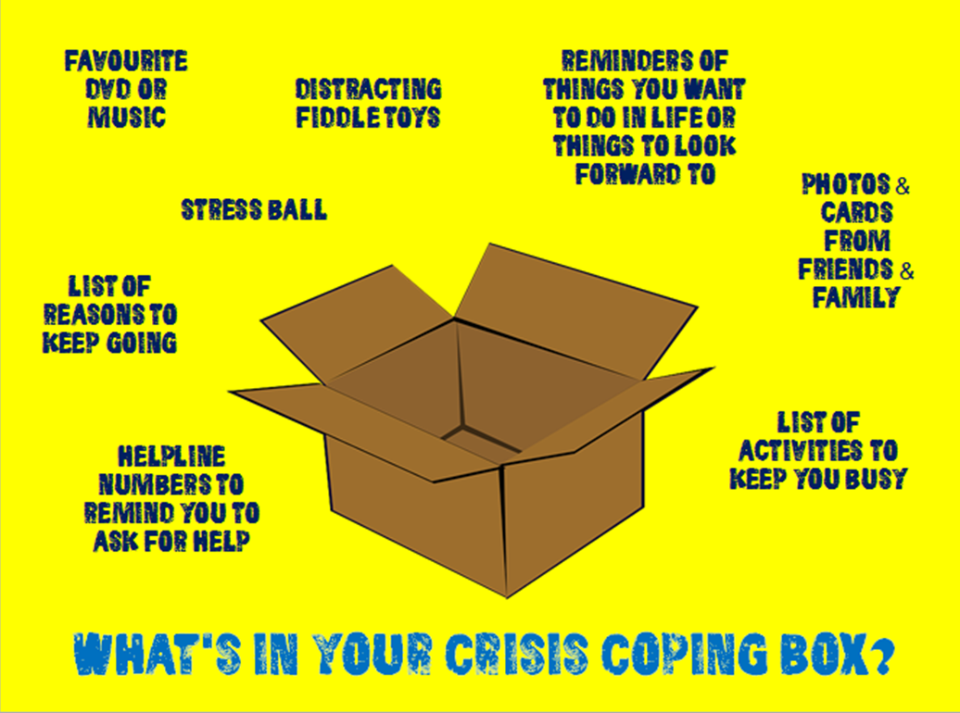
Coping and Resilience Boxes
https://youtu.be/OyfgodSSdV4

Slide 17
Thank you for listening.
Any questions or reflections?

Slide 18
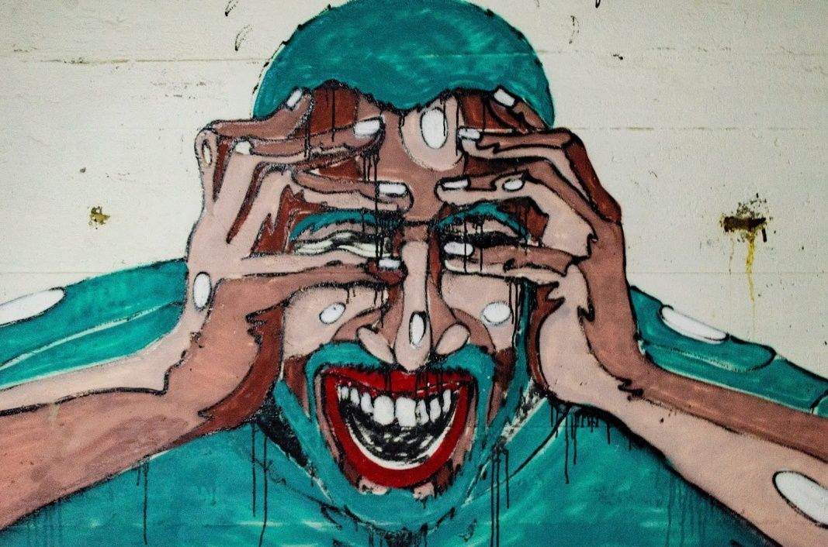
Understanding coping and resilience
Learning to sail
Mountain climbing
Tandem bike
Full Bucket
This Photo by Unknown Author is licensed under CC BY-NC-ND
Notes:
Often young people are labile in mood and find it hard to identify, express or communicate thoughts and feelings, particularly when distressed
Emotional states can change quickly
Using thermometer ratings (scores out of 10) to monitor changes can be helpful
Use analogy of bottle of coke being shaken up to highlight emotional explosivity and how to you might manage this- i.e., wait for things to calm down before trying to open up
Use beach ball analogy to think about often Yps carry around a lot of stressors and they cant always see the wood through the trees- need to find ways of helping them to manage their beach ball whilst maintaining control, in a safe way
Behaviour is functional
Emotions are complex- primary versus secondary emotions

