Slide 1
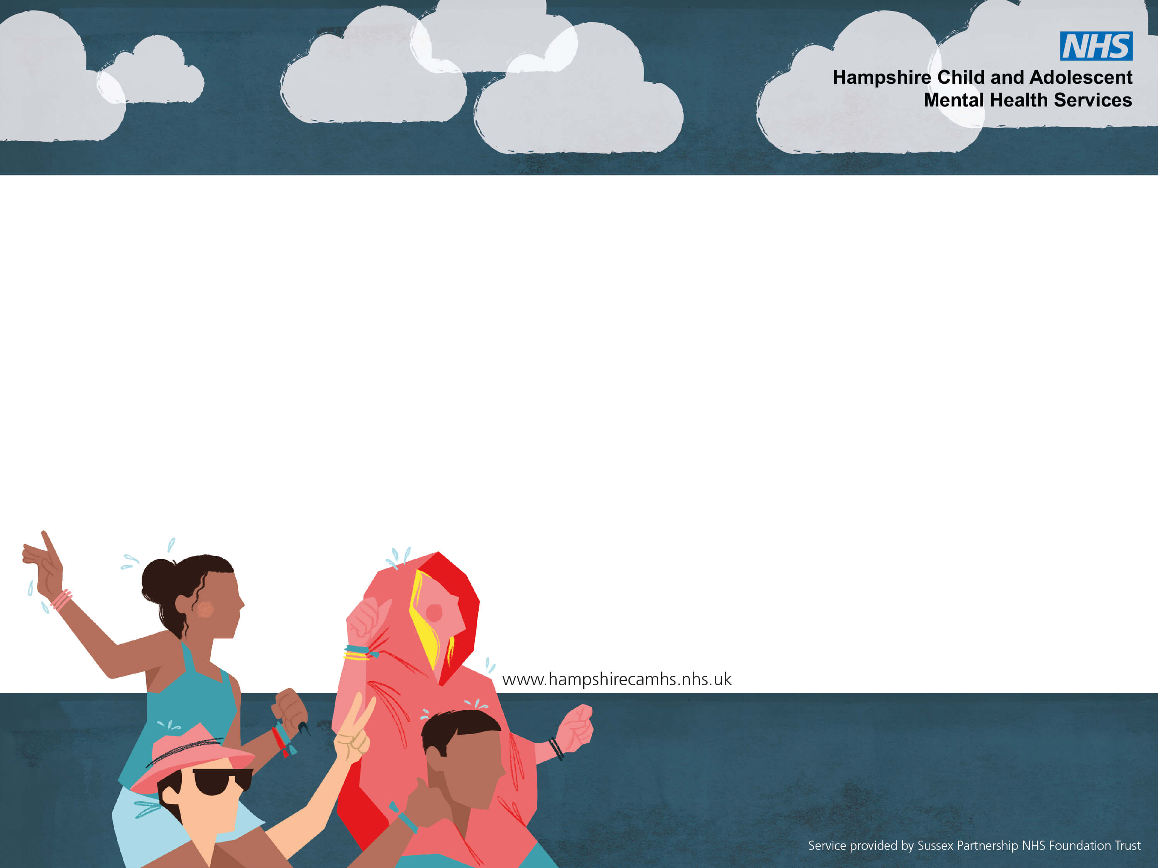
Artificial Intelligence (AI)
Safeguarding risks and implications for young people

Slide 2
Session Aim
To gain an understanding of Artificial Intelligence (AI) and understand its implications for Safeguarding children and young people.

Slide 3
Session Outcomes
To understand what is meant by the term Artificial Intelligence (AI).
Be able to identify the risks of AI for children and young people.
To recognise the benefits of AI and why it is a growing phenomenon.
Consider recent news stories about AI and think aboutthe implications for children and young people.
To understand what is meant by the term Artificial Intelligence (AI).
Be able to identify the risks of AI for children and young people.
To recognise the benefits of AI and why it is a growing phenomenon.
Consider recent news stories about AI and think about the implications for children and young people.

Slide 4
What is AI?
To understand what is meant by the term Artificial Intelligence (AI).
Be able to identify the risks of AI for children and young people.
To recognise the benefits of AI and why it is a growing phenomenon.
Consider recent news stories about AI and think aboutthe implications for children and young people.

Slide 5
Examples of AI uses
To understand what is meant by the term Artificial Intelligence (AI).
Be able to identify the risks of AI for children and young people.
To recognise the benefits of AI and why it is a growing phenomenon.
Consider recent news stories about AI and think aboutthe implications for children and young people.
Robotics
Healthcare
Finance
E-commerce

Slide 6
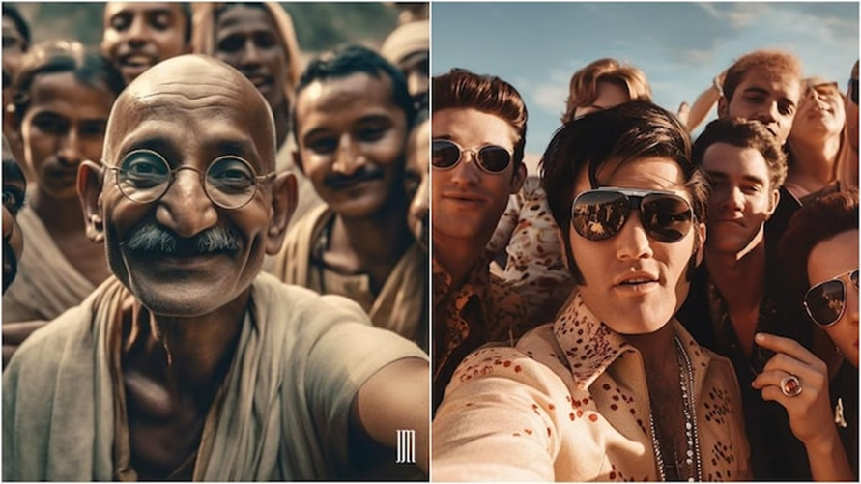
AI as art
To understand what is meant by the term Artificial Intelligence (AI).
Be able to identify the risks of AI for children and young people.
To recognise the benefits of AI and why it is a growing phenomenon.
Consider recent news stories about AI and think aboutthe implications for children and young people.
An artist named Jyo John Mulloor took to Instagram to share selfies from the past created using AI.

Slide 7
AI Safety Summit 2023
To understand what is meant by the term Artificial Intelligence (AI).
Be able to identify the risks of AI for children and young people.
To recognise the benefits of AI and why it is a growing phenomenon.
Consider recent news stories about AI and think aboutthe implications for children and young people.
“I truly believe there is nothing in our foreseeable future that will be more transformative for our economies, our societies and all our lives…….than the development of technologies like Artificial Intelligence. But as with every wave of new technology, it also brings new fears and new dangers. ” - Rishi Sunak
Prime Minister's speech at the AI Safety Summit at Bletchley Park on 2 November 2023.

Slide 8
Different types of AI
To understand what is meant by the term Artificial Intelligence (AI).
Be able to identify the risks of AI for children and young people.
To recognise the benefits of AI and why it is a growing phenomenon.
Consider recent news stories about AI and think aboutthe implications for children and young people.

Slide 9
Generative AI: ChatGPT and DALL-E
These programs learn from vast quantities of data, like online text and images, to generate new content which feels like it has been made by a human.
"Chatbots" - like ChatGPT - can have text conversations -Snapchat uses this and can give mental health advice.
Other AI programs like DALL-E can create images from simple text instructions.
Generative AIs can also make videos and even produce music in the style of famous musicians.
Many artists, writers and performers have warned that such AIs allow others to exploit or imitate their work without payment. The recent Actor’s strike in America was partly about asking for protection for Actors to prevent people using their image without consent.
To understand what is meant by the term Artificial Intelligence (AI).
Be able to identify the risks of AI for children and young people.
To recognise the benefits of AI and why it is a growing phenomenon.
Consider recent news stories about AI and think aboutthe implications for children and young people.

Slide 10
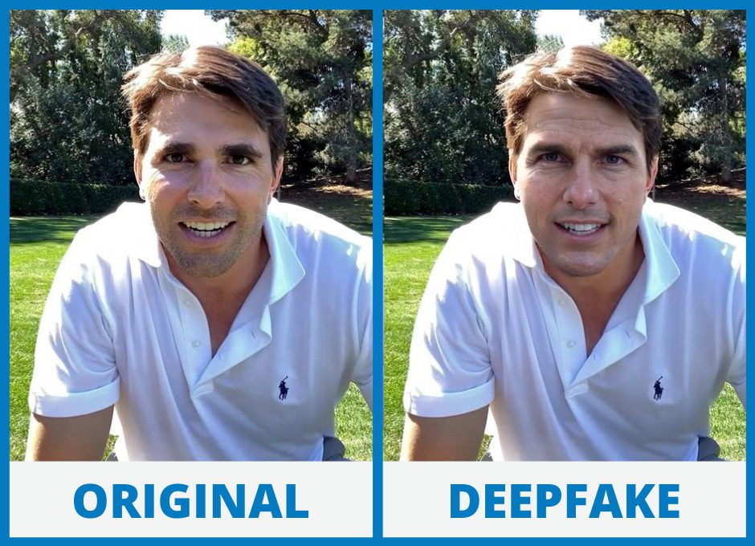
What is ‘Deepfake’?
‘Deepfakes’ are computer generated, manipulated images or videos of a person in which their face or body has been digitally altered so that they appear to be someone else.
These are often used to spread false information, with malicious intent or to create pornography. Creators collect images of a person through social media posts, web pages (such as a company site) or film and TV.
To understand what is meant by the term Artificial Intelligence (AI).
Be able to identify the risks of AI for children and young people.
To recognise the benefits of AI and why it is a growing phenomenon.
Consider recent news stories about AI and think aboutthe implications for children and young people.

Slide 11
Childline
Increase in calls to Childline with concerns about AI
Among these mentions of AI:
Most involve the generation of child sexual abuse images or videos, or the threat to make them with blackmail/financial extortion.
There were some examples of young people sending “fake images” they had made themselves.
There were a few mentions of ChatGPT, usually from young people seeking information or reassurance about something they’d seen online.
One 15-year-old girl told Childline:
“A stranger online has made fake nudes of me. It looks so real, it’s my face and my room in the background. They must have taken the pictures from my Instagram and edited them. I’m so scared they will send them to my parents, the pictures are really convincing, and I don’t think they’d believe me that they’re fake.”
To understand what is meant by the term Artificial Intelligence (AI).
Be able to identify the risks of AI for children and young people.
To recognise the benefits of AI and why it is a growing phenomenon.
Consider recent news stories about AI and think aboutthe implications for children and young people.

Slide 12
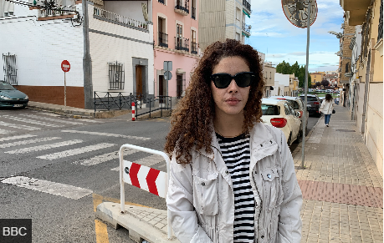
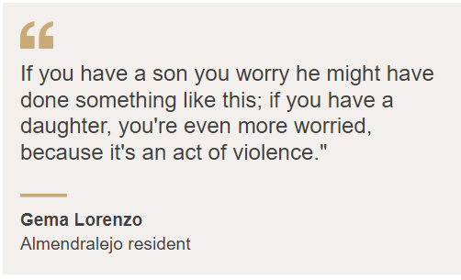
To understand what is meant by the term Artificial Intelligence (AI).
Be able to identify the risks of AI for children and young people.
To recognise the benefits of AI and why it is a growing phenomenon.
Consider recent news stories about AI and think aboutthe implications for children and young people.
A sleepy town in southern Spain is in shock after it emerged that AI-generated naked images of young local girls had been circulating on social media without their knowledge.
The pictures were created using photos of the targeted girls fully clothed, many of them taken from their own social media accounts.
These were then processed by an application that generates an imagined image of the person without clothes on.
………Police are now investigating and according to reports, at least 11 local boys have been identified as having involvement in either the creation of the images or their circulation via the WhatsApp and Telegram apps.

Slide 13
To understand what is meant by the term Artificial Intelligence (AI).
Be able to identify the risks of AI for children and young people.
To recognise the benefits of AI and why it is a growing phenomenon.
Consider recent news stories about AI and think aboutthe implications for children and young people.
A charity that helps people worried about their own thoughts or behaviour says an increasing number of callers are feeling confused about the ethics of viewing AI child abuse imagery.
The Lucy Faithfull Foundation (LFF) says AI images are acting as a gateway.
The charity is warning that creating or viewing such images is still illegal even if the children are not real.
Neil, not his real name, contacted the helpline after being arrested for creating AI images.
The 43-year-old denied that he had any sexual attraction to children.
The IT worker, who used AI software to make his own indecent images of children using text prompts, said he would never view such images of real children because he is not attracted to them. He claimed simply to be fascinated by the technology.
“Some offenders think this material is in some way OK to create or view because there are no children being harmed, but this is wrong," LFF's Donald Findlater

Slide 14
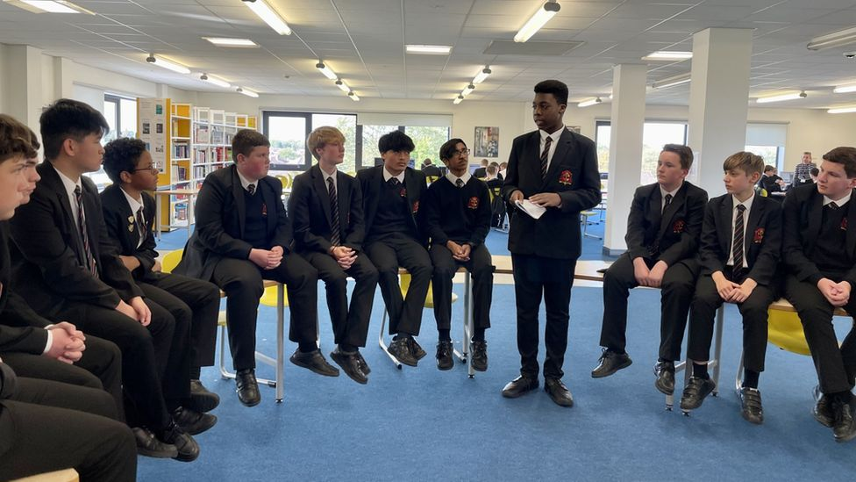
Amid growing calls for schools to teach pupils about artificial intelligence (AI), BBC Young Reporters Theo and Ben have been looking at its risks and potential - and asked their classmates how they have used it to try to sharpen up their homework.
We asked our form groups to fill out an anonymous survey. A total of 31 out of 33 had used AI in schoolwork, and 27 thought it should be taught in schools.
In interviews, most of our friends and classmates had used ChatGPT, an online tool that can answer questions in human-like language. They said it helped them come up with ideas, research, and things like structuring and phrasing.
Some, though, confessed to using it to cheat.
It did not always go to plan. One person said ChatGPT gave them the wrong dates for a history essay, and another said it got "90% of the answers wrong" in a physics assignment.
To understand what is meant by the term Artificial Intelligence (AI).
Be able to identify the risks of AI for children and young people.
To recognise the benefits of AI and why it is a growing phenomenon.
Consider recent news stories about AI and think aboutthe implications for children and young people.
"But to help you with your schoolwork, I don't see an issue - as long as you've got that critical eye and you double check what it's coming back with" Computer science teacher

Slide 15
Resources
A guide to artificial intelligence (AI) for parents | Internet Matters
www.internetmatters.org/resources/parent-guide-to-artificial-intelligence-ai-tools/
AI Initiative | Common Sense Media
www.commonsensemedia.org/ai
Homepage - UK Safer Internet Centre
www.saferinternet.org.uk

