Slide 1
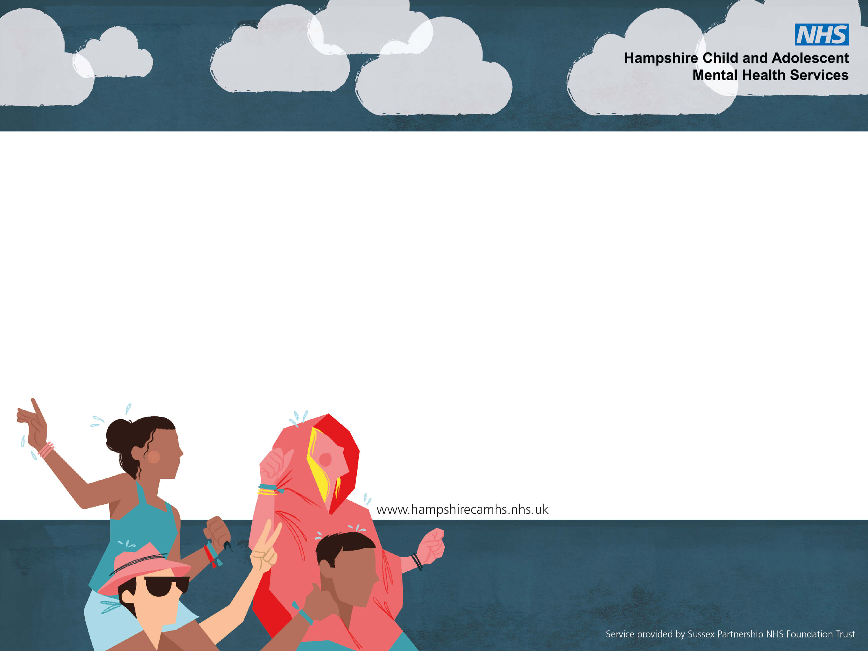
CARE Skills
(Coping And Resilience Education)
Dr Steph Smith, Clinical Psychologist & Clinical Team Lead for Romsey and District MHST
Dr Kate Hodgson, Clinical Psychologist & Clinical Team Lead for Winchester and Andover MHST
Notes:
STEPH - Welcomes
Introductions
Understanding of the audience – professional capacity, parent/carer, both ? Neither?

Slide 2
Overview
What is coping and resilience?
How to help young people to understand, identify and express what is going on for them?
Parent/carer/professional reactions
Skills and resources
Top tips
Questions
Notes:
STEPH Overview –
What do we mean by coping/resilience?
Lots of thinking around Helping young people understand, identify and express what is going on for them. In terms of their emotions and understand their reactions to things.
Think about our part in supporting young people that as parents/carer and professionals.
A lot of this is rocket science- basic skills you may know a lot of this already – act as a refresher/know that you are on the right track but also the most basic things do work – but hope you take something useful away with you today.

Slide 3
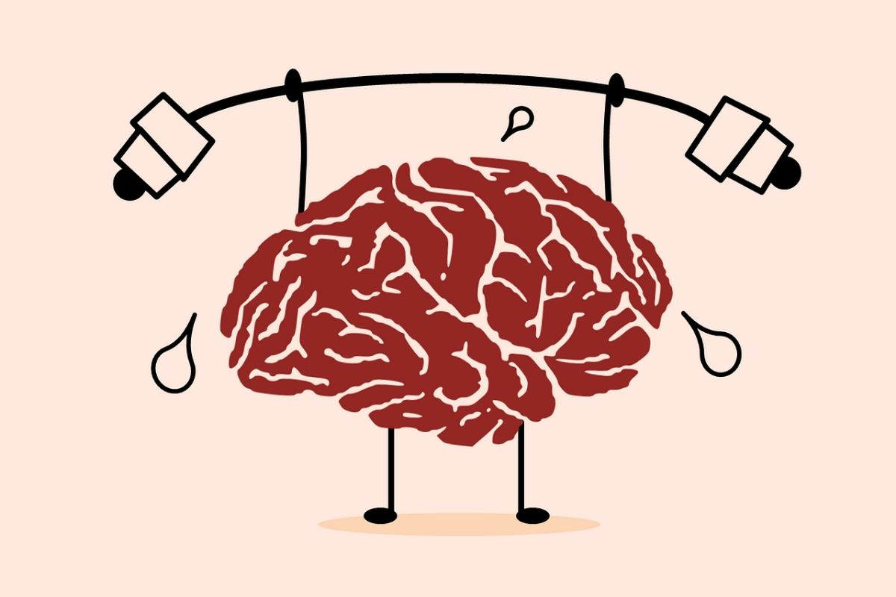
What do we mean?
COPING: The ability to respond to a challenging situation in a helpful way without becoming overwhelmed.
RESILIENCE: The ability to recover from or withstand difficulties (in emotional experiencing) in a way that is not harmful.
Notes:
STEPH = What do we mean by the terms coping? And resilience? Ask the audience? – slide in –
Coping – we might be thinking we need - flexibility and problem- solving skills. Ability to access support from others
Resilience – we might need to think about personal resources for being able to understand and respond to our emotional needs. A ‘full bucket’ filled from connection, activity, purpose, compassion
It doesn’t necessarily feel good to be coping – its hard, we may want to escape the situation
-

Slide 4
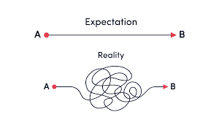
Expectations vs reality of life
Notes:
KATE –
We just wanted to start with considering –Expectations’ - our expectations can have a huge impact on our ability to cope. Something to hold in mind. Are they Realistic?
1) Expectations young people have of themselves and that we have of ourselves.
We all experience feelings of worry, sadness, anger, loneliness, shame and guilt at times. This is normal and part of being human and ok.
Mental and emotional health can vary and be dependent on a number of factors. These include but are not limited to;
The number of demands and stressors we have - Our physical health
Life events (including change and transition) - How much sleep we get
Relationships with other people - Our diet/ nutritional intake
Environmental, societal and cultural factors
How much we engage in leisure activities hobbies and interests
2) Expectations of others -
Check that your expectations of others (the young person, a parent/ carer or a professional) are reasonable and realistic in order to avoid disappointment, frustration or confusion.
3) expectations of someone’s ability to cope – young people don’t fully develop their ability to regulate themselves until into their mid 20s

Slide 5
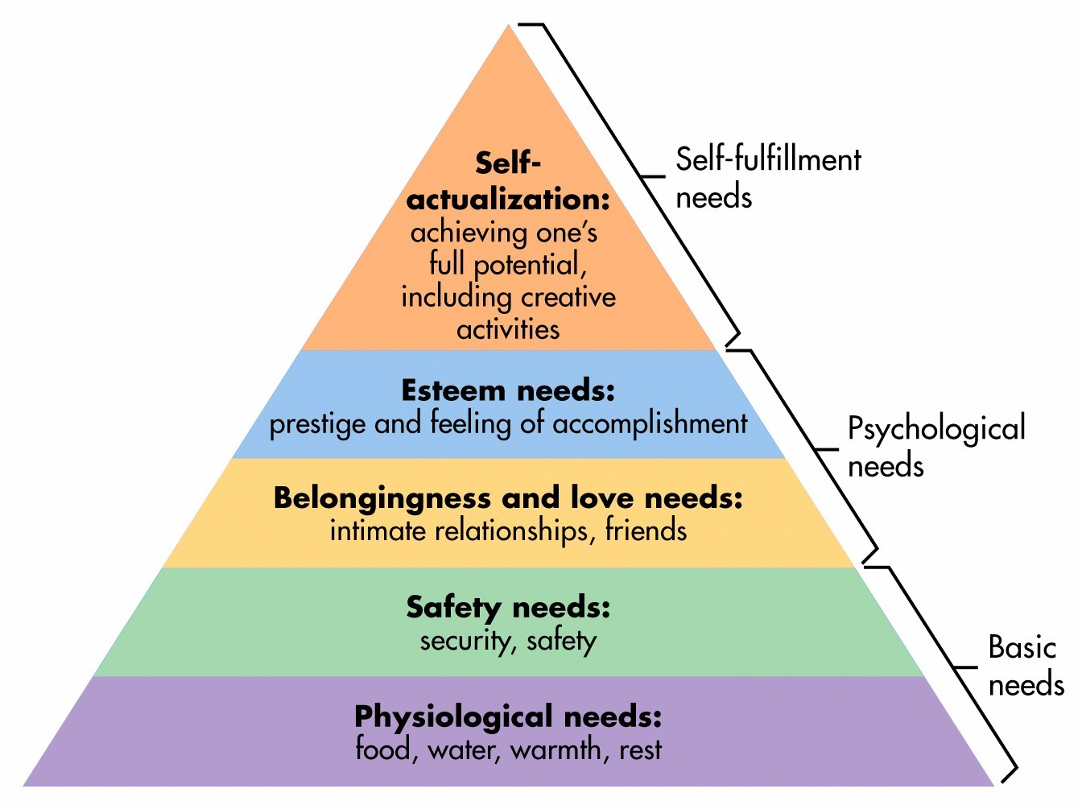
Maslow’s Hierarchy of Needs
Notes:
KATE –
Thinking about where someone is at and able to do -
not able to cope with difficult like situations is basic needs aren’t met…
We sometimes have wifi and battery added at the bottom – potentially more important that food/water for young people?
Thining about our individual starting points and what is important to us/what needs to happen may be very different from where someone else is –

Slide 6
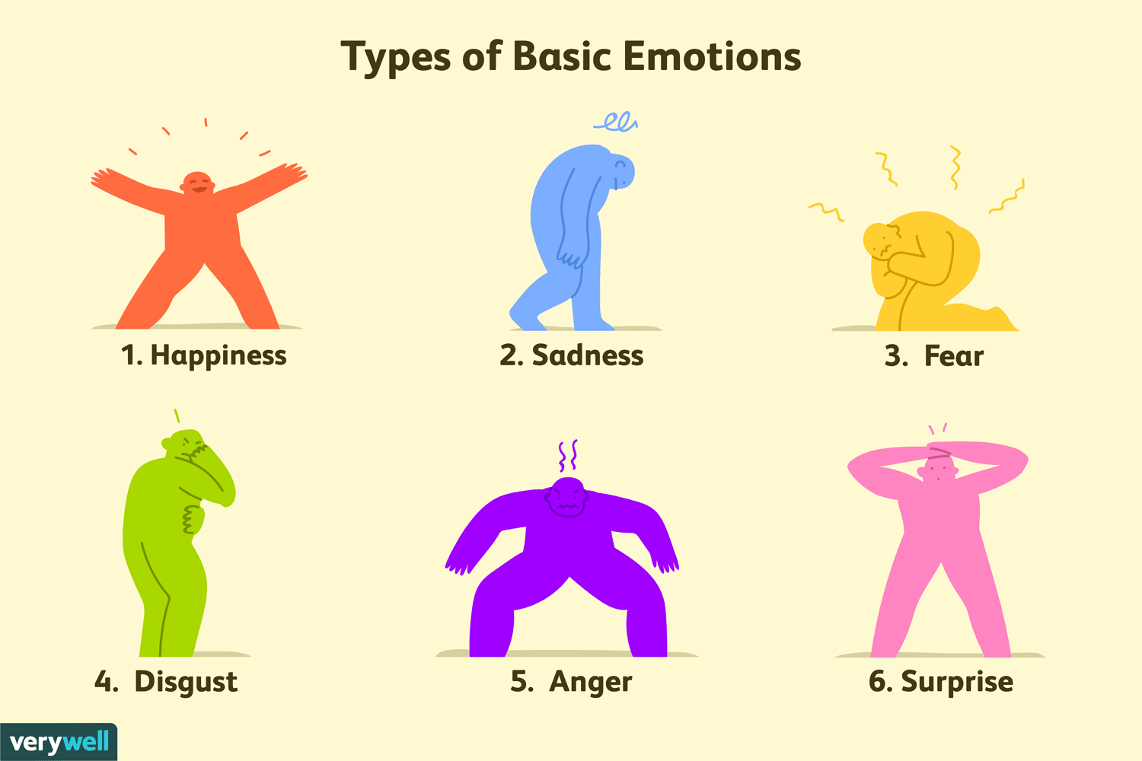
Identifying Emotions
Identifying emotions is difficult but really important
A skill to be learned and practiced
Notes:
STEPH Now want to start thinking about emotions – how we recognise them/describe them/express them….
And it is often a lot easier said than done –when asking YP how they are feeling we may often get ‘ I don’t know’ or if lucky ‘ I feel crap’ – okay but what do you mean by that? And that can be really hard for YP to answer - identify their emotions.
- difficult to understand the differences between emotions like anxiety and anger. Know the words but describing how it feels, look like it – they often don’t know.
Partly – we never usually experience one emotion at one time – usually feels lots of things at once
Young people can be labile- and mood/emotions can change very quickly.
We can also mix emotions – anger but crying – really confusing to understand and learn.
So asking ‘ how do you feel?’ not always that helpful.
So we are going to think a little about how do we get YP to start thinking about emotions. As these are definitely skills to be learned and practiced.

Slide 7
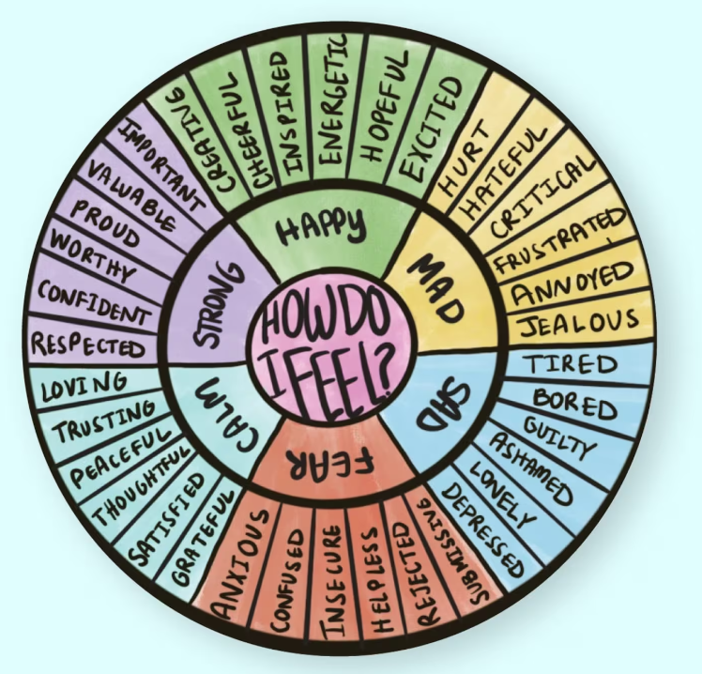
Wheel of Emotion
Notes:
Might use things like this –
Wheel of emotion – different emotions and different words
In our bodies - what does that feel like in our body?’ how do you know you are feeling worried?
So a quick/simple exercise - Draw out a body – one way is – give a scenario.
Coming home from school and child kicking off at parent – anxiety
Put on the spot to speak in front of the class.
Imagine you are a YP who has just come home from school and need to present at speak in front of the class. … what emotions notice in your body, sensations, ask the audience –
Help young people to then think about Triggers -what sorts of situations might trigger you feeling like this?
Using the young person’s words.

Slide 8
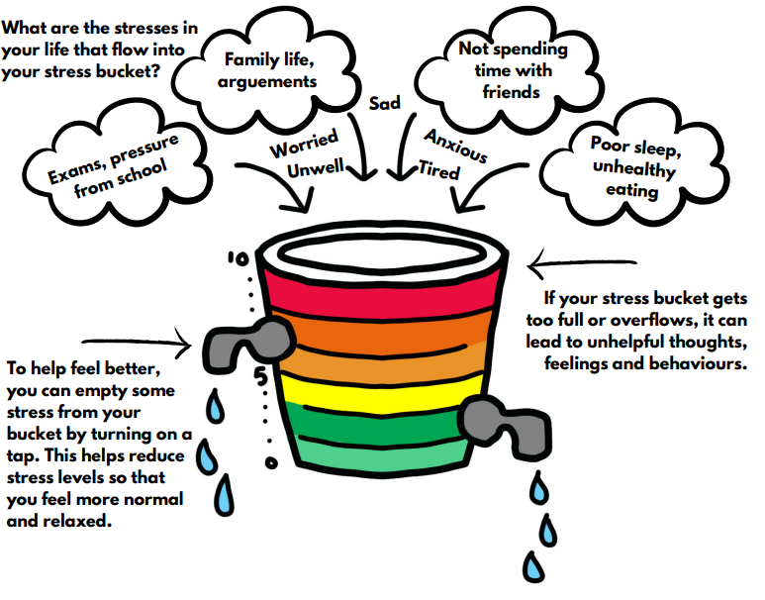
Understanding our Emotional States
Thermometer
The Fizz
Stress Bucket
Notes:
STEPH Emotional states can change quickly and its often hard to identify that change – so further tools like -
Using thermometer ratings (0-10 cool to hot ) to monitor changes can be helpful, most angry or most sad.
The fizz - Use analogy of bottle of coke being shaken up to highlight emotions bubbling up/exploding (how fizzy are you? Like you are about to explode?) and how to you might manage this- i.e., wait for things to calm down before trying to open up
Stress bucket? Metaphor of a bucket to represent one’s capacity to cope/handle stress. Life events/stress filling up your bucket and then the tap is the coping strategies to help feel better/empty the bucket. Prevent it from overflowing.

Slide 9
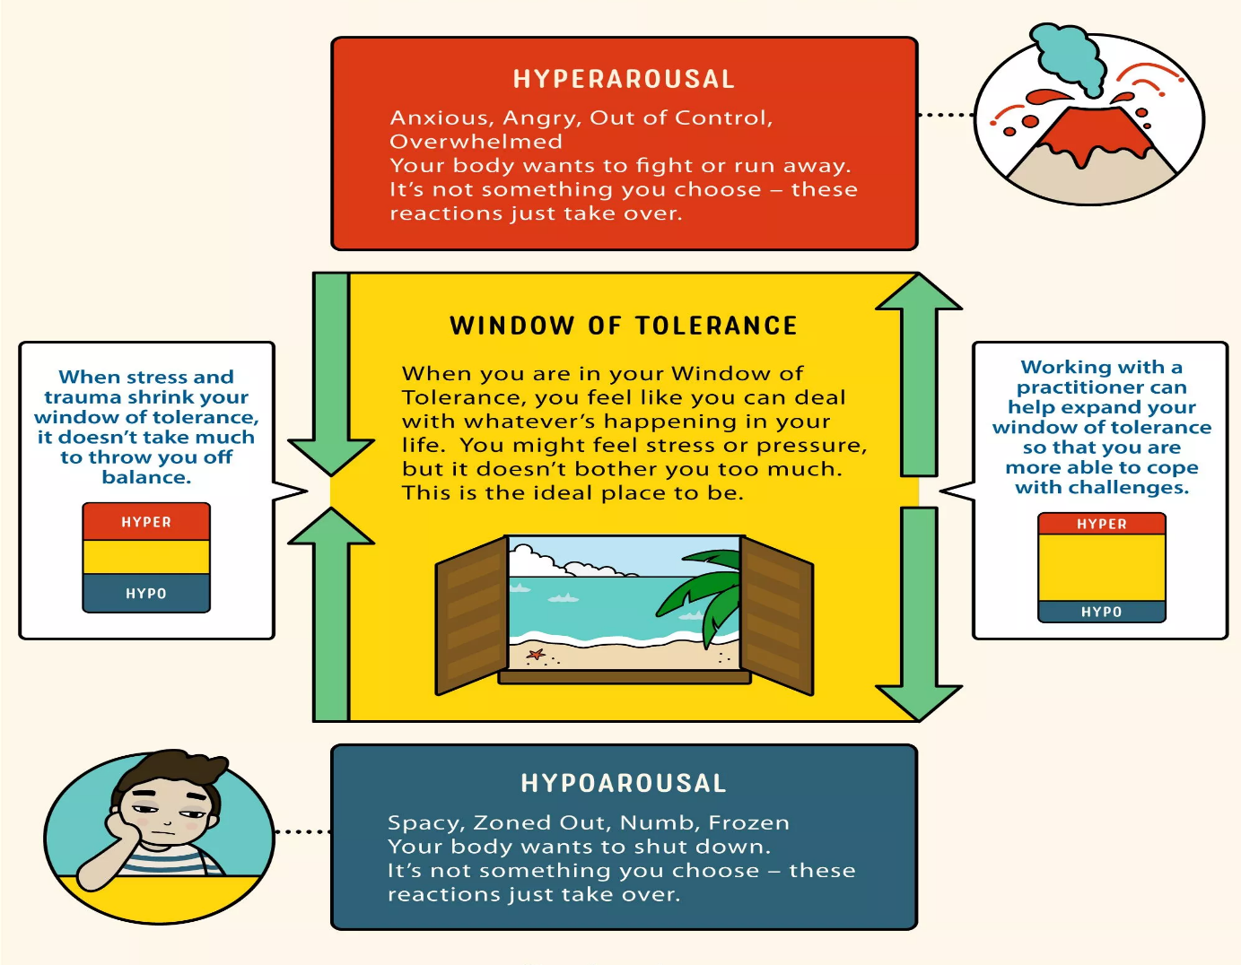
Window of Tolerance
Notes:
KATE
Now we are going to talk about 2 different models we often use with YP and families to help people understand their emotions and why and how they react to things and ultimately make changes. of you can understand difference reactions to difficult situations and how to change it.
This is the window of tolerance – we all have one and essentially defines ‘what we can cope with’. Some of us naturally have large windows of tolerance and can seemingly cope with a lot. Other’s are narrower and can become overwhelmed relatively quickly. We know that stress, trauma, can affect your window/ shrink it so it doesn’t take much to throw you off balance.
When you go outside of your window –
Hyperarousal – feel too much, explosive behaviour/overwhelmed, emotional/expressive.
Hypoarousal – shut off/shut down don’t speak, avoid
Completely normal and we all have the capacity to go in and out of our window of tolerance.
Important to consider – we all differ on what pushes us out of our window of tolerance and what can bring us back into what we can cope with. It may also take different amounts of time to bring us back. So important to consider when repairing relationships , trying to problem solve etc.
Skills to increase tolerance.

Slide 10
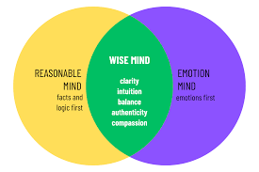
Wise Mind Model
Approaches situations intellectually
Uses logic and past experiences
Uses facts and research
Focused
Cold, icy, detached
Void of emotion
Behaviour driven by emotions
Reactive impulsive- no thought to consequences
Rational logical thinking or talking not possible
Red hot
Intuitive thinking
Balance between rational and emotional mind
- “I feel this, I know that so I will do X”
Notes:
KATE –
Similar idea but slightly different
Wise mind model – each of us can be in these different states and each of us may naturally ‘be at home’ in one of these states.
Reasonable/rational mind – cool, calm, collected. Don’t do emotions. Sheldon/spock types. Helpful at times – very logical. Pretty boring if we didn’t have any emotional responses. Helpful.
Emotion mind – other end of the spectrum. Behaviours/reactions – powerfully driven by emotions. I feel something I’m going to do something. Homer Simpson?
Wise mind – ‘foot in both camps’ – able to feel emotion/acknowedlge emotion but not impulsively react on that. I’m angry but if I do X that will be a negative consequence/ harmful.
Helpful to think where a YP naturally sits? And help them to work towards developing the other side.
And yourself too – matches/mismatches.

Slide 11
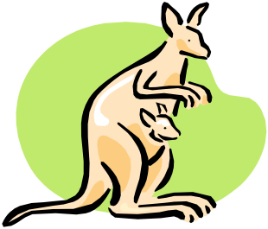
Carer Reactions
Kangaroo
Accommodating carer
Struggle to develop their own
problem-solving skills/emotional resilience
Collude/reinforce unhelpful behaviours
Trapped in the role of an ‘infant’
Rhinoceros
‘Overcontrol’ carer
Often results in conflict
Dolphin
Side by side carer
Young person has more independence,
autonomy and freedom
Notes:
STEPH Slide intro –
So we have looked at a few models of to understand YP reactions to stressful situations.
Time to think about our own reactions as parent/carers/professionals.
Professor Janet Treasure from the maudsley hospital in London developed this analogy using animals. To think about our own carer reactions to our YP’s distress and how we deal their emotions.
Kangaroo – represents an accommodating carer, naturally want to help someone in distress to fix, problem solve for them. Which when they are young is the natural thing to do. BUT if we keep doing this through their adolescent/early adulthood that YP
No opportunities to develop their own problem-solving skills and emotional resilience and colluding with some quite unhelpful behaviours.
Completely understandable and natural instinct to protect our YP not always the most helpful response.
Similarly we have the Rhino
Rhinoceros – as adults we are very much in control of our own lives, we can dictate where we go/who we see/what we do –
when something comes along in our life where we feel out of control we can end up feeling helpless, leading to overcontrol and ‘you will do what I say’ like responses.
Again although an understandable reaction it often results in conflict
So we want to strive for is the dolphin (more dolphin like)
When a dolphin has a baby - swim out in front and guide and show the baby dolphin the way.
get older they swim side by side so they are still there, nurturing, offering support/guidance but more of an equal journey.
As the dophin gets older still it then swims out in front with the parent behind.
Still very much on its own journey but still offering love and support but the young dolphin has more independence, autonomy and freedom.
if a YP has a mental health difficulty you may need to swim side by side that little bit longer or out in front.
Think about how we can do differently…

Slide 12
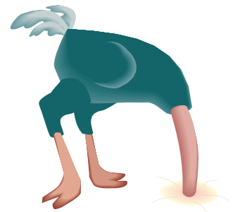
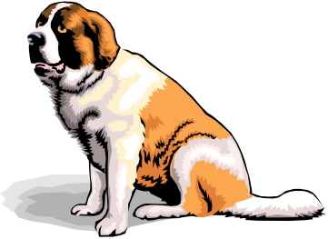
Carer Emotions
Ostrich
Minimisation ‘head in the sand’
Invalidated/not understood
Jellyfish
Overly-sensitive carer
Defensive
St Bernand
Calm and steady carer
Unconditional love/support
Notes:
How we deal with difficult emotions –
Ostrich – represents minimisation and ‘head in the sand’ approach.
Leading busy lives and juggling lots of demands. Really easy to minimise when a young person’s is stroppy or upset. easier to brush it to the side.
‘minimise too much’ might feel invalidated and may not feel understood and may not come to you if their problems get more serious/severe.
Jellyfish – are us who are too emotional
High expectation on themselves/ feelings of guilt/ some way to blame. Defensive and find it difficult to offer support or take any support. Breaks down communication and diffcult to work together.
St Bernand – you want to be more like a dog and not just any dog –
Loving, always happy to see you, faithful. Unconditional support and love.
young people - insecure and need containment/unconditional support so Even after raging arguments – they often do that as they feel safe enough that you will love them unconditionall.
And that’s what we mean by the St bernand – you can still say that behaviour is unacceptable but I love you, I want to support you and get through together.
Nice metaphor - Trys to take away blame/guilt - that was a bit of a rhino response – how could I be more dolphin?
Their emotional responses and behaviour.

Slide 13
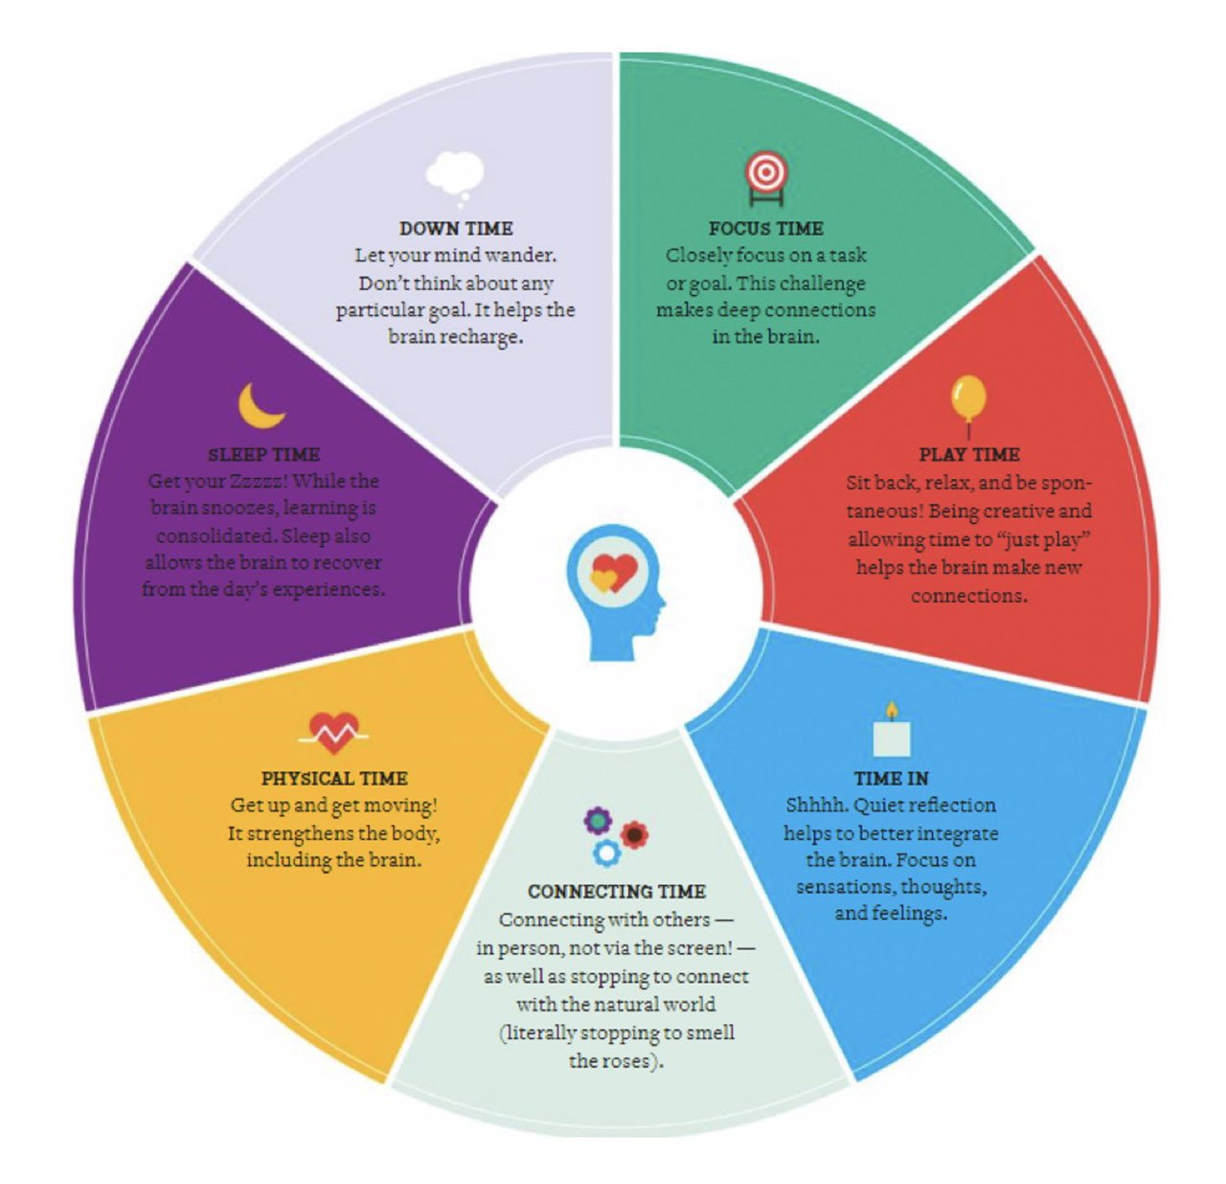
Balanced lifestyle
‘Healthy Mind Platter – Dan Siegel
Notes:
KATE -intro – starting to think more about supporting YP to build reliance and coping strategies.. Lets use – dan Siegel – healthy minds platter.
Balanced lifestyle
Hobbies/ interests- build self-esteem, mastery, efficacy, esteem, confidence, social skills
Sports- good for mind and body
School- education, personal development
Relationships- with adult caregivers and peers; belonging, meaning, care, nurture
Enjoyment, fun, creativity, expression, taking part
Not about success or achievement necessarily
Jar and Hot Chocolate

Slide 14
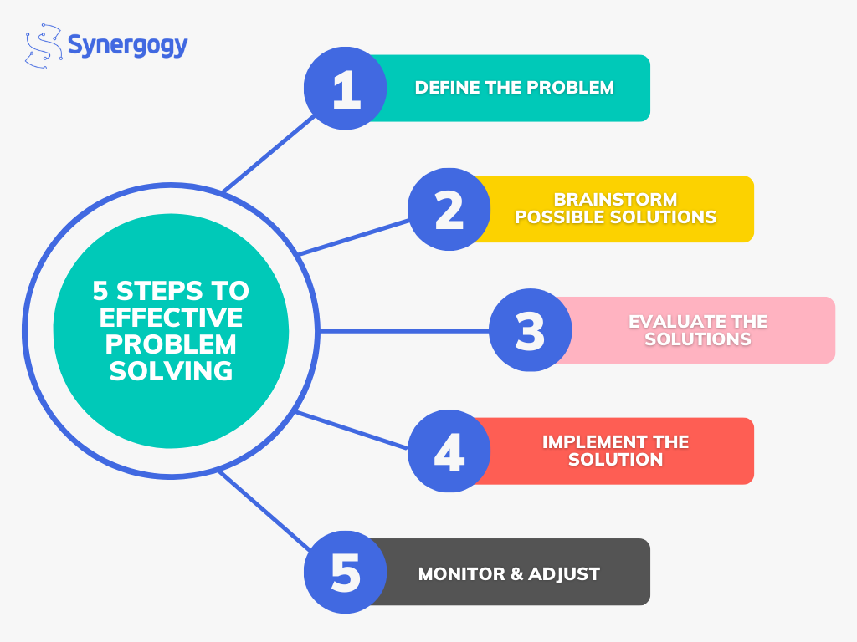
Problem solving skills
Notes:
KATE –
Other tools/strategies for coping –
Developing good problem-solving skills – feel we all ‘can problem solve’ but actually it needs to be a sit down and plan out activity. As above.

Slide 15
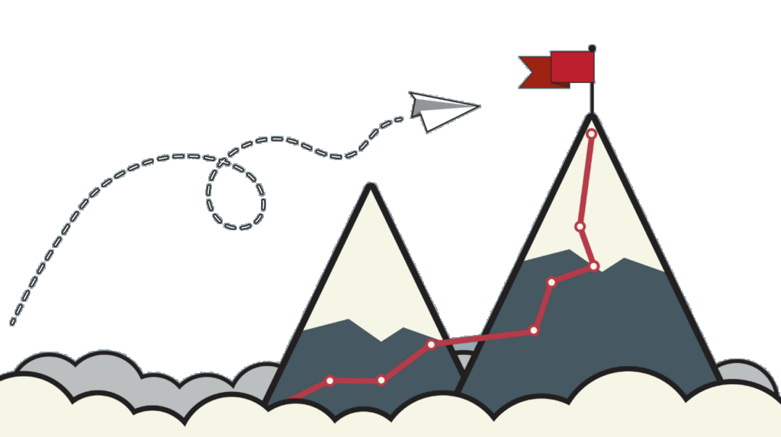
Goals and hooks
Values
Coping ahead plans/relapse plans?
Notes:
Goals and hooks –
All about motivation. What inspires/motivates a young person/what are they interested in? so if they are struggling and their motivation is low how do we capture their imagination/help to fall in love with life again. How can we bring what inspires them into their life? Sense of self-esteem, pleasure and mastery.
Value driven actions – what is important to us? how we want to behave/ how we want others to treat us/us to treat others. Identifying personal values allows us/YP to align their actions with what truly matters!
Coping ahead plans – worth thinking about. To look back on/ to prepare for future setbacks/difficult times. What has been helpful/what are my triggers/ feelings/thoughts/behaviours? – lead onto coping boxes.

Slide 16
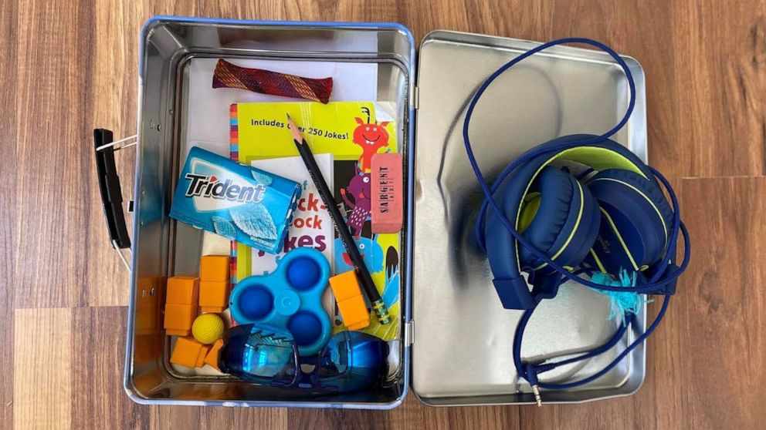
Coping and Resilience Boxes
https://youtu.be/OyfgodSSdV4
Notes:
KATE Show coping boxes senses, what to include, examples – kate show yours??
Show on the website location –
Favourite things – music, DVD, pictures, food
Distracting fiddle toys
Reminders of things they want to do in life/look forward to.
Photos/cards from family and friends
List of activities to keep them busy
Helpline numbers?
Stress balls?

Slide 17
A-Z coping and coping cards
https://youtu.be/5EXpkVw3fh0
Notes:
STEPH Finish on and watch video.
A to Z of coping – lots of different ideas and strategies. Outside on our stall to take your own copies home.
Here’s the thing with coping strategies. A lot of young people tell me that it didn’t work. What do you mean ‘not work? Well I still felt anxious… so yes you can’t get rid of emotion.
Coping strategies are not designed to get rid of emotion.
Help you tolerate the emotion, either until the intensity passes or you are more within your window of tolerance to do something adaptive about it. Less overwhelming.
Different things work for different people
And like learning any skill – takes time and practice. Especially practicing when you are calm or noticing early warning signs – potentially prevent them from tipping out of window of tolerance.

Slide 18
Top Tips
Try to avoid asking ‘how are you feeling?’
Check you and your young person has the same understanding of emotions/language being used.
Avoid making assumptions!
Normalise all emotions.
Try to talk to your young person regularly - Acknowledge and validate their feelings.
Notes:
Try to find other ways of exploring how a person is feelings rather than asking ‘how are you feeling? Using emotion wheels/colours/scales.
……………….
3) Assume you know what is going on and how the young person is feeling or wanting
4) Okay to feel sad/worried/angry from time to time.
5)………

Slide 19
Encourage (through role modelling) a healthy lifestyle.
Check your expectations.
Share information – joined up support/approaches are best for the young person.
Avoid making promises you can’t keep/asking young people to make promises.
Seek support and advice if you need it (supervision for professionals.
Notes:
6) Encourage (through Role modelling) a healthy lifestyle, making time for friends, taking part in hobbies/interests/trying new things. Eat and drink well. Good sleep and having a break from technology and social media.
7) Check you expectations are reasonable and realistic in order to avoid disappointment, frustration or confusion.
8) Try not to make promises you can’t keep – like things will be okay or promising not to tell someone about a disclosure

Slide 20
Thank you for listening.
Any questions or reflections?

