Slide 1

Parent and Carer Event
Supporting a Young Person in Crisis
Hampshire CAMHS i2i Service

Slide 2
Overview:
Discuss signs and symptoms demonstrated by young people when in crisis
Tips of how to communicate with and support a young person who discloses they are in crisis/ struggling or if you have concerns a young person may not be coping
Where to access further support/advice

Slide 3
What is Crisis?
Crisis is subjective; unique to each person both in terms of what triggers and crisis and what it looks/ feels like
In a nutshell- feeling overwhelmed and unable to cope with intense thoughts and feelings for a sustained period of time
Can lead the young person to behave in reactive, impulsive or risky ways.

Slide 4
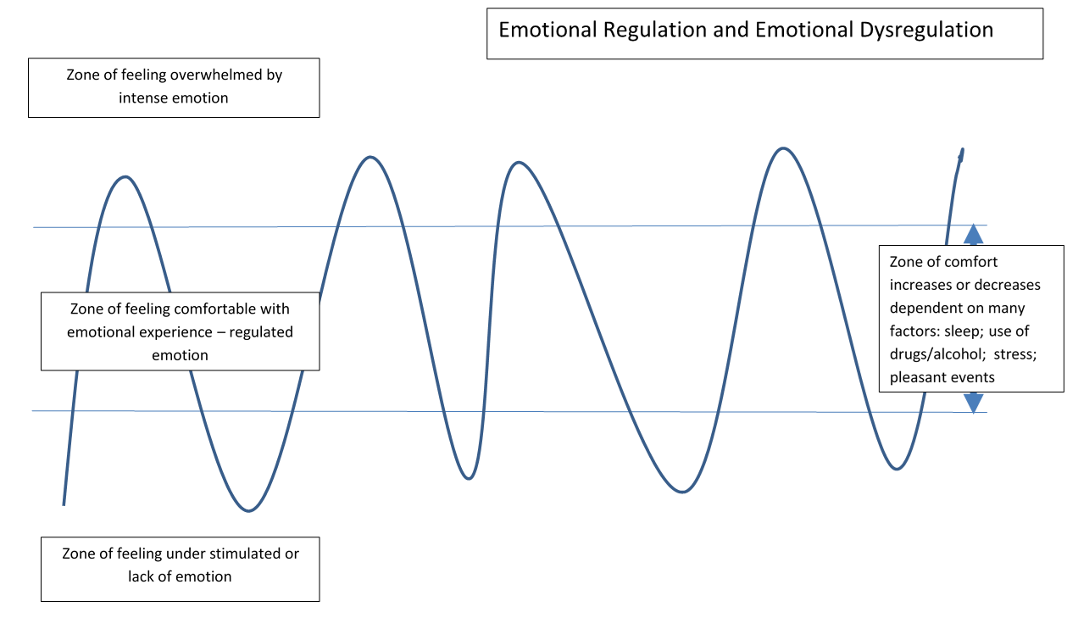

Slide 6
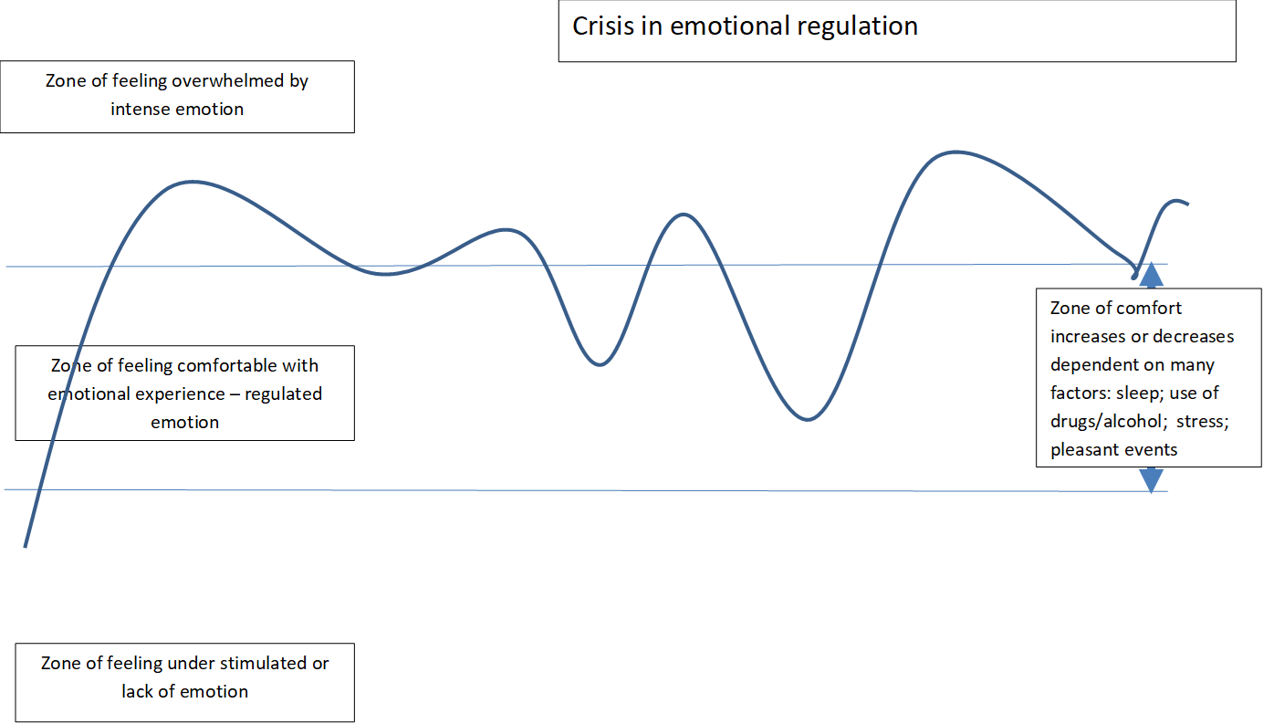

Slide 7
What might we see?
Self harming behaviour as an attempt to self-regulate
Expressions of suicidal thinking as an attempt to escape
Difficulties with problem solving due to stress hormones
Difficulties with communicating
Being on high alert due to anxiety centre in the brain being stimulated

Slide 8
How does it feel?
Upset
Sad
Angry
Confused
Disappointed
Helpless
Worried
Numb
Validation
This is an understandable response although it is not effective in resolving the crisis
Self harm as an attempt to regulate
Royal College of Psychiatrists surveyed 509 people of all ages & found that a significant number of patients had been blamed for wasting time as staff felt their problems were self-inflicted
Comment from a young person: “I have not self-harmed in order to annoy staff, but rather because something is very, very wrong inside”
Camelot Enquiry 2008 found that for many young people disclosure of self-harm was a very negative experience
Notes:
How does it feel for the young person
How does it feel for parents/ carers/ professionals living with or supporting a young person in crisis
Your responses are important.

Slide 9
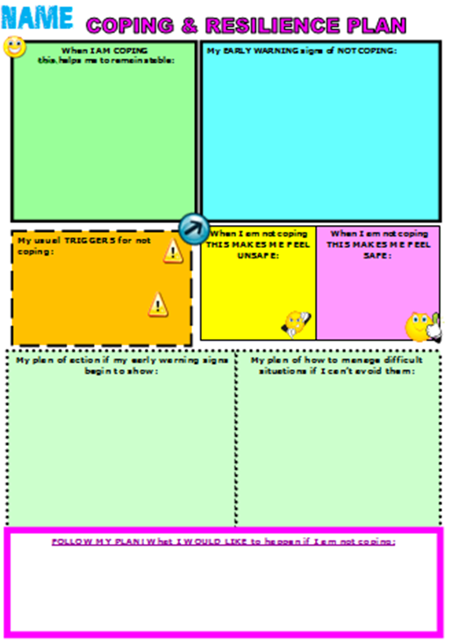
What wellness looks like
Early Warning Signs of Not Coping
Triggers for not coping
Factors that increase risk vs increase safety
Plan of action when early warning signs present
Follow my plan if I am not coping

Slide 10
I stay in my room a lot more
I stay in bed in the morning until the last minute and am often late for school
I feel like I want to cry a lot
I stay up until 2am scrolling through my phone
Being connected to other people
Having activity in my life each day
Working on getting good sleep
Doing something nice for someone else
Writing down 3 things each day that I have enjoyed or am grateful for.

Slide 11
Arguing with my friends
Feeling overwhelmed by exam preparation
Feeling hopeless about long term goals
Having access to things I can harm myself with
Using social media
Spending time talking to people I trust
Having a plan for each day at school

Slide 12
Make a safety plan with parents/school – do I need to be checked on more? Do I need to remove certain items for a while?
Write a list of 10 things to do when I’m feeling overwhelmed
Let someone know that Im starting to wobble
Start an activity planner
Do some problem solving around the things that are causing me distress

Slide 13
10 things to do when I’m overwhelmed:
Choose from:
Distraction by self – to refocus attention
Distraction with others – to connect and refocus attention
Soothing activities – to support nervous system
Self Compassion– to counteract negative thinking cycle
Body calming – exercise, breathing, changing temperature, shaking out muscles

Slide 14
Talk with me about the pros and cons of changing plans
Involve me in any decisions about my care
Work with me to avoid going to the hospital if at all possible

Slide 15

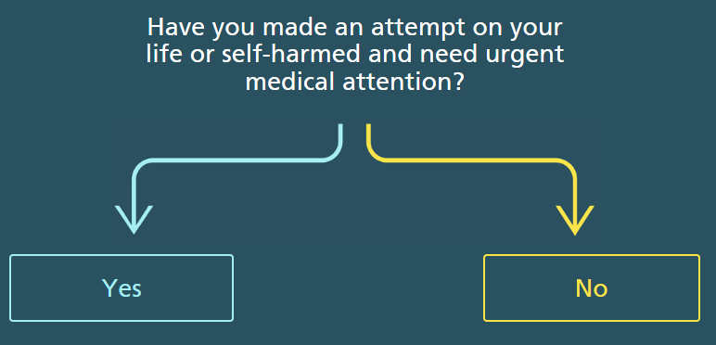
Help I’m in Crisis
www.hampshirecamhs.nhs.uk

Slide 16
