Slide 1
Understanding ADHD
Practical strategies to support children and young people with ADHD to thrive
Notes:
Understanding ADHD

Slide 2

Housekeeping
Collect a handout with helpful links
Please complete the feedback form at the end – This helps us improve based on your feedback and demonstrates the need.
If you score less than a 6 – please tell us why!
Please be respectful of the other parents and staff in the room
Fire exits
Toilets
If you have any further questions, please visit the CAMHS stand or the person on the PACE reception desk.
You can download the slides from the Hampshire CAMHS website
Notes:
PACE 25 September 2024 – CAMHS
You can download the slides from the Hampshire CAMHS website
We have handouts for you with links to information
Please complete the feedback form – this helps us improve based on feedback and also demonstrates the need.
If you score less than a 6 – please tell us why!
If you have any further question’s please visit the CAMHS stand or the person on the PACE reception desk.

Slide 3

What do we hope to achieve from this session?
Notes:
Log in details for the Menti Meter:
https://www.mentimeter.com/auth/login
Username: hantscamhsdigital@southernhealth.nhs.uk
Password: PACE2025! (all caps)
Ask the parent/carers – what do they hope to achieve from this session?
This is a check in to/ see how we can gauge the session to meet their needs
Allow a few minutes for people to load their answers onto a word cloud
The goal is to answer your questions as we go along but if we are unable to, we will have time at the end to answer questions. We can also signpost to the right place to find the information
Something to think about – what skills has your child developed to manage their ADHD already and what do you think would be helpful to introduce? This is in the workbook as take home activity

Slide 4
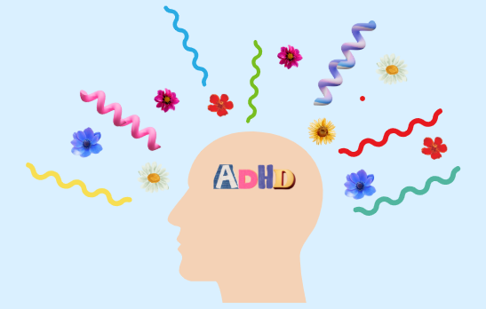
Agenda
What do we already know?
What is ADHD
Building Self-esteem with ADHD
Building up from the base
Executive Functioning
Behaviours that challenge
Communicating your needs
Signposting

Slide 5
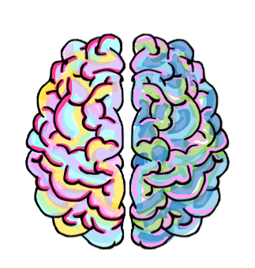
What is ADHD?
Attention Deficit Hyperactivity Disorder
Is a common and chronic, neurodevelopmental disorder that affects a person’s ability to focus attention, regulate activity levels and control their impulses. Occurs across the lifespan
          Three subtypes:
          1)ADHD predominantly inattentive subtype type
          2)ADHD predominantly hyperactive-impulsive type
          3)ADHD combined type
Let's talk about ADHD (youtube.com)
Notes:
Video link: Let's talk about ADHD (youtube.com) https://www.youtube.com/watch?v=YeamHE6Kank&t=42s

Slide 6
Combined ADHD
Inattentive Subtype
Distractibility
Forgetful
Losing things easily
Struggling to concentrate
Struggle to focus
Struggle to listen
Slower Processing speed
Hyperactive-Impulsive Subtype
Impulsive
Fidgety and Restless
Often Speaks over others or
finishes their sentences
Struggles to wait their turn
On the go constantly
Talks excessively
Both
Sleep Issues
Sensory Problems
Executive Functioning Impacted
Working Memory Problems

Slide 7
There is more to ADHD….. Kids with ADHD may have trouble with
Managing time
Getting and staying organized
Managing emotions
Following directions
Shifting focus from one thing to another
Keeping things in mind (working memory)
Thinking before saying or doing things
Focusing on what's important
Notes:
Kids with ADHD may have trouble with
Managing time
Getting and staying organized
Managing emotions
Following directions
Shifting focus from one thing to another
Keeping things in mind (working memory)
Thinking before saying or doing things
Focusing on what's important

Slide 8
Building self-esteem with ADHD

Slide 9
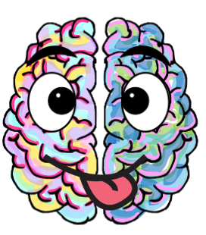

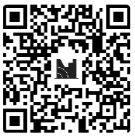
The Positive Attributes of your child
Notes:
Log in details for the Menti Meter:
https://www.mentimeter.com/auth/login
Username: hantscamhsdigital@southernhealth.nhs.uk
Password: PACE2025! (all caps)
Go to Meti meter
Click on the left-hand side of screen (my presentations)
Then click on what are some positive attributes of people with ADHD
Then click on the blue bottom on the right-hand side that says present , share screen with the audiences, there words will start to appear on the screen as they submit there answers
How to run this slide:
Tell the group to scan the QR code on their phone and take 2-3 mins to write some of the strengths of there child with ADHD.
Then share the word cloud created and reflect with the group on the wonderful strengthens children with ADHD can have.
Read out some of the strengths as they pop up
Reflect on the strengths and bring back to ADHD
Talk about the ratio of positive to negative comments heard by a child with ADHD.
Script: Possible reflections
Children who have ADHD can be marvellously creative and imaginative. The child who daydreams and has ten different thoughts at once can become a master problem-solver, a fountain of ideas, or an inventive artist.
Children with ADHD may be easily distracted, but sometimes they notice what others don’t see.
Because children with ADHD consider a lot of options at once, they don’t become set on one alternative early on and are more open to different ideas.
I’m sure you will already know that children with ADHD are rarely boring! They’re interested in a lot of different things and have lively personalities. In short, if they’re not exasperating you (and sometimes even when they are), they’re a lot of fun to be with.
When kids with ADHD are motivated, they work or play hard and strive to succeed. It actually may be difficult to distract them from a task that interests them, especially if the activity is interactive or hands-on.

Slide 10
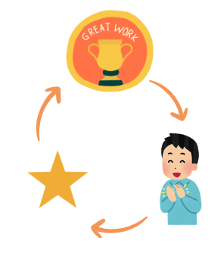
Praise
Rewarding good behaviour and ignoring unwanted behaviour when safe to do so
Find the good and PRAISE!
Be specific and immediate
Notes:
Purpose: to think how do we praise our children with ADHD in a meaningful way
Script:
Talk thought a example of praising a specific behaviour if you can think of an example of one a parent shared do that if not use this example ……..
Examples
“Well done for putting your shoes on when I asked”
“I noticed you trying really hard on your English homework well done for the effort you put in today”
“you opened up your homework planner, first step to doing the homework, im proud of you for starting”
“Thankyou for being so funny today you really made my day”
“you were such a team player today at football, really proud of you”
Key points:
The more you praise a specific behaviour the more you likely you are to see it again.
Exercise
Think about a situation that happened that didn’t go well
Think about how might

Slide 11
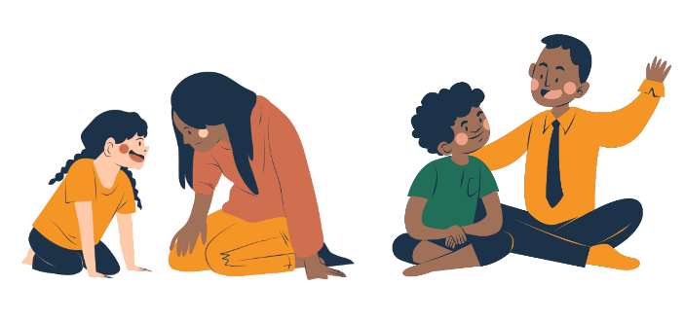
Talking to your child
Minimise distractions
Give advanced notice to transitions
Get their attention
Eye contact
Non-verbal cues
Facial Expression
Give two choices
Avoid asking too many questions at once
Give time to respond
An indirect approach often succeeds
Frequent praise
Model the way you want them to communicate
Notes:
Before speaking to your child – try and minimise distractions in the room to aid attention. For example if there is the tele on in the background – switch this off.
try and get their attention – eye contact is important along with the use of their name (However if the YP struggles with emotional regulation difficulties and/or ASC – eye contact may be difficult)
It can be difficult for a child with ADHD to try and carry on doing a task while also listening to someone speaking. Getting their attention first means they can stop what they are doing and encourages them to listen to you while talking to them.
Use EXPRESSION! Try to use facial expressions and gestures when speaking to your child; this emphasises what you are saying and gives your child clues to what you mean.
This also increases your child’s understanding of non - verbal communication by linking words with gestures and faces. Also try to keep your voice lively to hold your child’s attention.
If you need your childs attention due to a risk such as crossing a road – it is important to use a clear tone and short immediate phrases – “Margot you need to wait, there is a car coming”
If you are asking a question - ask one question at a time allowing time to respond – what would like you for your lunch tomorrow – we have tuna mayo or cheese?
For some communication – an indirect approach can be helpful – such as asking how your child is getting on with their friend…. This could be something to discuss whilst out on a walk, or in the car getting a drive thru drink together. Its important for your child to feel safe in the environment when discussing certain topics.
- for a child with ADHD and struggles with emotional regulation, they may feel things in extremes –
- Try not take the child’s behaviour personally
- Reduce eye contact if angry as this can be confrontational
- One to one quiet times
- The ‘One sentence rule’
- ‘Time out’ does not work always work
- Using ‘we’ words
- Daily structure and clear boundaries
- Physical touching when upset may worsen their behaviour. Just stand by and be available
- Focus on positive behaviours
- Children may forget messages
- They may find it very difficult to cope with change

Slide 12
Building up from the base
Building up from the base

Slide 13
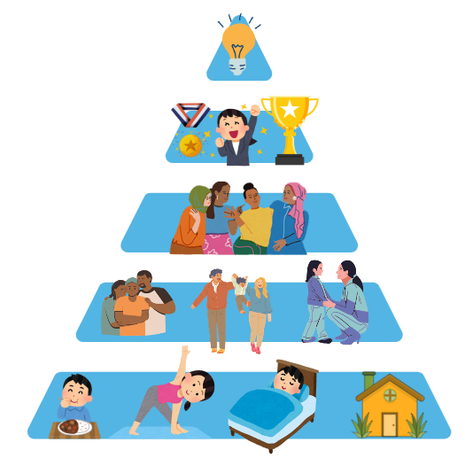
Maslow’s Hierarchy of needs
Notes:
Purpose of this slide: explaining that your child mood and behaviour will be underpinned by getting there needs meet. If the base needs are not being meet this can make it harder to meet the higher needs.
Time to take on this slide: 5 minutes
What to say script:
Maslow’s Hierarchy of needs
This is a theory that is based on what is needed starting from the bottom of the pyramid to the top.
It suggests that you need your physiological and safety needs to be met before you can set your mind to the needs further up the pyramid.
From the bottom up, the needs are:
Physiological (food, water, sleep, shelter)
reflections…
We know as parents/carers how hard it it is to attempt to get your child to do their home work after school when they are hungry and tired…
Having a snack and some structured down time before considering trying to complete home work – works for some. Others might struggle with “home is home” and “school is school” and may find benefit in a homework club.
As adults we know how difficult it is to access creativity, purpose and motivation when we are stressed about money, we might not be feeding ourselves well and getting by on limited sleep.
Some questions to think about with your child with ADHD –
How does their ADHD affect the day-to-day functioning? – are they forgetting to eat and drink regularly? Are they eating a variety of foods?
If they are taking medication for physical health and/or ADHD, are they taking it as prescribed, are they keeping well in themselves?
How is their sleep? How much sleep are they getting?
Are they getting out into nature? Are they getting movement and exercise?
Safety (physical safety, job security, financial security, housing stability)
Safety is about being physically safe, so being safe from dangerous situations. There is evidence to suggest that having ADHD you are nearly two times more likely to be injured. Often injuries are accidental. For example, road safety is important – so assessing your child’s ability to cross the road safety, stop and wait for the lights, listening to your instructions of when to cross. Having road awareness is a skill that needs to be practiced. There may need to be adaptations to the way your child walks to school – sussing out where they can cross safely. Some children with ADHD simply are unable to walk to school on their own. It’s important to assess as parents/carer but also re-assess and adapt to try promote independence where possible.
Being protected from conversations about financial instability is important for children.
The feeling of feeling safe in your body is also important. If you are feeling on edge/ hypervigilant a lot of the time
Question to ask is - how can we as a family reduce the chaos in the house? How can we have a calmer day? How can we make time for relaxation?
Love and belonging needs (friendship, family, intimacy, sense of connection)
It is important to look at how healthy your childs relationships are.
For children with ADHD is important for them to seek connection with others. For example - attending clubs that they get enjoyment and friendship from.
It is a human need to be able to connect with others. Having a sense of connection in the household is important – even if its sitting together but doing other activities.
Questions to ask – is my child getting enough connection with others throughout the day? How are we connected at home? How do we demonstrate our love - do we give each other hugs?
Self-esteem (confidence, respect of others, achievement, the need to be a unique individual)
It can be hard for children with ADHD to identify their strengths,
It is important that we highlight their strengths
There is evidence to suggest that children with ADHD have more negative than positive comments made about areas of their life, in particular – school life.
What are your child’s unique attributes? How do we acknowledge these to help them build a sense of identity?
How can you recognise and celebrate achievements?
Top of the pyramid!
Self-actualisation (a feeling of deeper purpose, creativity, acceptance, finding meaning and inner potential)
when our lower order needs are being met which is an ongoing practice, we can then focus on how to be the best versions of ourselves.
It can be hard to see the long term goals when the day to day life is hard with managing symptoms of inattention, hyperactivity and impulsivity.
It’s important to support children with ADHD to navigate what they want from day-to-day short term goals to their long goals such as career development.
What other achievements do they want in life? This is also based on their core values – so how do they want to be perceived by the world? – kind? Caring? Creative? Family oriented? Driven? Successful?
Key points: if the basic needs aren’t being met, the child will be unable to meet their psychological and self fulfilment needs.
Workbook Activity

Slide 14
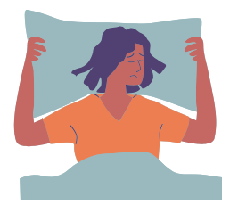
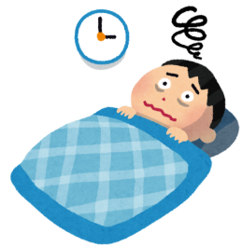
Sleep Difficulties and ADHD
Children need 9 or 10 hours of sleep a night.
There is a strong link between ADHD and sleep problems.
Lack of sleep has negative impact on the child’s emotion and concentration
Lack of sleep and sleep disruption is common for parents of children with ADHD and impacts family quality of life.
Notes:
Lack of sleep can negatively impact on a child’s emotions, concentration and task performance, as well as affect the wider family’s quality of life.
Without enough sleep children and adults can feel grumpy, irritable, sadder, angrier, more anxious, be more forgetful, find it hard to make decisions and pay attention.
Surveys show that children with ADHD take longer to settle to sleep and get up more frequently when they are put to bed.
Sleep disorders are fairly common in children, but sleep disorders seem to be more common if the child has ADHD. For example snoring and sleep apnoea is more common in children with ADHD, teeth grinding is more common.
The evening leading up to bedtime can be stressful because of the symptoms of ADHD and calming bedtime routines more difficult .
Often small interruptions such as a phone can throw bedtime routines off.
Children with ADHD are often unable to stop going over events of the day at bedtime.
Lack of sleep and sleep disruption is common for parents of children with ADHD.
Can affect the wider family’s quality of life.
Surveys show
42% parents with children with ADHD are woken before 6AM.
70% parents felt more irritable
61% parents felt unable to concentrate and less able to cope with problems.
46% parents say they argue more with their partners.
Nearly fifth parents have had to take time off work.
64% had cancelled or avoided social activities in the past six months. Hard to get babysitter if child has sleep difficulties.

Slide 15
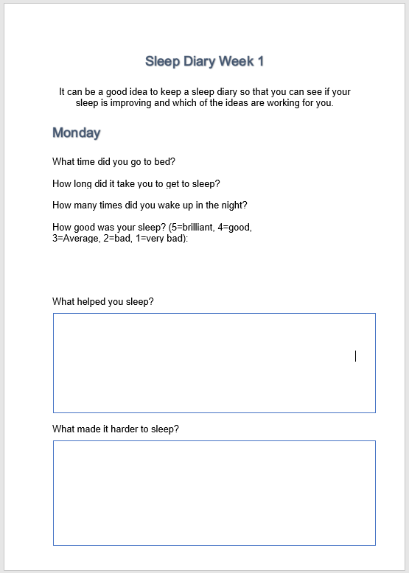
Sleep Diary
What time did you go to bed?
How long did it take you to get to sleep?
How many times did you wake up in the night?
How good was your sleep? (5=brilliant, 4=good, 3=Average, 2=bad, 1=very bad)
Notes:
Simply recognising the nature and extent of the disturbances can be the first important step towards improving the situation.
Filling in a sleep diary can help identify the times of particular difficulty for you and your child.
This might uncover the main pressure points and could be useful for starting discussions to help sleep.
Keeping track of your child’s sleep problems and patterns can help you to think
about the quantity and quality of sleep your child is getting, and how this is then
impacting on your family life in general.
Complete sleep diary for 2 weeks and you can add what helped you sleep and what made it harder.

Slide 16


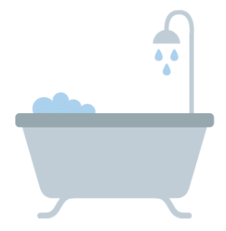

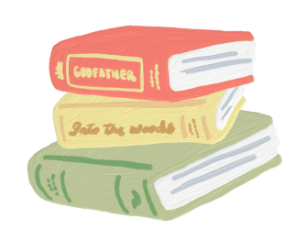

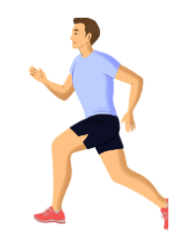




Strategies to Help Sleep
Notes:
Regular Evening Routine
When we do the same things each night before going to bed it helps our mind know it’s nearly time to sleep. An example of an evening routine might be: 7.00pm I have a warm bath, 7.30pm I have a drink of Horlicks, 8.00pm I read my book, 8.30pm I go to bed and turn the lights off.
Some of the following suggestions might help you decide what to put in your evening routine.
Have a warm drink
Having a warm drink can help you relax before bed. Remember though you shouldn’t drink things with caffeine in them in the afternoons or evening as caffeine can keep you awake.
Caffeine is found in tea, coffee, cola drinks (e.g. Coca Cola, Pepsi), energy drinks (e.g. Red Bull, Monster and relentless). Caffeine remains in the body for three to five hours on average, but can affect some people up to 12 hours later.
Food
Try to avoid giving your child a large meal a few hours before he/she goes to bed. Also you may decide to cut out certain foods if they exacerbate the symptoms of ADHD, such as food with additives, colours, or foods high in sugar.
Having a warm bath or shower
Having a warm bath or shower can also help you relax, especially if you have tense muscles. Remember not to have the water too hot or too cold though as this will make you feel even more awake.
Using a lavender scented bubble bath or body wash in the evening is also very relaxing; avoid using citrus scented toiletries in the evening as these tend to make us feel more alert.
Reading a book
Reading a book can also help you to relax as this can help us slow your thinking down and take your minds off other things.
Having the TV on while we are trying to sleep keeps our minds active and busy and will make it more difficult to fall asleep, not least because need to concentrate on the TV and keep our eyes open.
Turn TV and computer games off earlier
The same is true for computer games; especially those which make you feel excited, scared or stressed.
They also trigger our bodies to feel more awake because of the light emitted from the screen. Our bodies respond to light by becoming more awake and alert.
You may decide to take a television or computer out of a child’s room to avoid temptation
Listen to music
Listening to calming music can help encourage sleep. Music can help distract you from worrying thoughts and can help block out other noises that may keep you awake. It is best to listen to something calming and fairly quiet rather than something which makes you feel excited.
It is a good idea to ask your mum or dad to turn off your music for you once you have fallen asleep.
Don’t exercise right before bed
Doing exercise during the daytime is a good way to help you feel more tired in the evening. Daytime exercise can make a big difference in helping children gain quality sleep at night. Encourage your child to do some light exercise such as walking, skipping, or playing a team
sport every day, but avoid strenuous physical activity for a few hours before bedtime. Doing exercise releases chemicals which make us feel awake so try not to do this late in the evening, right before bed.
Use relaxation exercises
There are several different relaxation exercises you can try which might help you to sleep. It is best to practice these with other people who know how to use them first before trying them on your own.
Keep your bed for sleeping
Avoid spending time in your bed when you are doing activities other than sleeping. Doing other activities in bed before bedtime prevents our brain from associating lying in bed with going to sleep therefore can make it harder to get to sleep.
Try not to worry when you get into bed
If you start to worry when you get into bed, it might be a good idea to have “worry time” earlier in the day where you try to talk about your worries with your parent/ carer.
Make sure you have a suitable bed time. Make sure your child goes to sleep at the same time each night and gets up at the same time
each morning. You could be trying to get to sleep earlier than is right for you. If you are not tired at your planned bedtime, you can try delaying your bedtime by 30 minutes until you feel tired so that you fall asleep quicker when you get into bed. Your bedtime should then be gradually made earlier until you are going to sleep at your planned bedtime.
Avoid day time naps
Even if you are feeling tired during the day time try to avoid naps as this will make you feel less tired in the evening.
Get daylight exposure – Sunlight is a key driver for Circadian Rhythm

Slide 17
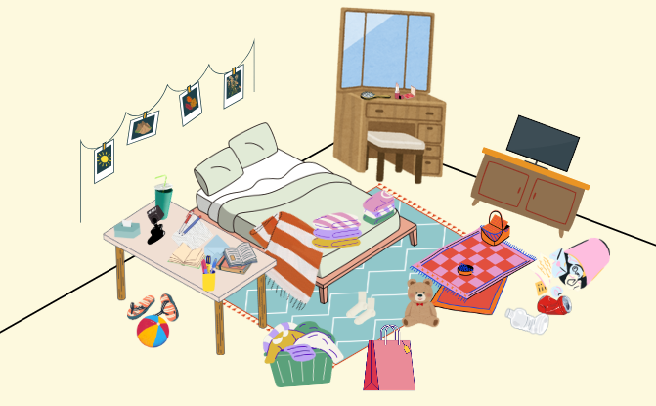
Bedroom Environment
Light
Noise
Temperature
Notes:
Light: the light in your room should be low. Think about street lights outside, flashing objects in your room e.g. your phone/ TV, lights on while you’re sleeping.
Reduce exposure to green/blue light in the evenings – this reduces Melatonin production
Consider a red light in your bedroom in the evenings to increase Melatonin production Unplug electronics 60 minutes before bed
Black out curtains
Electronics out of the room
Noise: your bedroom should be quiet when you are trying to get to sleep. Think about if there is noise from inside your home as well as outside your home and how this can be minimised.
Temperature the recommended temperature to get the best night sleep is 16- 19 degrees Celsius. Adjust the temperature in your room by using a heater/ fan until you feel it is the right temperature.
Sharing bedrooms – different levels for beds, bunk beds
Bed for sleep , separate homework area

Slide 18

Movement Breaks
Movement can help our bodies release dopamine which indirectly helps us focus
Fidgeting and movement can help someone with ADHD feel more regulated
How do you incorporate movement breaks into your young person’s day?
Notes:
Purpose: to highlight the importance of movement brakes and fidgeting for attention and regulation.
Key points
Movement brakes can help with focus
Fidgeting and movement can realize dopamine helping ADHDer feel more regulated
Discuss ways you can add movement brakes into daily life
Time: 2-3 mins
Script
Fidgeting often occurs when someone with ADHD is placed in an under-stimulating environment, and to stimulate their brain, they will fidget. (1,2)
This is because people with ADHD are low in something called dopamine a chemical in their brains, and fidgeting behaviours cause a realize of dopamine.
Research has found that on tasks that are less cognitively demanding, fidgeting can improve the performance of people with ADHD. However, this is not true for cognitively demanding tasks (tasks we have to put lots of mental effort into doing). (3)
Having fidget toys to use during boring or low-stimulating tasks can be one way we can support our ADHD children.
Movement brake where we get up and move our body, can help children focus better and pay more attention in class, it is also a great way to support a child with ADHD in managing those impulsive behaviors such as calling out (4, 5).
we can add movement breaks in though using fidget toys, getting up doing 5 mins of exercises, or even just walk round the block then back into the room.
1) Paloyelis, Y., Asherson, P., & Kuntsi, J. (2009). Are ADHD symptoms associated with delay aversion or choice impulsivity? A general population study. Journal of the American Academy of Child and Adolescent Psychiatry, 48(8), 837–846. https://doi.org/10.1097/CHI.0b013e3181ab8c97
2) Andrade, J. (2010). What does doodling do? Appl. Cogn. Psychol. 24, 100–106. doi:10.1002/acp.1561
3) Koiler R, Schimmel A, Bakhshipour E, Shewokis PA, Getchell N. The impact of fidget spinners on fine motor skills in individuals with and without adhd: an exploratory analysis. JBBS. 2022;12(03):82-101. doi:10.4236/jbbs.2022.123005
4) Myers, S., 2024. The Effectiveness of Brain Breaks in Reducing Disruptive Behavior in a Student With ADHD (Master's thesis, Caldwell University).
5) Mulrine, C.F., Prater, M.A. and Jenkins, A., 2008. The active classroom: Supporting students with attention deficit hyperactivity disorder through exercise. Teaching exceptional children, 40(5), pp.16-22.

Slide 19
Executive Functioning

Slide 20
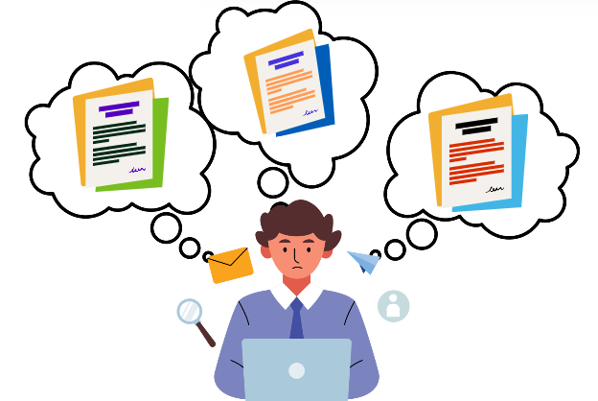
Working Memory
Working memory is the ability to take in, hold and process information.
Chunking information
Questions
Activities to help working memory
Notes:
Working memory allows people to retain, recall, and process information in the short term. It is a complex process that takes place in the brain’s frontal cortex. Working memory enables a person can hold a piece of information—or several pieces of information—in their mind while simultaneously applying that information to a task or problem.
Researchers have identified strong links between ADHD and poor working memory
Working memory deficits are present in the majority of children with ADHD . Importantly, working memory deficits appear to be present in upwards of 3 out of every 4 ADHD cases
Ref Working memory and short-term memory deficits in ADHD: A bifactor modelling approach 2020 Kofler et al
People with ADHD can struggle to hold complex strings of instructions in their minds and carry them out (working memory deficits). Chunking is where we take a big task and chunk the information into small easy to understand sections or steps.
For example, when you leave the house, you might think of the group of items you need to bring--phone, wallet, keys, jacket--and thinking of them together helps you remember each.
Look for ways to relate groups of items.
Breaking down a room to clean into four zones, with specific bullets on tidying each part.
Avoid asking too many questions at once. This can be quite overwhelming for a young person, and can feel like they may be being tested. Asking questions one by one, that challenge them to think rather than need an immediate answer, can be less overwhelming. Repeating questions or instructions can also be helpful but make sure you wait for the answer.
Use simple repetitive language
Use the young person’s own words
There are many activities / games you can do with your children to help working memory: For example the I went to the shops today and brought game….. (complete in table groups)
One person starts by saying “I went to the shops today and bought...” something beginning with ‘A’ (e.g. apple). The next person continues by saying “ I went to the shops today and bought an apple…” and then something beginning with ‘B’ (e.g. banana). Continue around the group, working through the alphabet, adding one more item to the end of the list each time

Slide 21
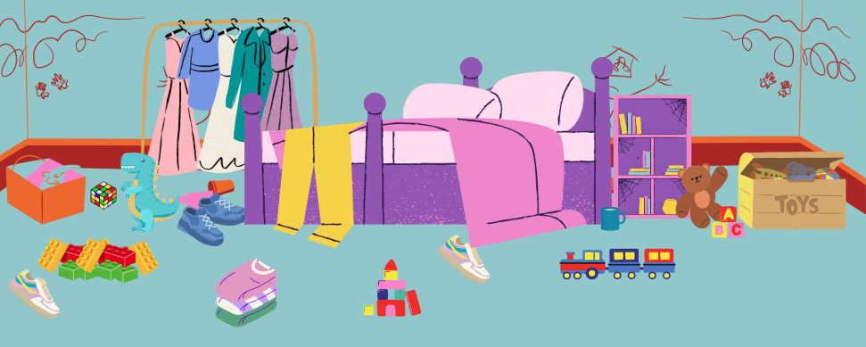
Notes:
Breaking down tasks and information!
Reflections – How would you ask your child to tidying their bedroom?
People with ADHD can struggle to hold complex strings of instructions in their mind and carry them out. Chunking is where we take a big task and chunk the information into small easy to understand sections or steps.
For example if your child needed to clean their bedroom but was really overwhelmed by the task you can break the task down into smaller chunks - Ask parent what the smaller tasks are as part of cleaning this bedroom.
Steps:
Decide what jobs need to be done in the bedroom e.g. pick up dirty clothes, remove dirty cups, put toys in a box, hoover
Then you can do one task at a time, Important to remember to give one instruction at a time.

Slide 22
Make bed
Take dirty cups downstairs
Put clothes away
Hoover floor
Put toys away
Scrub the drawings off the walls
Notes:
Breaking down tasks and information!
You can use chunking with any task from homework to cleaning to getting dressed.
You can also use chunking with any task from homework to cleaning to getting dressed.
For example if need to write an essay for history class on WW2 I could break the task into
Reading the instructions about the homework take time to understand them.
Research stage
Watching YouTube videos about WW2
Reading a Wikipedia article about the war
Start by getting all the facts you just learned onto paper
Order the facts and write some waffle around them to make an essay.
For example if need to write an essay for history class on WW2 I could break the task into
Reading the instructions about the homework take time to understand them.
Research stage
Watching YouTube videos about WW2
Reading a Wikipedia article about the war
Start by getting all the facts you just learned onto paper
Order the facts and write some waffle around them to make an essay.

Slide 23
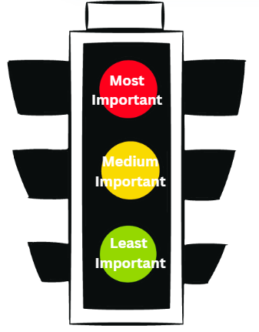

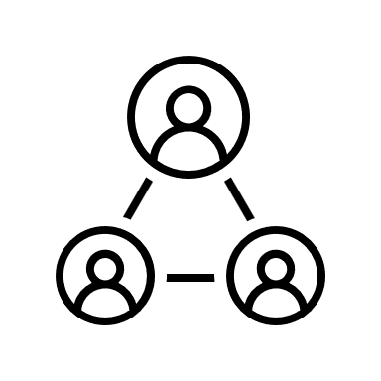


Breaking down tasks
 | Important | Not Important
Urgent | Do it now ! Example: the homework due tomorrow | Delegate it Example: needing to bring cookies for the bake sale
Not urgent | Schedule it Example: Revising for exam next month | Bin it Example: Reorganizing my bookcase or doing the extra reading for class.
We will all have different priorities but knowing where to start can help
Notes:
Purpose: show practical ways to brake big lists of tasks down that can be used for our older teens wit ADHD.
Time:
Script:
As your children become your teenagers and life expectations increase, People with ADHD can struggle to know where to start especially when there are a list of tasks that all need doing. Breaking things down into an order of when things need to get done can help your ADHD child prioritize tasks and figure out where to start.
We can break a list of tasks down using the matrix you see if its
Important and urgent we do it now
If it’s not important but urgent we delegate someone else to help or even do it for us
If it’s important but not urgent schedule a time to do it
And if it’s not important and not urgent bin it cos you’re probably not going to do it.
Or we can take 3 pens to that to do list and prioritize them in term of importance which can often give us a places to start.
Activity dummy list – task is to choose 1 method and break down to-do list

Slide 24
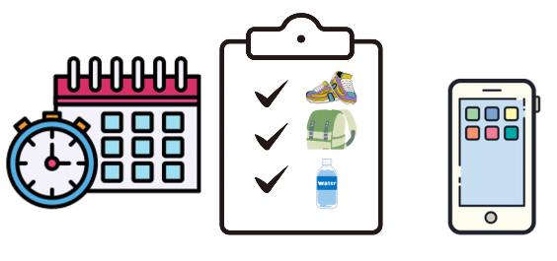
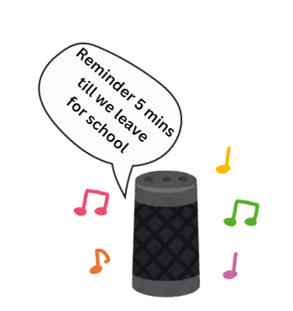
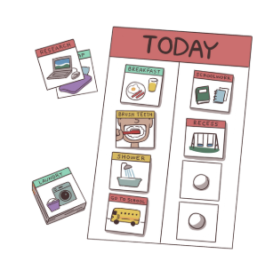
Visual Prompts and Timetables
People with ADHD can struggle with time blindness
Visual prompts and timetables can help understand what needs to be done in a time frame
Using tech to help with reminders can help keep us on track
Some good ideas might be
  Using smart speakers
  Organisational Apps
  Now and then picture charts
  Visual timetables
  Family white boards
Notes:
Key points
ADHDers can struggle with time blindness
Visual prompts and reminders can help a person with ADHD understand what needs to be done and when.
Additional strategies to discuss
timers
google home reminders
visual time tables
apps focuses keepers
task bracelets – bands that go on the arm and have individual tasks written on start the morning with all tasks of the wrist and take off as do tasks.

Slide 25
Behaviours that can challenge

Slide 26
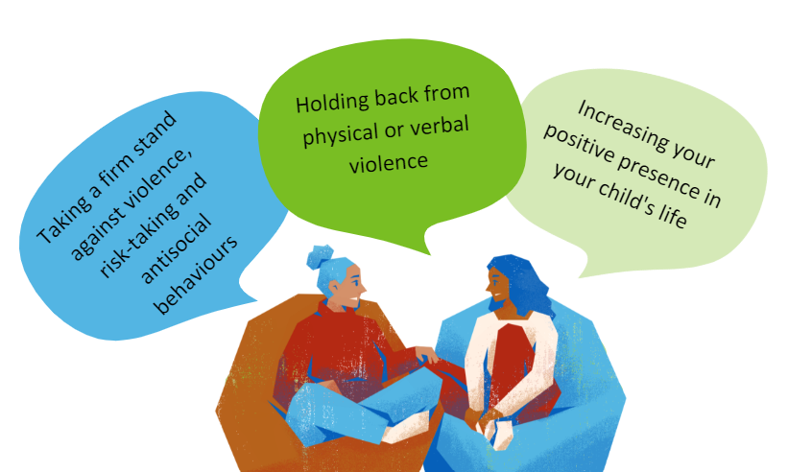
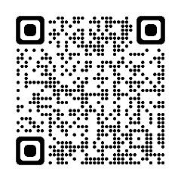
Non-violent Resistance
Notes:
1. Taking a firm stand against violence, risk-taking and antisocial behaviours
2. Holding back from physical or verbal violence
3. Increasing your positive presence in your child's life
Please use the QR code to link to the Youth Options team that provide non-violent resistance (NVR) training. The team are experienced in supporting families that are experiencing challenging behaviours. They work with families that have children who have ADHD, ASD, anxiety, self-harm, alcohol and drug misuse, criminal activity and violence and controlling behaviours.
You can refer directly through their website for support – there is an online form to complete.
Recommendations by the NVR experts -
What you should do:
stay calm
stop and think
remain positive
give yourself time to
plan your response
be non-judgmental
tell your child that you
are doing this because
you love them
be gentle and firm
persist
resist violence
believe that things can get better.

Slide 27
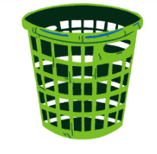
NVR Baskets
Ignore
Negotiate
Sticking Point
Notes:
A helpful starting point with NVR is to decide behaviours we are going to focus on changing, it can end up being a never ending battle if we tackle everything at once. One method we can adopt is writing a list of all the behaviour our child does that we start by deciding them up into behaviours we can ignore for now, things we can negotiate over and having a few sticking points that we hold to.
Deciding which behaviour to focus on
It is important to decide where to begin. Parents often find that
part of the difficulty is that they do not agree on what to take a
stand about or how to do this. Preparing to make the
announcement helps clarify goals and brings parents together.
Q There are so many things we need to change, where do
we start?
A For this to work you need to concentrate on only one or two.
Begin by writing every behaviour that you want to change on
a separate piece of paper. Now you are going to work out
which are the most important.
Use the idea of baskets to help you work out what is most
important.
Prioritising
This is the largest basket. Put all the things that
you are going to ignore in here. Most of your
pieces of paper should be in this basket.
This is the middle-sized basket. Put the things in
here that you are prepared to be flexible about
or negotiate over.
This is the smallest basket. Put in here things
that you will no longer tolerate. This should be
no more than one or two things.

Slide 28




Parent/carers – self care
Time for yourself
Enjoying the small pleasures
Doing something towards your mental health
Notes:
Looking after yourself as parents –
We have a short video about capturing the small pleasures in life and looking after yourselves into order have the energy to look after your child with ADHD.
Here is the video clip – Small Pleasures
https://youtu.be/1Oo88CvUCxc?si=_sphMopSsoq-4D-2
3min 55s
You can access the full parent/carer handbook on the Hampshire CAMHS website
Link also in the workbook – direct to workbook if you are running out of time

Slide 29
Communicating your needs

Slide 30

‘I’ Statements: Fact – feel – want
Fact
What are the observable facts
What are your feelings about the situation
What’s your wants/needs
Feelings
‘You set me a paper that’s due on tomorrow, I feel really overwhelmed with the amount of homework I got to do at the moment, and would really appreciate it if you could either go though it with me or give me more time?
‘I know you said my fidget toys are distracting to other student, but I am feel restless and unable to concentrate without them, and I would like it if we can come to a compromise about having some fidgets in class.
‘I forgot my PE kit, I am really frustrated at myself because I want to do PE, can I do it in my uniform.
Wants
Notes:
Communicating our needs in a effective and assertive way is important.
When our needs are not being met this can lead to
some big emotions,
acting out in ways to try and get our needs meet,
becoming anxious about situations, this can sometime lead to problems getting bigger. E.g avoid the homework because we didn’t understand the instructions then get in trouble because we didn’t do it.
I statements are a way we can clearly communicate using the Fact, Feel, want formular we start with
Fact: what we perceive the facts of a situation are – these should be clear observable facts not speculation. Also by stating the facts it enables the other party to clarify or add information about the facts of the situation.
Feelings: how this situation has impacted us, this is our truth
Wants / Needs: clearly stating what we need allows us to state what we need them to hear it and a potential point to negotiate from if needed.
Go through the examples then get the parents to come up with there own I statements then you can state what u
Activity come up with own I statements

Slide 31
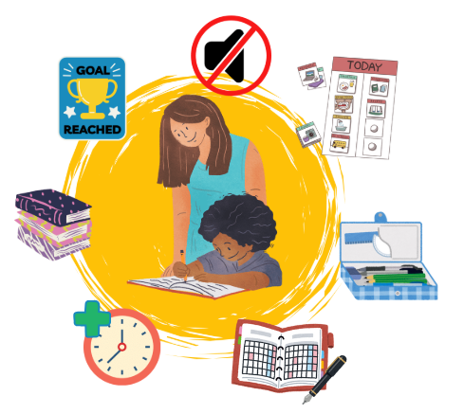
Classroom
Modifications to the classroom environment
Managing distractibility
Encouraging organization and planning
Managing behaviours in the classroom
Exams and Assignments
Supporting mood and socializing
These are suggestions that can be taken away but ultimately need to be discussed with the teacher.
Notes:
talk about it in general – it has to be something worked out together with the teacher and parent/carer –
- Sit away from distractions –front and centre of classroom
- Utilise positive role models
Increase distance between desks
For assignments –
Allow extra time
Break long assignments into smaller parts, shorten work periods
Pairing written instructions with oral instructions
Distractibility –
Provide peer assistance in note taking and ask student questions to encourage participation
Involve student in lesson preparation
Cuing student to stay on task with private signal
Scheduling 5 minute period to check work prior to handing in
Behaviour –
Ignore minor inappropriate behaviours
Increase immediacy of rewards and consequences
Acknowledge correct answers only when hand is raised and student is called upon
Send daily /weekly progress reports home
Set up achievable behaviour contract
Organising and planning –
Recommend binders / dividers and colour coded folders
Provide assignment book and supervise writing down of assignments
Allow student to keeps sets of books / resources at home
Allow student to run errands or stand at times
Provide short breaks
Mood and socialising –
Set up social behaviour goals with student and implement reward program
Encourage cooperative learning tasks
Assign special responsibilities to student in presence of peer group
Compliment positive behaviour and work give opportunity for leadership roles
Frequent acknowledgment of appropriate behaviours
Encourage student to walk away from angering situations
Parenting support groups e.g.
Barnardoswww.barnardos.org.uk
Schools e.g.SENCo / ELSA /referrals to Educational Psychologist
Local Support Groups ADHD Foundation www.adhdfoundation.org.uk
www.braain.co,uk
National Support Groups
Hampshire CAMHS website www.hampshirecamhs.nhs.uk
www.addiss.co.uk
www.beaconhouse.org.uk
www.hampshiresendiass.org

Slide 32
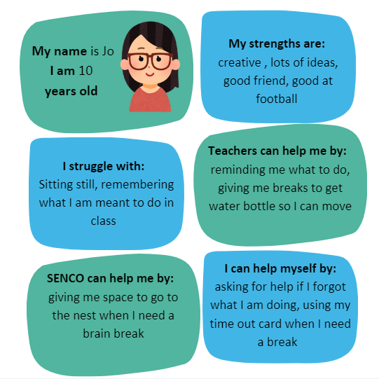
Personalised Passports
Co-created document with input from the young person and the school
Distributed to all school staff members
Recognizes the unique strengths and challenges of the young person
Outlines how various individuals can assist the young person
Highlights ways the young person can support themselves
Notes:
Lots of schools have their own version of personalised passports, the important things to keep in mind are they should be a document that is co created with the young person and a trusted member of staff who understands the classroom environment and the child’s special educational needs.
They should have a focus on the child's strengths and positive traits.
A good school passport will acknowledge not just a diagnosis but the individual difficulties that child has , not all kids with ADHD are the same.
It should outline what can be done to help the young person and who’s can do those things. Including what the young person can do for themselves.

Slide 33
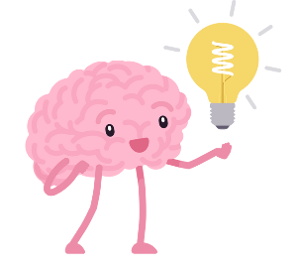
Ending Reflection
What special skills does your child already have to manage their ADHD
Following today what do you think would be helpful for them to use
Notes:
In the work booklet there is space for parents to joint down these reflection. If there is time ask them to share.

Slide 34
Websites
Where we got our information:
https://www.cdc.gov/adhd/data/?CDC_AAref_Val=https://www.cdc.gov/ncbddd/adhd/data.html
https://www.adhdcentre.co.uk/female-vs-male-adhd/
https://www.additudemag.com/gender-differences-in-adhd-women-vs-men/
https://neurodivergentinsights.com/misdiagnosis-monday/adhd-vs-adhd
Useful websites
Right to Choose - ADHD UK https://adhduk.co.uk/right-to-choose/

