Slide 1
Understanding the impact of trauma on young people and how together we can help them recover
Supporting Trauma Recovery
Sarah Matthews, CAMHS Lead for Children in Care

Slide 2
Working with trauma and intergenerational trauma
Seems turned off
“I expect crisis, danger and loss”
“No Place is Safe”
‘All or nothing’ thinking
“my own feelings are unsafe”
Low self esteem
Appear manipulative
Difficult to engage
Irritable, easily agitated, angry
Hopeless, powerless
Feel like they are being targeted
Impulsive and reactive
Basic mistrust of others
Non-compliant
Difficulty getting motivated
“other people are unsafe and cannot be trusted”
Pessimism about the future
Adapted from Wave Trust 2009
Notes:
Working with traumatised parents as well as traumatised children means you will need to be doubly thoughtful about body language, tone and how you communicate
Do you identify with any of this – what seems familiar to you
Here is an insight in to the types of behaviours and thought patterns that are common among traumatised people:
Credit Wave trauma informed training
What is trauma? prior to next slide

Slide 3
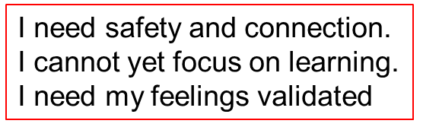
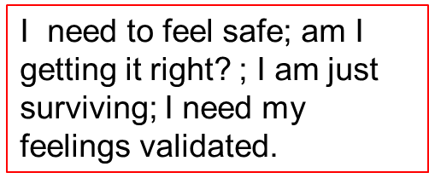
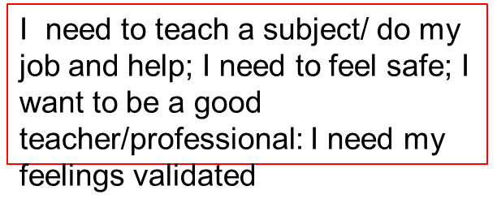
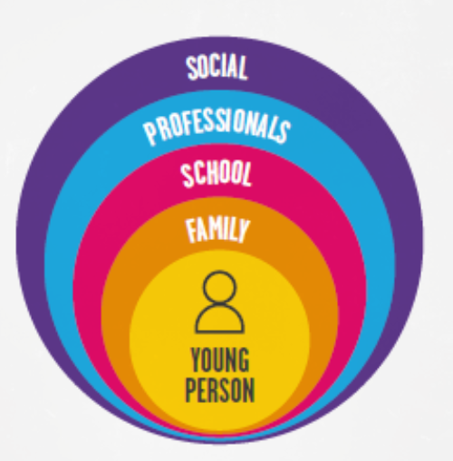

What are the child’s and adult’s experiences currently?
It is highly unlikely when working with young people with complex difficulties who may have experienced significant adversity, that a single intervention or agency will provide a single solution. In general, complex situations require complex solutions and good cross-agency collaboration focused on achieving consensus is likely to have the most productive results..
Notes:
The network around a YP can often be very anxious and want the YP ‘fixed’ or diagnosed. The YP lives within a context that impacts
Open to audience again – where are you and your young person at

Slide 4
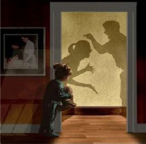
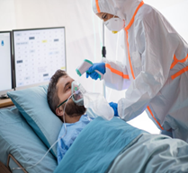
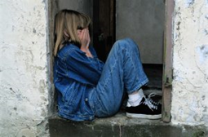
What is Trauma ?
A psychological trauma can occur when a child experiences either a single event or long lasting or repeated events that are so overwhelming it affects their ability to cope or make sense of what happened.
Examples of traumatic events include:
Natural or man-made disasters, war
Serious accidents i.e. road traffic collision
Illness of self and others
Bullying
Loss and grief
Experiencing or witnessing violence
Physical, emotional or sexual abuse
Neglect
Notes:
Ask the question – what is trauma – working in the nhs in camhs – feels traumatic!
Is being neurodiverse in a neurotypical world traumatic?
Covid? Living with uncertainty at all times, no one has the answer?

Slide 5
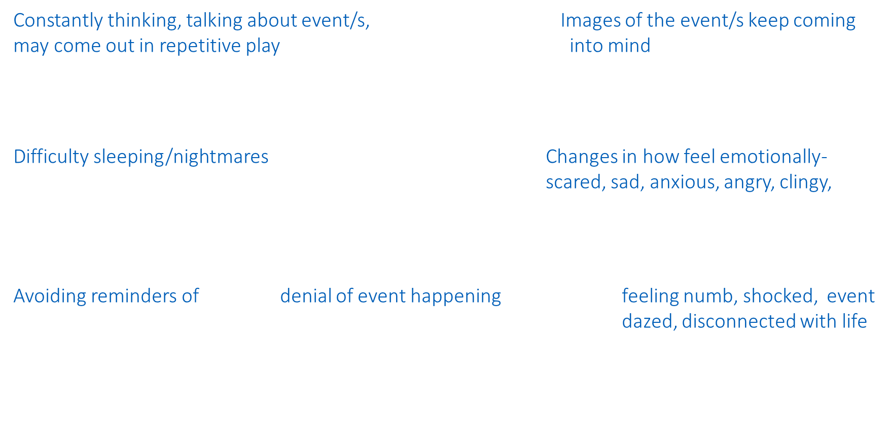

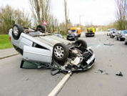

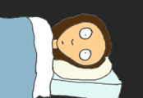




Typical reactions after a traumatic event

Slide 6
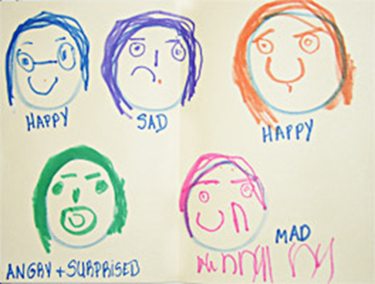
Typical feelings after trauma
Anger: About what happened to them and any others involved
Guilt/shame: That they could/should have done something to prevent it/were to blame/ they survived when others suffered or died/that they are intrinsically bad so that is why this bad thing happened to them
Frightened: That the same event may happen again/unable to cope with their feelings/not in control of what is happening in their life
Helpless: Unable to do something about what happened
Sad: That the trauma happened and someone was hurt/died, especially if they
knew/loved them
Ashamed/
Embarrassed: By what happened/cannot tell anyone about it
Notes:
It is common to experience distress after a traumatic event. In most case the emotional reactions get better over the days and weeks that follow the trauma. Children may not have the words to tell you what they feel, but often comes out in behaviour:

Slide 7

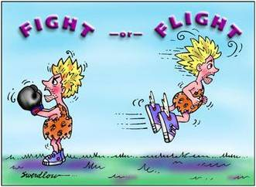
Key Signs and Symptoms of PTSD
Re-experiencing intrusive/flashback memories
Difficulty falling/staying asleep
Difficulty concentrating
Hypervigilance to danger/threat
Fight Response: fighting the danger or threat. Feelings of irritability, anger, agitation. Behaviour aggressive, oppositional, confrontational or defiant.
Flight Response: fleeing, escaping, avoiding the danger. Feelings of panic, anxiety. Behaviour running away, disappearing, hiding, avoidant.
Freeze Response: becoming tense, still, silent in response to danger. Feeling of anxiety, fear. Behaviour exaggerated startle response, distracted, confused, forgetful
Flop Response: mind and body shutting down in response to danger. Feelings- overwhelmed, hopeless, low. Behaviour- body becoming loose and floppy, low energy, withdrawal, isolation

Slide 8
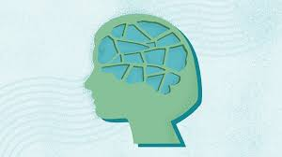
Post Traumatic Stress Disorder diagnostic criteria- present for over 1 month post event/s
Intrusions or re-experiencing of the event (such as intrusive memories, repetitive play in which the events or aspects of it are expressed, nightmares, flashbacks, distress triggered by reminders of the event or events)
Avoidance (avoiding thoughts, feelings or memories of the event or events, or avoiding people, places, conversations or situations that are associated with the event/s).
Arousal and reactivity or sense of current threat (such as irritability, being overly vigilant, being easily startled, concentration problems, sleep problems).
Exaggerated negative beliefs about themselves, the world or other people;
Having distorted thoughts about what caused the event or events and the consequences;
Persistent negative emotions;
Less interest in significant events;
Feeling detached or estranged from others and finding it impossible to experience positive emotions.
Notes:
Information purposes

Slide 9
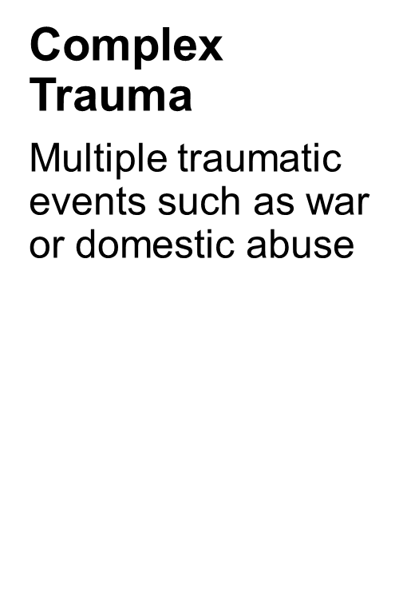
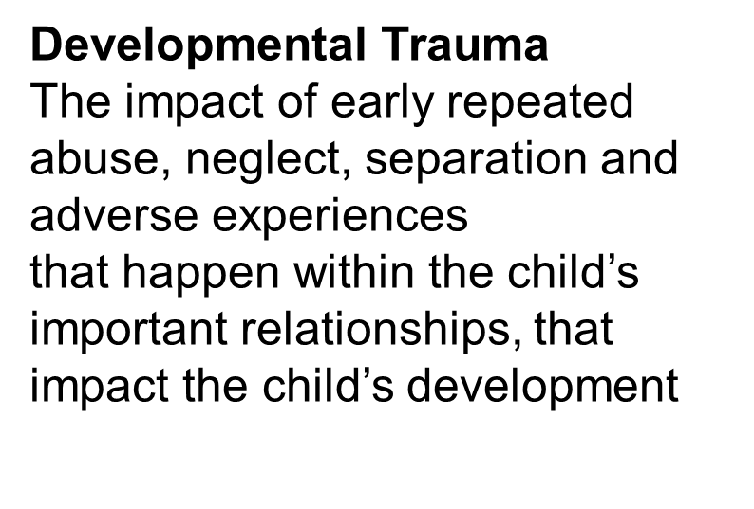

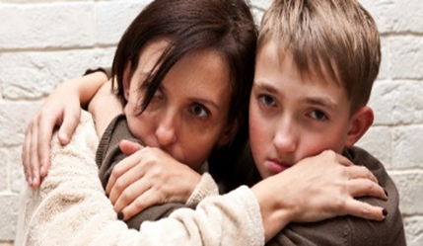
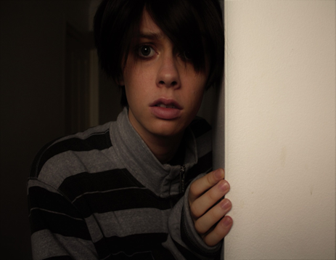
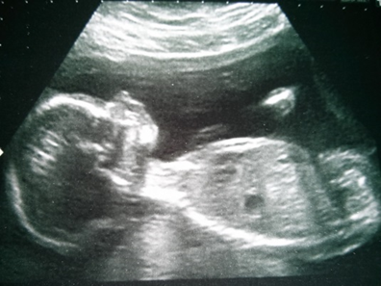
Traumatic Experiences
Notes:
Distinction - Difference between impact of trauma on development – cf to mental health diagnostic – the mental health impact of trauma
Complex trauma
Usually relational with longer impact e.g War, Domestic violence for parents, multiple traumatic bereavements etc
Developmental trauma is more likely to occur when a birth mother:
Was in a violent relationship
Used alcohol or substances
Had own trauma history
Had serious mental health problems
Trauma in Utero
This can occur in spite of the child growing up within a ‘safe’ (stable, contained and getting needs met) environment
Baby is hard wired to be over sensitive to life’s stresses. The body holds the memory and even if child is then in a safe place, their development can be impacted

Slide 10
Complex PTSD- additional symptoms
Problems in affect regulation (such as marked irritability or anger, feeling emotionally numb)
Beliefs about oneself as diminished, defeated or worthless, accompanied by feelings of shame, guilt or failure related to the traumatic event
Difficulties in sustaining relationships and in feeling close to others

Slide 11
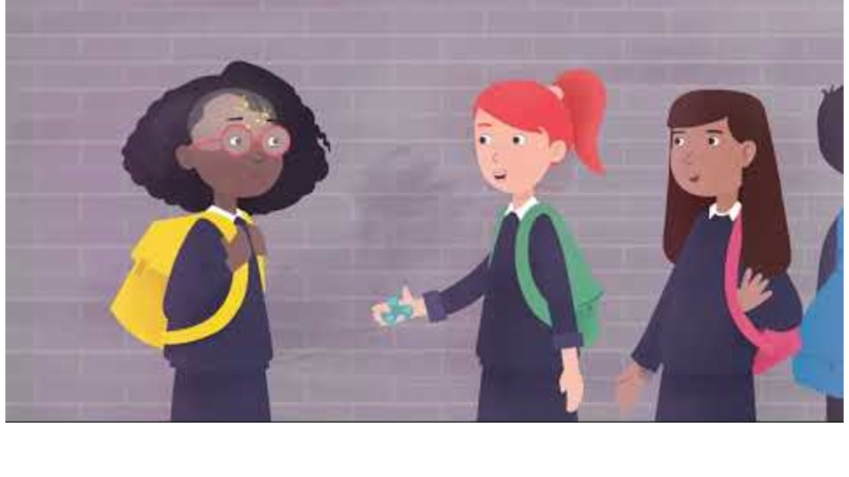
https://youtu.be/xYBUY1kZpf8?si=zAis-e7ZFdO_P98E

Slide 12
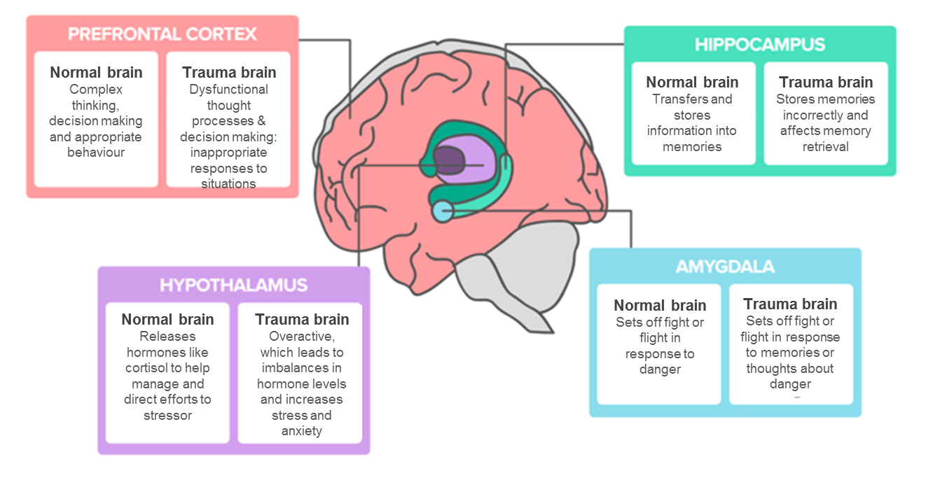
How trauma affects the brain
https://www.youtube.com/watch?v=6sZFq2K363A Van der Kolk- 3 ways brain is changed
Notes:
Understanding where a child is at in terms of functioning is crucial in assessment and planning interventions. Often cognitive part of brain is underdeveloped /’offline’ when not feeling safe/experiences of significant trauma

Slide 13
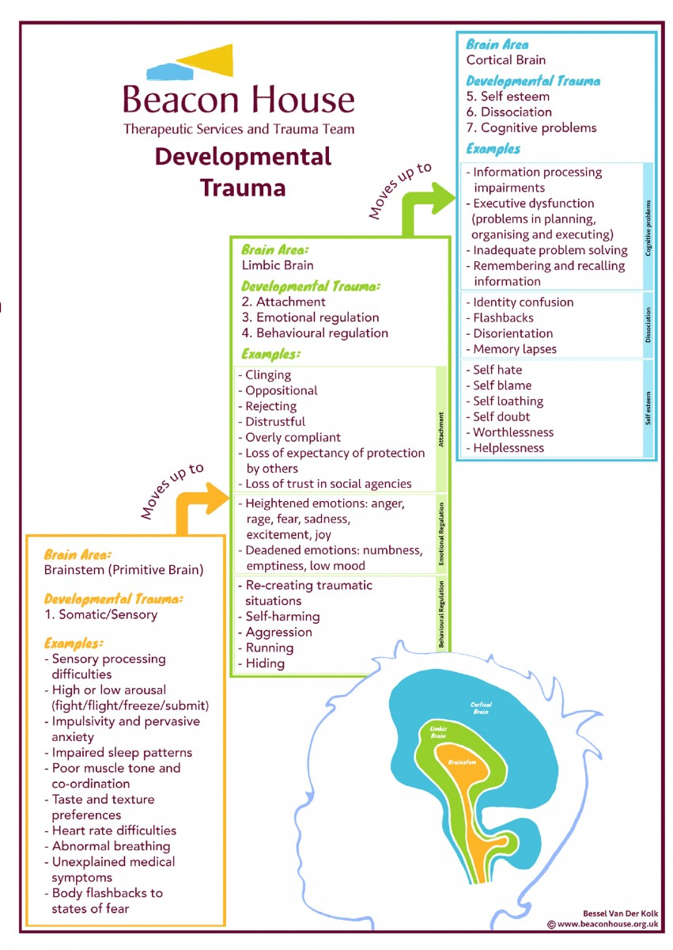
Notes:
Use whiteboard

Slide 14
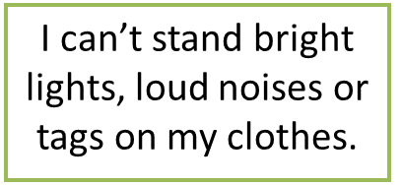
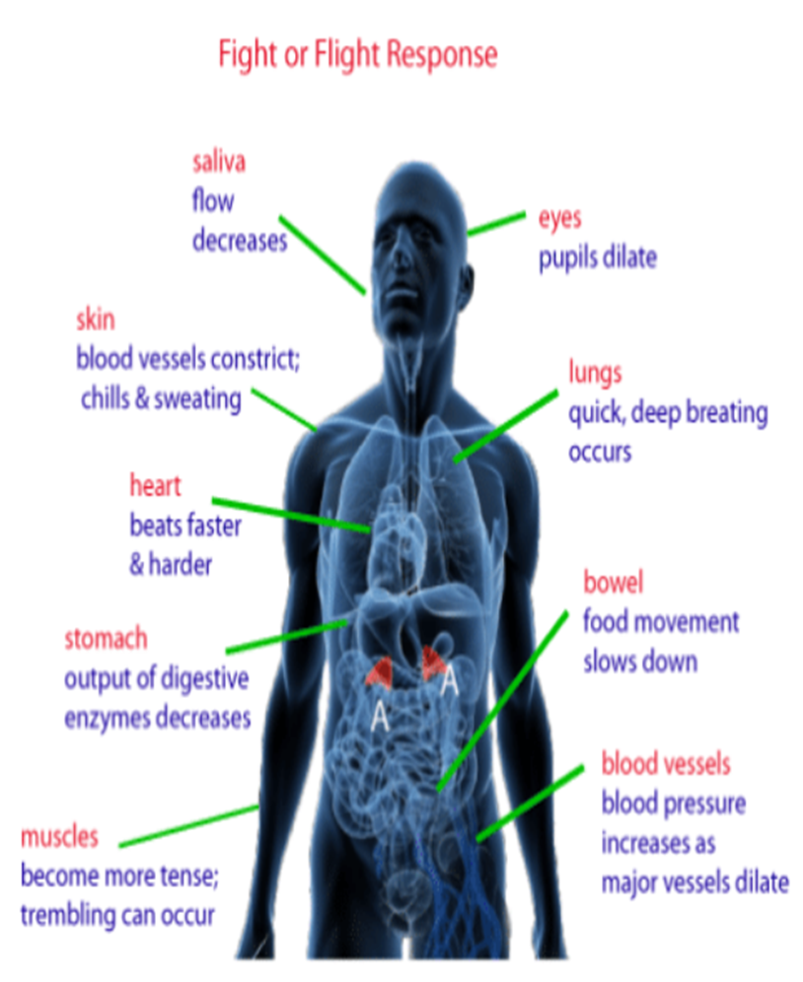
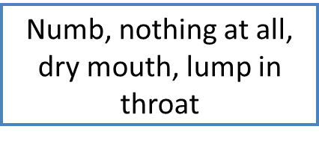
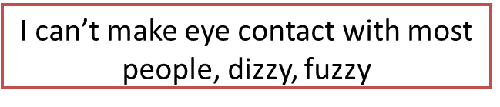
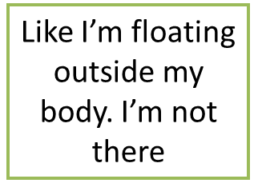
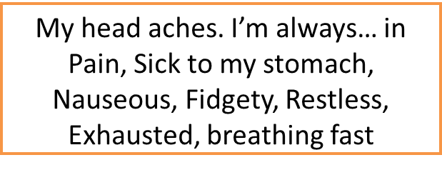
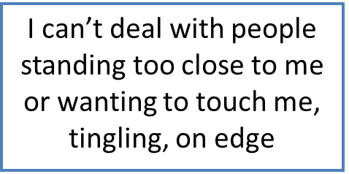
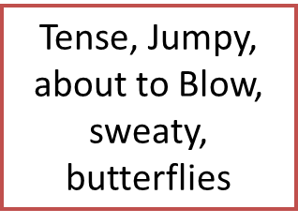
Physical Response to Trauma
I may struggle with chronic constipation and overflow diarrhoea

Slide 15
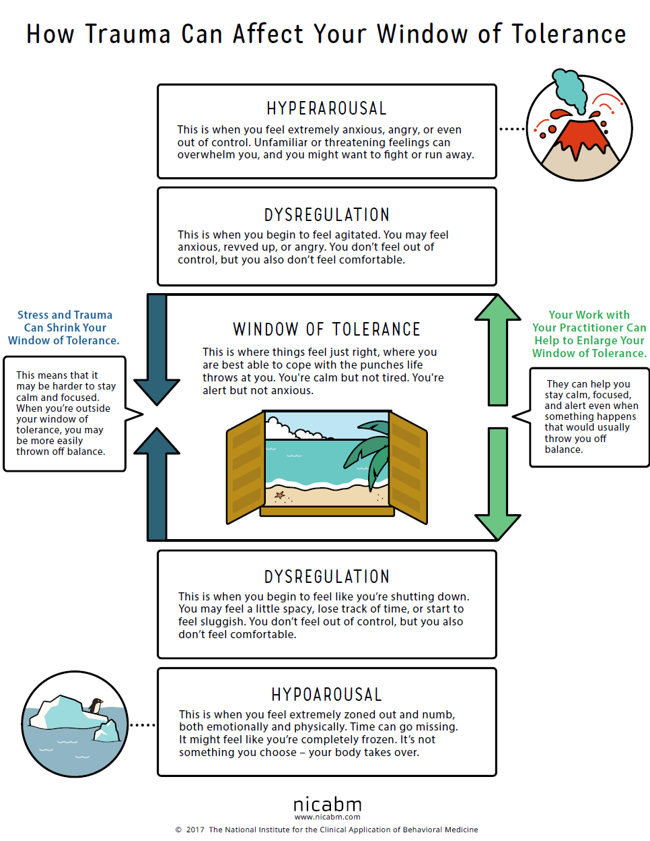
https://youtu.be/py8deTlxNco Trauma and the brain- hand model/upstairs downstairs brain
Window of tolerance
Notes:
Staying in your window of tolerance when your child/yp is dysregulated is also very important

Slide 16
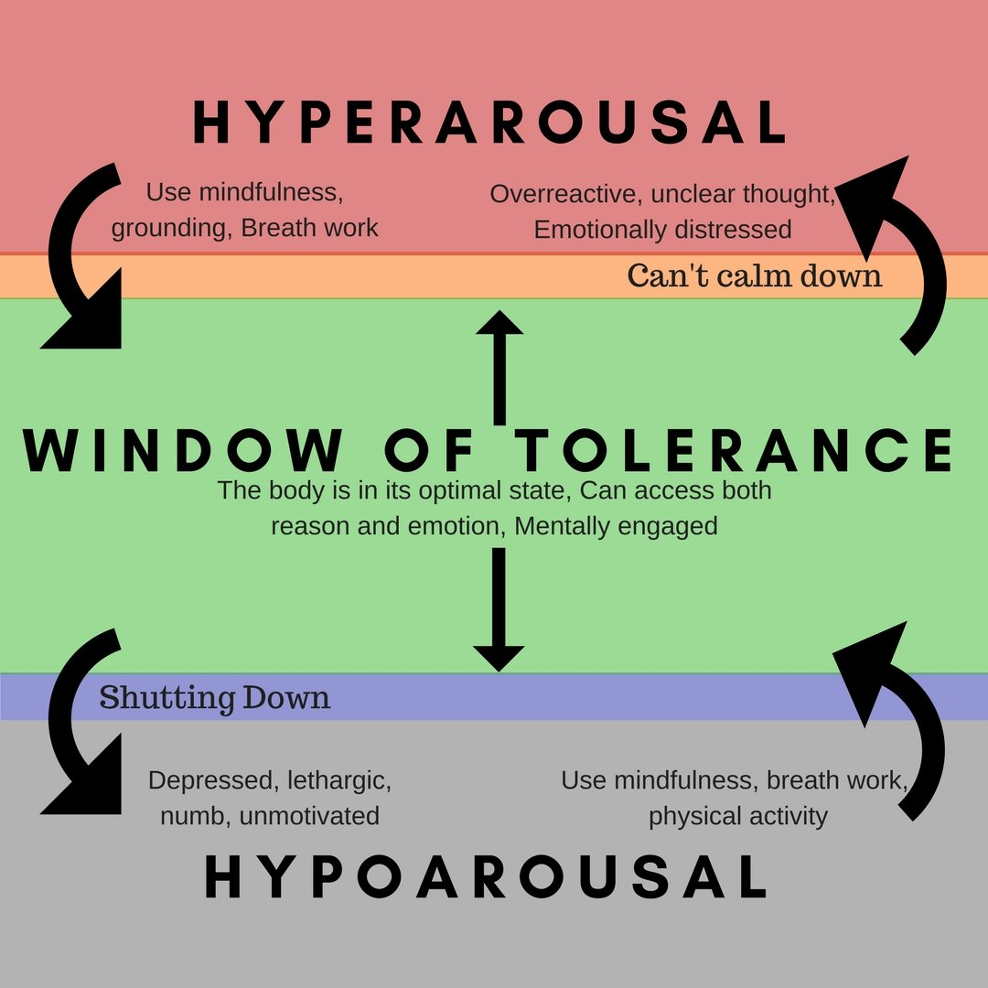
FEELING TOO MUCH? CALM DOWN USING SOOTHING ACTIVITIES:
Breathing exercises, calming smells, gentle movement and stretching
Soothing music
Change your temperature use a fan or cold drink or splash water
FEELING TOO LITTLE? WAKE UP USING ENERGISING ACTIVITIES:
Energising smells, exercise
Stand up, move your body
Mental stimulation, notice 3 things you can see, hear and feel
Change your temperature use a fan or cold drink or splash water

Slide 17

Triggers/overactive alarm
Our brains recognise danger signals, particularly to past threats and prepare us to respond. ‘False alarms’ can happen when we see/feel something that reminds us (trigger) of a past event that was frightening and causes the body to feel unsafe again.
Common triggers to notice for children :
Raised voices, shouting
Unpredictability/change in home/school routine
Transition from 1 activity or setting to another
Loss of control- e.g not be allowed to be in control of a game
Feeling vulnerable/rejected
Confrontation, authority, limit setting
Loneliness
Sensory overload- too much stimulation from environment
Specific smell, taste, touch

Slide 18
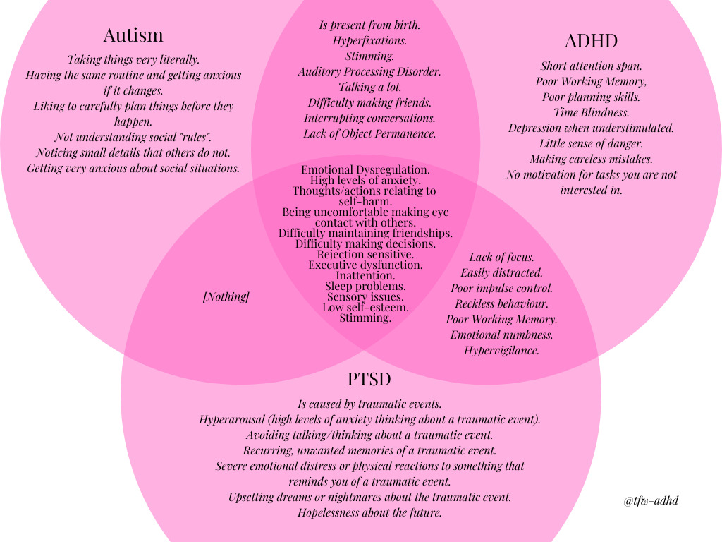
Trauma/Neuro Developmental/both
Notes:
Complex ptsd crossovers more- hard to distinguish without knowing background of ‘what happened to you’- how did they have to adapt to survive and what are they still doing?

Slide 19
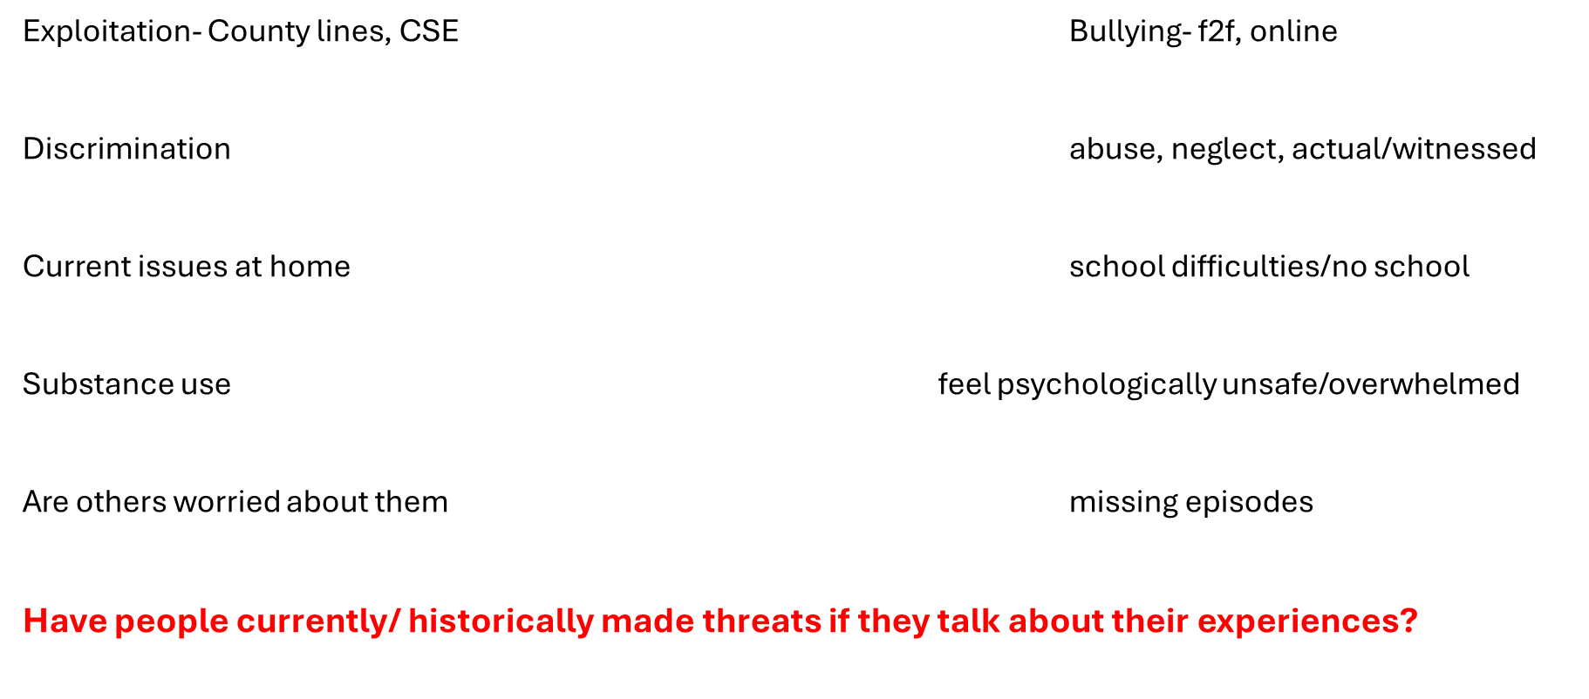

Consider safety first- are they physically safe?
Notes:
A lot of kids won’t talk about these experiences, is it ok to ask them if anyone has anyone ever threatened you or your family to get them to do something

Slide 20
Where are you at? Where is Yp at ?: Start with safety
Explore Trauma, Mourn Losses
Resilience and Resources:
Self Esteem and Identity
Empathy and Reflection:
Managing Behaviour in Relation to Others
Comfort and Co-regulation:
Eliciting Care from Relationships
Developing Relationships
Feeling Safe
(Physically and Psychologically)
Resilience
Empathy
Comfort and co-regulation
Relationships
Safety
Kim Golding, 2007

Slide 21

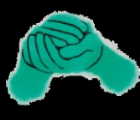
Sense of Safety
Sense of Calm
Sense of Connection
Sense of Control
Sense of Hope
Five principles
to guide the
environment
for recovery
from traumatic
events
(Hobfoll et al., 2007)
Notes:
How do you create a sense of safety : traumatic event can leave you feeling world is unsafe even is it currently is. Meet basic needs first, establish routines and familiarity, maximize consistency ( eg staff, timings, environment), be reliable and trustworthy, monitor any traumatic info via Social media etc, help YP have accurate info, make sense of and have opportunities to talk but also respect avoidance. Remain calm, compassionate, curious
How do you create a sense of calm: traumatic events can leave people feeling on high alert to danger all the time. We can help by providing a calm environment- if possible, areas where not overstimulating/noisy- quieter area, calm communication, calming techniques if overwhelmed- grounding, sensory, physical, playful
Connection: traumatic events can leave people feeling isolated and alone. Social supports and attachments are protective factors for recovery. Look for opportunities for social support and connection: peers, parents/carers, family, teachers, staff, sports coaches, clubs
Sense of control: traumatic events leave people feeling they have any control over things that happen around them. Collaborate and provide choices, teah emotional regulation, attend to what they can do, help independence- doing things for self, manage expectations- be transparent
Sense of Hope: Traumatic events take away a person sense of hope for the future ; don’t dismiss their concerns but listen, be curious about worries and help rebalance them- draw attention to skills, strengths and small steps, weave in some positive future focus.
Do a white board

Slide 22




A playful approach can help you to feel someone is alongside you and can add enjoyment when things are tough
When someone accepts your experiences and the reasons for your behaviour, this can you feel safe. Non- judgemental approach.
Someone being curious about your feelings and behaviour can help you feel understood and help you make sense of difficult feelings and experiences ‘I wonder’
Having support helps you to feel you are not alone, someone who can be with you in the darkest places, you can then think safely about past and current experiences.
https://youtu.be/1Evwgu369Jw
Playfulness
Acceptance
Curiosity
Empathy
Notes:
Dan Hughes- explain why PACE
Brene Brown Empathy video

Slide 23
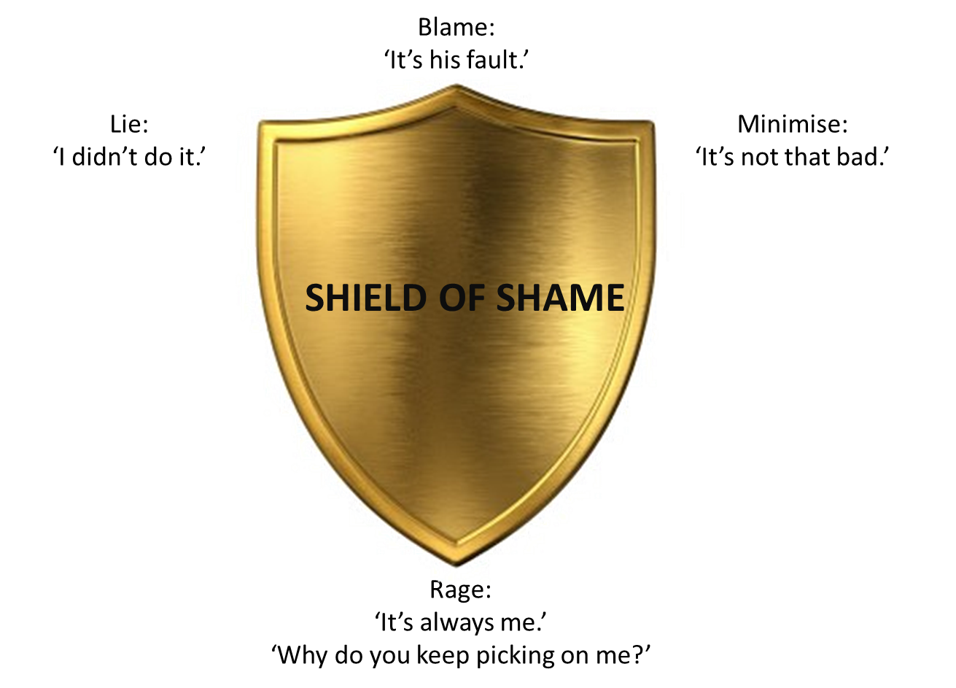

Parents/adults try to provide nurture , behavioural support, guidance and teaching…………..however the impact of complex trauma and on children means……..
I am afraid you will reject me
I need to be in charge so I feel safe
I have learnt adults are not to be trusted
I cannot be good enough for you

Slide 24
Behaviour management approaches……………………….
Focusing on behaviour , does not help a child build trust in the relationship and safety
Without a solid relationship, can be shame inducing. This prevents the experience of guilt so children cannot feel remorse or learn to make amends
Represents an evaluation. Children experience disproval of self not behaviour, triggering shame. If rewarded they fear they cannot sustain this, triggering anxiety and shame about being found out to be bad really.
Consequences may feel like loss of relationship. Love is conditional and can be lost. Children expect this and discipline triggers fears of abandonment.
Focus on predictability and consistency, so that a child learns cause and effect. If a child has grown up in a chaotic, unpredictable environment they cannot make sense of cause and effect. A consequence will be experienced as a parenting being mean to them as not linked to the cause.

Slide 26
Connect to Calm………………Connection before Correction
Third: We can
support the child to
reflect, learn, remember,
articulate and become
self-assured.
Heading straight for the 'reasoning' part of the brain with an expectation of learning,
will not work so well if the child is dysregulated and disconnected from others.
Second: We must relate
and connect with the child
through an attuned and
sensitive relationship.
First: We must help the child
to regulate and calm their
fight/flight/freeze/collapse
responses.
Dan Siegel - Connecting to Calm

Slide 27



Trauma can make children and young people experience a range of feelings. These can be exhausting and overwhelming. These include feeling … SLOW AND TIRED – you feel tired, droopy, heavy FAST AND EMOTIONAL – your body moves super-fast, heart races, noises are louder, objects are brighter FAST AND WIGGLY – you have lots of energy and feel you need to move Children may experience all of these feelings in one day and these feelings may feel out of your control. There are, however, helpful exercises you can use to regulate these feelings. These are simple but very effective.
Self Regulation
1. HUG - Give yourself a tight hug; squeeze each arm as you do this
2. ARM MASSAGE - firmly squeeze your arms from your shoulders to your wrists.
3. FINGER PULL- lock your two hands together by your finger tips and hold for ten seconds
4. PALM PUSH – Push our palms together and hold for five to ten seconds
5. WALL PUSH - Push your hand against a sturdy wall, using all your body
6. JUMPING JACKS – jump up and down moving your arms and legs up and down making star shapes
7. TAKE SPACE – take some alone from others and stressful situations
8. BUTTERFLY PAT – cross your arms and pat each arm or shoulder one by on.

Slide 28
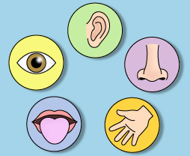
Grounding
What is Grounding?
Grounding is a technique that helps keep someone in the present. Sometimes when we feel overwhelmed or experience traumatic events we can almost feel out of touch with our surrounding or feel not present in the moment. This can often feel scary and can make it very difficult for us to do daily activities and engage with other people. Grounding ourselves in these moments can be very helpful in giving us some control over our thoughts and feelings.
Grounding technique
When we cannot change a situation or experience but feel overwhelmed by upsetting thoughts, images or very uncomfortable feelings, our five senses are a great tool to help us do something in the moment to manage
5 | Five THINGS YOU CAN SEE (notice shapes, light, shadows, colours of the things you see)
4 | Four THINGS YOU CAN HEAR (Notice how loud, soft, close the sounds are, where are they?)
3 | Three THINGS YOU CAN TOUCH (notice the temperature, texture, feel of objects you can touch)
2 | Two THINGS YOU CAN TASTE OR SMELL (notice the tastes and smells of the place you are in)
1 | One LONG BREATHE (pay attention to your breathe, notice how this feels)
You can do on your own or with someone else. If one step is too hard, go on to the next.

Slide 29
Sensory self soothe kit and safe/calm space
Notebook, pens
Mindful colouring
Essential oils
Bubbles- increases deep breathing
Weighted blanket
Fidget/squishy toys
Ice pack- feel grounded, present
Crunchy/chewy food
Space at home/school that feels calm
With sensory soothe kit items

Slide 30
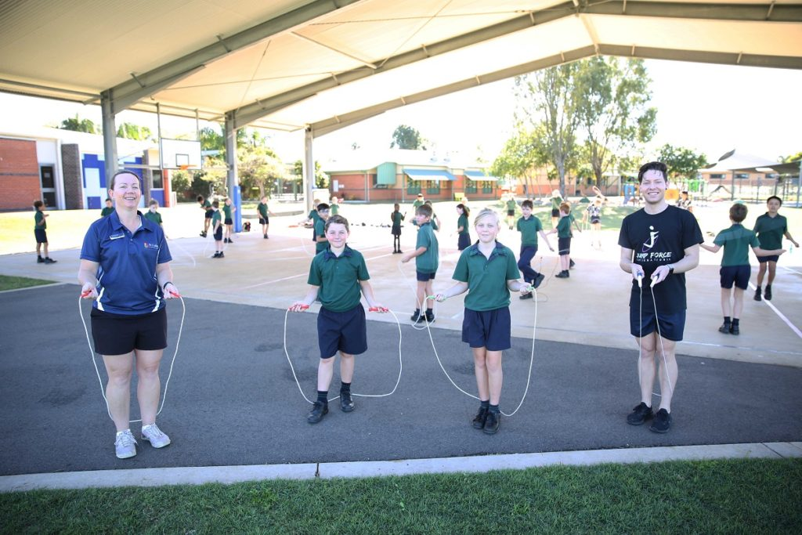

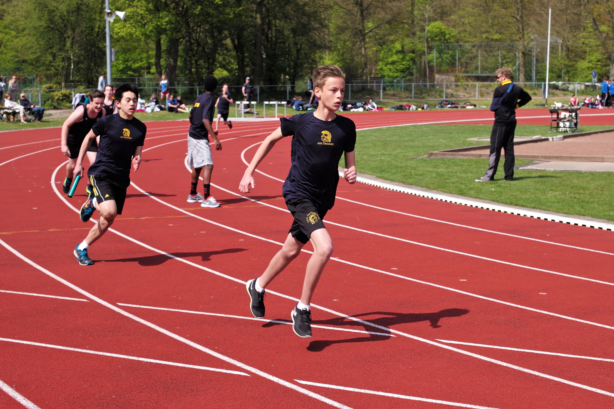

Brain stem calming activities
Walking
Dancing
Running
Trampolining/jumping
Skipping
Movement
Stretching/rocking
Drumming
Tapping
Singing
Music
Breathing
Yoga
Weave into everyday routine individually or as whole family, class activity

Slide 31
Resources
Resources - UK Trauma Council
ChildhoodTraumathBrainSocialWorldv1.0.pdf
https://beaconhouse.org.uk/resources/
https://hampshirecamhs.nhs.uk/videos-podcasts/
Trauma and the Nervous System: A Polyvagal Perspective - YouTube

