Slide 1
The slides for this presentation and a top tips sheet are all available for download on our website: https://HampshireCAMHS.nhs.uk
This session has also been filmed and is available to watch on our website.
You will find this on the Videos page and in the relevant Mental Health issue page.
Please do your feedback form as it helps us to keep sessions relevant and useful.

Slide 2
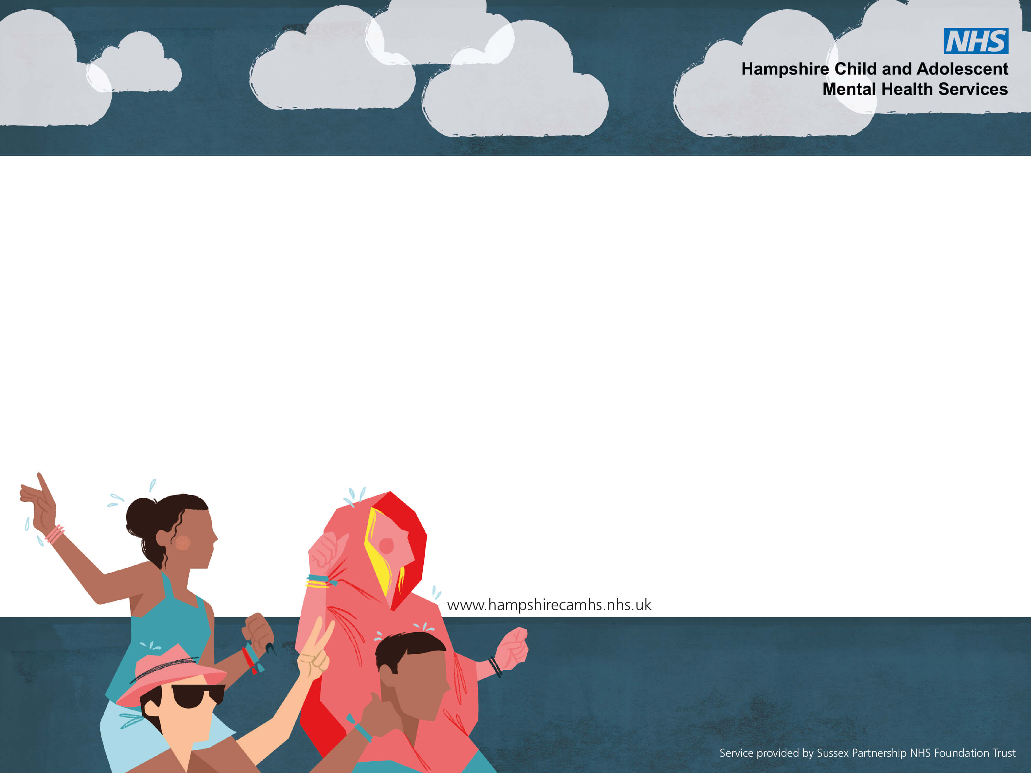
Understanding & Managing Anxiety

Slide 3
Today’s Session will cover
What is anxiety?
Signs and symptoms
Strategies to manage anxiety
Resources

Slide 4
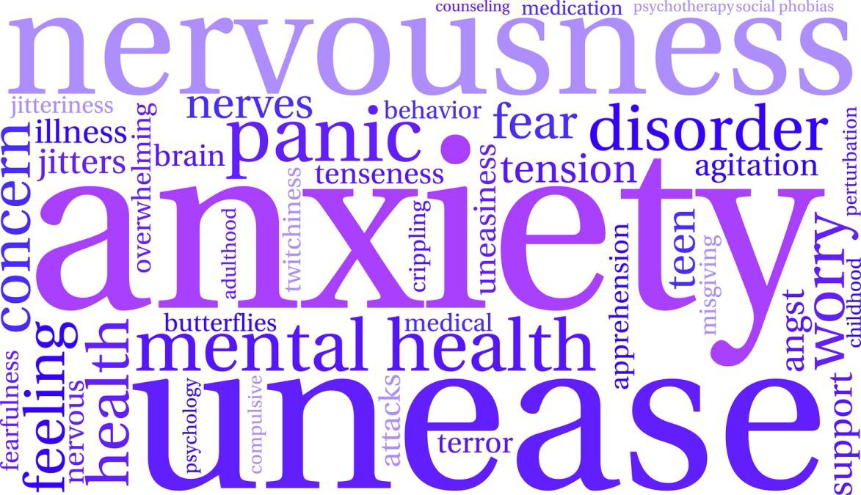
What is anxiety?

Slide 5
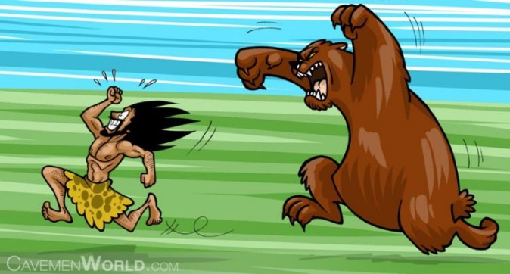
Why do we get anxious?.
Anxiety keeps us safe. Picking up danger – we’re good at it!
Like all mammals our bodies have evolved to always be alert to potential threat.
Anxiety helps us communicate distress as the first course of action if safe to.
It motivates us to act
Anxiety has been bred into us over thousands of years as an adaptive survival strategy. In other words: IT’S NORMAL
https://www.youtube.com/watch?v=YemitZJBT1Y
Notes:
Anxiety is a good thing

Slide 6
How do we get anxious?

Slide 7
Our Internal Alarm system

Slide 8
Social context is important
Babies may respond to ‘frightening’ noises coming from parents but learn not to fear it.
How?
https://www.youtube.com/watch?v=HX8mIHeuaf0
Through play and social interaction babies learn how to hold feelings of fear while still discovering, exploring and expanding their experiences and abilities.

Slide 9
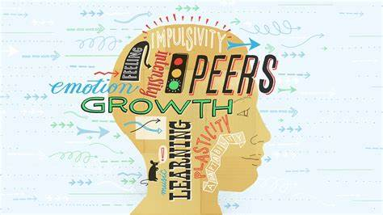
The developing brain is important

Slide 10
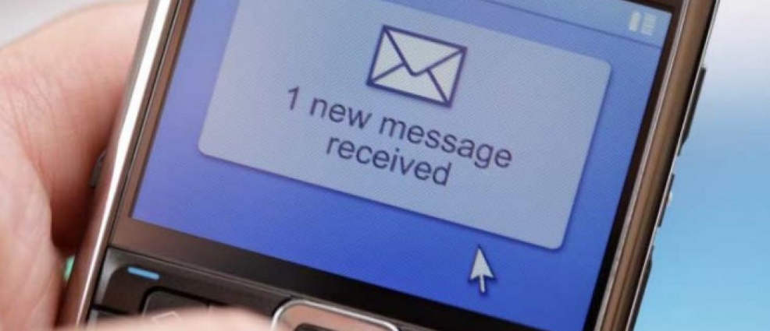
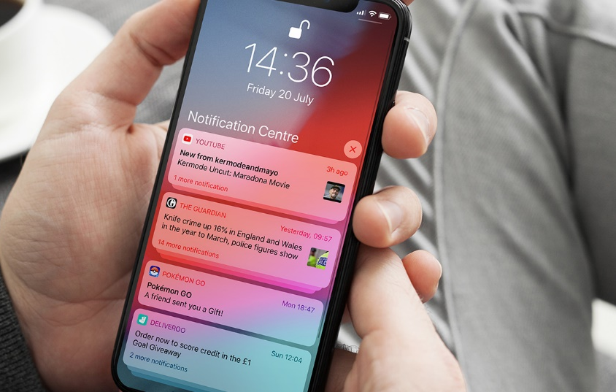
Our bodies are on the lookout constantly and alert us to potential incoming threat signals to ‘protect’ us from danger.

Slide 11
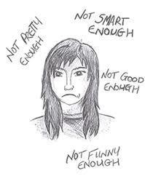
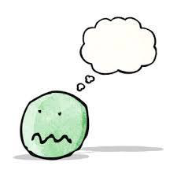
Triggers
A social event e.g. a party, peers
An upcoming performance e.g.
exams, school play, sports days
Specific phobia, e.g. spiders, dogs
Social media, the news
Going away, separation from parent
New situations
Sensory overload
Worries about everything and anything: ‘what if…?’

Slide 12
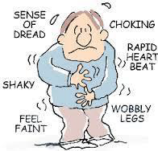
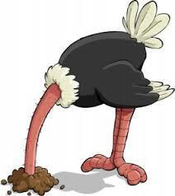
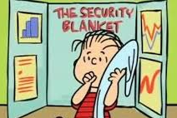
Signs of anxiety
Thoughts
Physical Feelings
Behaviours

Slide 13
When is anxiety a problem?
When it keeps showing up and getting in the way of doing what you need to do
e.g. going to school.
And doing what you want to do
e.g. go to a party with your friends.
It starts to affect the whole family

Slide 14
Why does anxiety keep on
showing up?
Problems stick around because how we think, feel and behave MAINTAINS the original anxiety.
We might not always know what caused anxiety but we can understand it by looking at the links between our thoughts, feelings and behaviour – what we do.

Slide 15
HOT CROSS BUN MODEL of ANXIETY
Thoughts: Everyone is looking at me, they will think I’m stupid, they all know the answer, I’m stupid.
Situation: Jess didn’t understand something in class and wanted to ask a question:
Behaviour: Look down, try to be invisible, not get on with work, escape if anxiety too much.
Feelings:
Anxious, sad
Physical sensations: heart racing, breathing shallow, nervous stomach, clammy hands, go red, hot.
Vicious cycles

Slide 16
Anyone willing to have a go?
Situation: Waving to Ben across the street
Thoughts:
Behaviour:
Feelings:
Physical sensations:
Vicious cycles

Slide 17
What can you do about it?

Slide 18
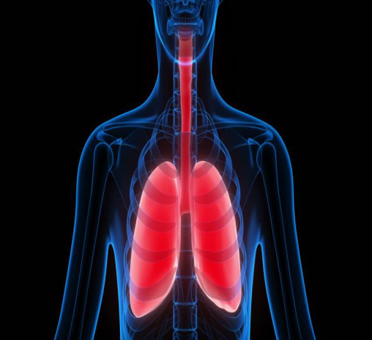
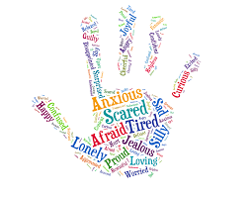
A.N.D Firstly
Aware
DESCRIBE the feeling:
NAME: the
body’s
message

Slide 19
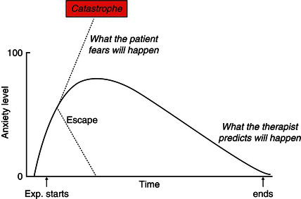
Test things out a little at a time
Very Scary
What you think will happen
Quite Scary
What actually happens
A little Scary

Slide 20
Confront the fear until anxiety has reduced by half, without distraction.
Remember - It is the child's ladder, only move up the ladder when the child is ready!

Slide 21
What can you do to support someone with anxiety?
Encouragement and praise for managing difficult situations.
Use rewards for achievement
Provide reflections to develop insight e.g. I wonder if you are feeling worried about the party next week?
Model facing fears or that a situation can be mastered- we know children learn from how others around them respond to situations
Be on the lookout for ‘have a go’ behaviour
Normalise anxiety for them
Allow independence and encourage problem solving

Slide 22
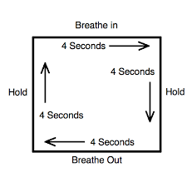
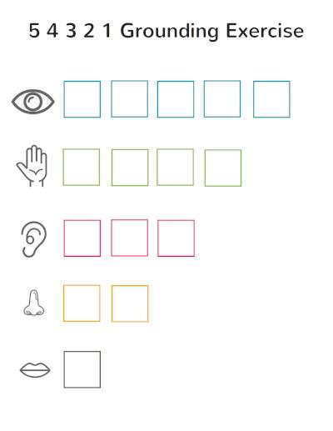
Stress Reduction…
Breathing overrides to body’s stress response and brings rational thinking back on line.
We need to come back to our senses
There are many apps and websites with scripts to download- it’s worth trying a few to see which work. Remember not everything will work for everyone

Slide 23
Thinking strategies
Identify the worry / anxious thoughts.
Encourage the young person to question it’s accuracy:
is it Fact or fiction? What’s the evidence for and against the thought?
If ‘always’ or ‘never’ are a part of the thought - Are there times when it hasn’t happened?
Think of examples of alternative, rational thoughts.
What would they say to a friend with the same worry?
Aim – create flexibility
Again, there are many resources to help with this.

Slide 24
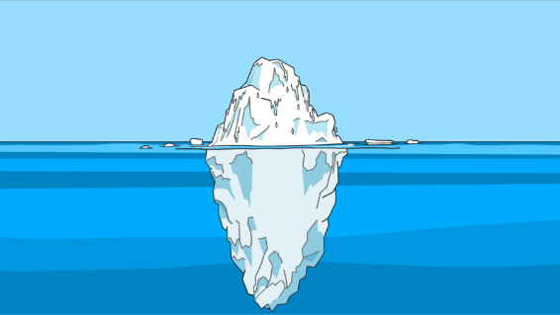
Neurodiversity and Anxiety
For any child or young person experiencing anxiety we should:
Help them to understand how to label and identify thoughts, feelings and behaviours
Consider if there is anything in the environment contributing to anxiety that can be changed
Make adaptions to strategies to meet their individual needs
Go at their pace
Focus on their strengths, goals and interests

Slide 25
Young person’s views on
managing anxiety
https://www.youtube.com/watch?v=l7g8Atv27Q8
Managing Worry and Anxiety for Kids - Flocabulary

Slide 26
Visit our Parent and Carer section – Hampshire CAMHS Website

Slide 27
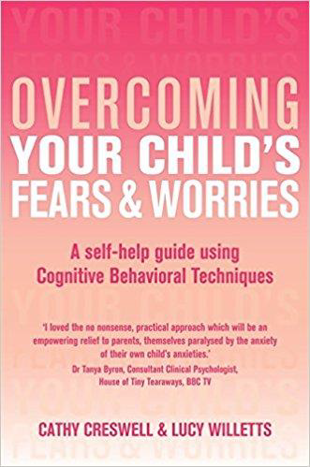
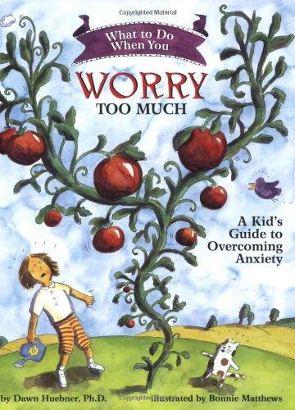
Websites
Hampshire CAMHS
www.anxietyBC.com
www.moodjuice.scot.nhs.uk
www.youngminds.org.uk
www.getselfhelp.co.uk
Books
Overcoming your child’s fears and
worries – Cathy Creswell and Lucy
Willetts (particularly for parents
with children under 12 but the
strategies could still be useful)
What do to when you worry too much Dawn Huebener
Resources

Slide 28
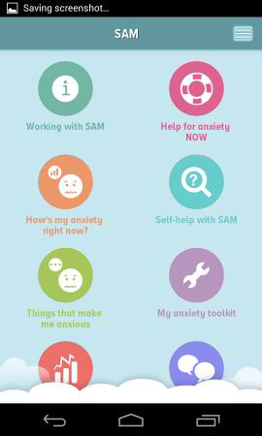
Various APPs
Mindshift
Headspace
Self help for anxiety management (SAM)
Worry Box
What’s up – The Mental Health App
Please see our leaflets at the CAMHS stand for more details

Slide 30
The slides for this presentation and a top tips sheet are all available for download on our website: https://HampshireCAMHS.nhs.uk
This session has also been filmed and is available to watch on our website.
You will find this on the Videos page and in the relevant Mental Health issue page.
Please do your feedback form as it helps us to keep sessions relevant and useful.

