Slide 1
Introduction to ADHD
Parents and carers event
Senior Nurse Practitioner and Non-Medical Prescriber

Slide 2

Housekeeping
Collect a handout with helpful links
Please complete the feedback form at the end – This helps us improve based on your feedback and demonstrates the need.
If you score less than a 6 – please tell us why!
Please be respectful of the other parents and staff in the room
Fire exits
Toilets
If you have any further questions, please visit the CAMHS stand or the person on the PACE reception desk.
You can download the slides from the Hampshire CAMHS website
Notes:
PACE 25 September 2024 – CAMHS
You can download the slides from the Hampshire CAMHS website
We have handouts for you with links to information
Please complete the feedback form – this helps us improve based on feedback and also demonstrates the need.
If you score less than a 6 – please tell us why!
If you have any further question’s please visit the CAMHS stand or the person on the PACE reception desk.

Slide 3
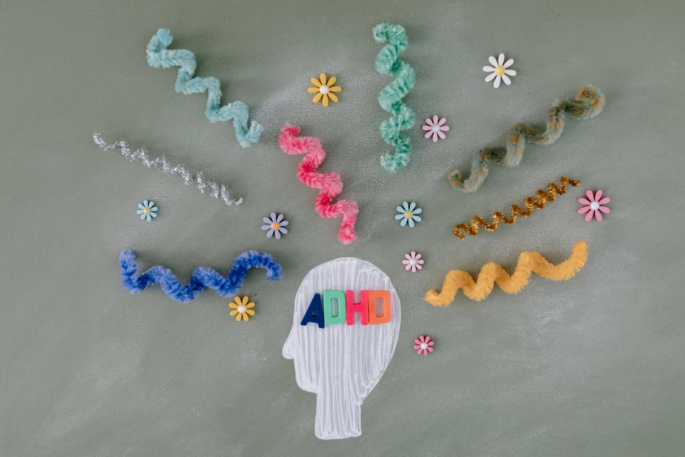
Agenda
What is ADHD
What does it look like?
Referral process
Assessment process
Alternative diagnosis
Support following assessment
Signposting

Slide 4
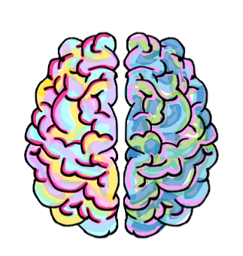
What is ADHD?
Attention Deficit Hyperactivity Disorder
Is a common and chronic, neurodevelopmental disorder that affects a person’s ability to focus attention, regulate activity levels and control their impulses. Occurs across the lifespan
          Three subtypes:
          1) ADHD combined type
          2) ADHD predominantly inattentive subtype type
          3) ADHD predominantly hyperactive-impulsive type
Let's talk about ADHD (youtube.com)
Notes:
Video link: Let's talk about ADHD (youtube.com) https://www.youtube.com/watch?v=YeamHE6Kank&t=42s

Slide 5
Combined ADHD
Inattentive Subtype
Distractibility
Forgetful
Losing things easily
Struggling to concentrate
Struggle to focus
Struggle to listen
Slower Processing speed
Hyperactive-Impulsive Subtype
Impulsive
Fidgety and Restless
Often Speaks over others or
finishes their sentences
Struggles to wait their turn
On the go constantly
Talks excessively
Both
Sleep Issues
Sensory Problems
Executive Functioning Impacted
Working Memory Problems

Slide 6


What do we know?
1 in 20 children have ADHD
All children can be inattentive, impulsive, or hyperactive but a child with ADHD will have severe problems in these areas compared to children their age.
People with ADHD have differences in
      Genetics
      Certain neuro (brain) chemicals
      The environment can make symptoms worsen (does not cause ADHD)
Notes:
1 in 20 children have ADHD
All children can be inattentive, impulsive, or hyperactive but a child with ADHD will have severe problems in these areas compared to children their age.
References:
ADHD: Reviewing the Causes and Evaluating Solutions – PMC
Núñez-Jaramillo L, Herrera-Solís A, Herrera-Morales WV. ADHD: Reviewing the Causes and Evaluating Solutions. J Pers Med. 2021 Mar 1;11(3):166. doi: 10.3390/jpm11030166. PMID: 33804365; PMCID: PMC7999417.

Slide 7
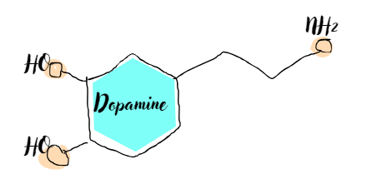
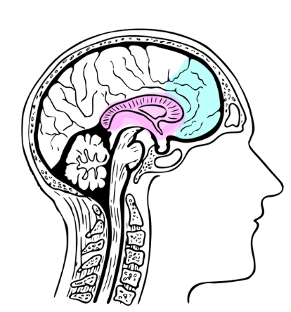
The Brain Bit
Symptoms of ADHD are associated with having lower levels of the brain chemical dopamine in the brain.
Dopamine carries signals between nerves in the brain and is linked to movement, sleep, mood, attention, and learning, motivation, reward and cognition,
Certain parts of the brain may be less active or smaller in children with ADHD.

Slide 8

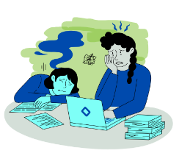
It is thought to be the “pleasure system” of our brains meaning it promotes feelings of enjoyment and reinforcement to motivate performance.
When we are deficient of Dopamine, it makes learning very difficult. That feeling of accomplishment when we learn something new simply isn’t there

Slide 9

A better way to think about it
Kids with ADHD are relatively brakeless. They are:
Unable to put the brakes on distraction Inattention
Unable to put the brakes on inside thoughts Impulsive
Unable to put the brakes on acting upon distractions or thoughts of Hyperactivity

Slide 10
There is more to ADHD….. Kids with ADHD may have trouble with
Managing time
Getting and staying organized
Managing emotions
Following directions
Shifting focus from one thing to another
Keeping things in mind (working memory)
Thinking before saying or doing things
Focusing on what's important
Notes:
Kids with ADHD may have trouble with
Managing time
Getting and staying organized
Managing emotions
Following directions
Shifting focus from one thing to another
Keeping things in mind (working memory)
Thinking before saying or doing things
Focusing on what's important

Slide 11
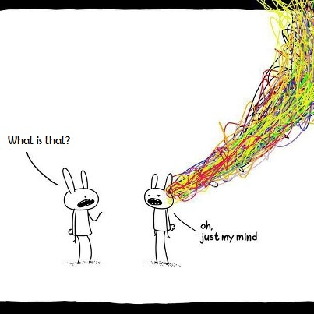

Slide 12
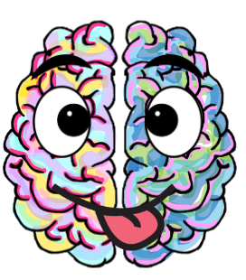


The Positive Attributes of ADHD
Notes:
Log in details for the Menti Meter:
https://www.mentimeter.com/auth/login
Username: hantscamhsdigital@southernhealth.nhs.uk
Password: PACE2025! (all caps)
Go to Meti meter
Click on the left-hand side of screen (my presentations)
Then click on what are some positive attributes of people with ADHD
Then click on the blue bottom on the right-hand side that says present , share screen with the audiences, there words will start to appear on the screen as they submit there answers
How to run this slide:
Tell the group to scan the QR code on their phone and take 2-3 mins to write some of the strengths of there child with ADHD.
Then share the word cloud created and reflect with the group on the wonderful strengthens children with ADHD can have.
Read out some of the strengths as they pop up
Reflect on the strengths and bring back to ADHD
Talk about the ratio of positive to negative comments heard by a child with ADHD.
Script: Possible reflections
Children who have ADHD can be marvellously creative and imaginative. The child who daydreams and has ten different thoughts at once can become a master problem-solver, a fountain of ideas, or an inventive artist.
Children with ADHD may be easily distracted, but sometimes they notice what others don’t see.
Because children with ADHD consider a lot of options at once, they don’t become set on one alternative early on and are more open to different ideas.
I’m sure you will already know that children with ADHD are rarely boring! They’re interested in a lot of different things and have lively personalities. In short, if they’re not exasperating you (and sometimes even when they are), they’re a lot of fun to be with.
When kids with ADHD are motivated, they work or play hard and strive to succeed. It actually may be difficult to distract them from a task that interests them, especially if the activity is interactive or hands-on.

Slide 13
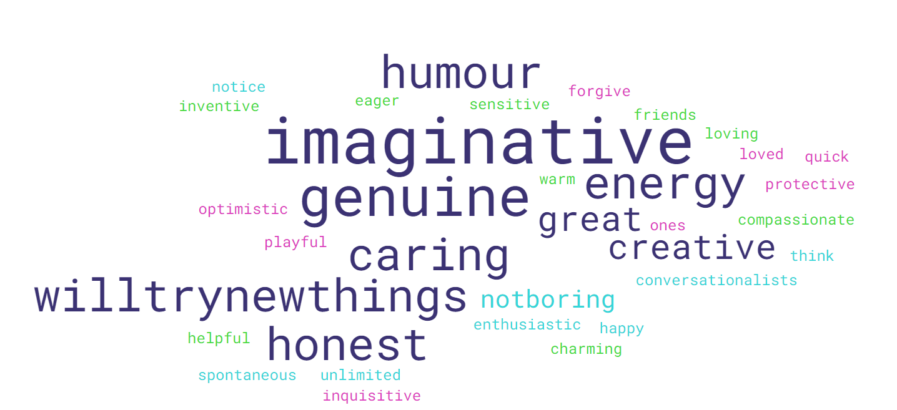
The Positive Attributes of ADHD
Notes:
Script
Children who have ADHD can be marvellously creative and imaginative. The child who daydreams and has ten different thoughts at once can become a master problem-solver, a fountain of ideas, or an inventive artist.
Children with ADHD may be easily distracted, but sometimes they notice what others don’t see.
Because children with ADHD consider a lot of options at once, they don’t become set on one alternative early on and are more open to different ideas.
I’m sure you will already know that children with ADHD are rarely boring! They’re interested in a lot of different things and have lively personalities. In short, if they’re not exasperating you (and sometimes even when they are), they’re a lot of fun to be with.
When kids with ADHD are motivated, they work or play hard and strive to succeed. It actually may be difficult to distract them from a task that interests them, especially if the activity is interactive or hands-on.
List of positive traits to talk though
Eager to make friends
Great long term memory
Charming
Warm and loving
Protective about loved ones
Inquisitive
Doesn’t hold a grudge
Quick to forgive
Genuine
Never boring
Playful
Honest
Optimistic
Unlimited energy
Will try new things
Great conversationalists
Great sense of humour
Caring
Spontaneous
Notice things that others don’t
Think of new ways of doing things
Imaginative and creative
Happy and enthusiastic
Helpful
Sensitive and compassionate
inventive

Slide 14

Gender Differences
In the UK NICE estimates, the prevalence of ADHD in adults is at 3% to 4%, with a male-to-female ratio of approximately 3:1.
This could be due to ADHD being less likely to be picked up on and diagnosed in girls.
Notes:
Script
According to the CDC in America Boys (15%) were more likely to be diagnosed with ADHD than girls (8%). (1)
In the Uk NICE estimate the prevalence of ADHD in adults is estimated at 3% to 4%, with a male-to-female ratio of approximately 3:1. (2)
This could be due to ADHD being less likely to be picked up on and diagnosed in girls. (3)
As we move on to discuss the gender differences between men and women its worth stating that both males and females can present as inattentive or inattentive hyperactive impulsive subtypes.
References
Danielson ML, Claussen AH, Bitsko RH, et al. ADHD Prevalence Among U.S. Children and Adolescents in 2022: Diagnosis, Severity, Co-Occurring Disorders, and Treatment. J Clin Child Adolesc Psychol. Published online May 22, 2024.
NICE (2024) Attention deficit hyperactivity disorder: How common is it? Available at: https://cks.nice.org.uk/topics/attention-deficit-hyperactivity-disorder/background-information/prevalence/#:~:text=In%20the%20UK%2C%20the%20prevalence,family%20income%20and%20social%20class. (Accessed: 25 October 2024).
NICE (2024) Attention deficit hyperactivity disorder: How common is it? Available at: https://cks.nice.org.uk/topics/attention-deficit-hyperactivity-disorder/background-information/prevalence/#:~:text=In%20the%20UK%2C%20the%20prevalence,family%20income%20and%20social%20class. (Accessed: 25 October 2024).
Website links
https://cks.nice.org.uk/topics/attention-deficit-hyperactivity-disorder/background-information/prevalence/#:~:text=In%20the%20UK%2C%20the%20prevalence,family%20income%20and%20social%20class.
https://psychcentral.com/adhd/adhd-symptoms-in-women#:~:text=However%2C%20there%20is%20a%20striking,with%20just%205.6%25%20of%20girls.
https://pmc.ncbi.nlm.nih.gov/articles/PMC3827008/
ADHD in Women vs. Men: How Prevalence and Symptoms Differ by Gender (psychcentral.com)
Why Is ADHD Underdiagnosed In Women? - The ADHD Centre

Slide 15

Male Presentation
Men and boys with ADHD are more likely to display behaviours such as:
Hyperactivity
Disruptive behaviour
Frequently losing items
Interrupting others during conversations
Aggressive and defensive behaviours
High-risk behaviours (e.g., substance misuse, speeding, unhealthy sexual behaviours, excessive financial spending)
Angry outbursts
Insensitivity
Notes:
Script:
In 1775 (Melchior Adam Weikard) A German physician published a textbook with a description of ADHD-like behaviours. Most of the early research on ADHD was conducted on boys.
When we look at the typically male presentations of ADHD we are more likely to see them showing behaviors such as
Hyperactivity
Disruptive behaviour
Frequently losing items
Interrupting others during conversations
Aggressive and defensive behaviours
High-risk behaviours (e.g., substance misuse, speeding, unhealthy sexual behaviors, excessive financial spending)
Angry outbursts
Insensitivity
In general, males with ADHD presented with externalizing problems such as conduct disorder and oppositional defiant disorder while females with ADHD presented with more internalizing problems such as anxiety and depression (1).
References
Lau, T.W.I., Lim, C.G., Acharryya, S. et al. Gender differences in externalizing and internalizing problems in Singaporean children and adolescents with attention-deficit/hyperactivity disorder. Child Adolesc Psychiatry Ment Health 15, 3 (2021). https://doi.org/10.1186/s13034-021-00356-8
Websites
https://adhduk.co.uk/the-history-of-adhd/

Slide 16
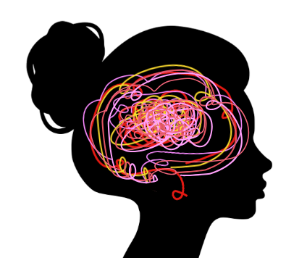
Female Presentation
Inattentive symptoms (losing focus and daydreaming, disorganized, forgetful and often late)
Co-occurring mental health symptoms: other conditions such as Anxiety, Depression, and OCD may be more noticeable and treated first.
Internalizing symptoms feelings of despair, inadequacy and overwhelm, lacking motivation being impatient.
Emotional dysregulation Crying with deep emotion, anger, and feelings of guilt and shame Episodes of rage or tears
Hormonal - Varying hormone levels can exacerbate ADHD symptoms across a woman’s lifespan
Notes:
Female vs Male ADHD - The ADHD Centre Gender Differences in ADHD: Why Women Struggle More (additudemag.com)
Script
Inattention Bit:
One study found Females are more likely to present as inattentive than males. (2)
Inattentive symptoms are losing focus and daydreaming, being disorganised, forgetful and often late, Difficulty maintaining attention and switching off while others are talking.
When females present with a more typical male profile in terms of difficulties with hyperactivity, impulsivity and conduct problems it’s a strong predictor or clinical diagnosis. (2)
Co-occurring conditions:
Co-morbid mental health symptoms: Low self-esteem, Comorbid conditions such as depression, anxiety and OCD are more noticeable than ADHD and are often treated first Anxiety might manifest physiologically in the form of headaches and/or nausea.
Internalizing symptoms bit:
Internalizing symptoms are where people express frustration by internalising them vs externalising behaviours are acting out type behaviours. An example of internalizing behaviour might be feelings of despair, inadequacy and overwhelmed, lacking motivation or being impatient.
Girls with ADHD have been found to be more likely to have problems such as anxiety (6).
Emotional dysregulation:
Emotional dysregulation (Crying with deep emotion, anger, and feelings of guilt and shame) Episodes of rage or tears
Hormonal
Varying hormone levels can exacerbate ADHD symptoms across a women's lifespan. At various points during a menstrual cycle due to fluxations in levels of estrongen and other chemelicals ADHD women may be more likely to do risk taking impulsive behaviour mid cycle, or be more avoidant and low in mood just before there period. (4)
Symptoms may also intensify throughout menopause Reduced oestrogen levels during the menopause also include a drop in dopamine levels, which are already lower in women with ADHD exaserbating symptoms of ADHD. (5)
References
Skoglund, C. et al. (2023) ‘Time after time: Failure to identify and support females with ADHD – a Swedish population register study’, Journal of Child Psychology and Psychiatry, 65(6), pp. 832–844. doi:10.1111/jcpp.13920.
Mowlem, F.D., Rosenqvist, M.A., Martin, J. et al. Sex differences in predicting ADHD clinical diagnosis and pharmacological treatment. Eur Child Adolesc Psychiatry 28, 481–489 (2019). https://doi.org/10.1007/s00787-018-1211-3 https://link.springer.com/article/10.1007/s00787-018-1211-3
Levy F, Hay DA, Bennett KS, McStephen M. Gender differences in ADHD subtype comorbidity. J Am Acad Child Adolesc Psychiatry. 2005;44:368–76.
Eng, A.G. et al. (2024) ‘Attention-deficit/hyperactivity disorder and the menstrual cycle: Theory and evidence’, Hormones and Behavior, 158, p. 105466. doi:10.1016/j.yhbeh.2023.105466.
Antoniou, E., Rigas, N., Orovou, E., Papatrechas, A. and Sarella, A., 2021. ADHD symptoms in females of childhood, adolescent, reproductive and menopause period. Materia socio-medica, 33(2), p.114.
Lau, T.W.I., Lim, C.G., Acharryya, S. et al. Gender differences in externalizing and internalizing problems in Singaporean children and adolescents with attention-deficit/hyperactivity disorder. Child Adolesc Psychiatry Ment Health 15, 3 (2021). https://doi.org/10.1186/s13034-021-00356-8

Slide 17
Typical ADHD symptoms across the lifespan
The younger child: very young children display externalising symptoms such as hyperactive and impulsive behaviour.
During middle childhood: symptoms of inattention become more apparent could be due to commencing school and increasing demands.
Adolescence: symptoms of inattention, impulsivity and less hyperactivity tend to be observed. Restlessness is more apparent than overt hyperactivity. Academic and social demands are greater.
Adulthood: inattention: struggles with timekeeping, organisation, planning, overwhelm, masking becomes a coping mechanism which increases symptoms of anxiety and depression.
Notes:
ADHD across the lifespan: What it looks like in adults | NIH MedlinePlus Magazine
ADHD Changes In Adulthood – CHADD
ADHD symptoms can change how they present over a lifetime. For example becoming more intensified during puberty, periods or perimenopause. Or can become more apparent when life stressors are bigger and masking strategies become less effective.
The younger child: very young children display externalising symptoms such as hyperactive and impulsive behaviour.
During middle childhood symptoms of inattention become more apparent could be due to commencing school.
Adolescence: symptoms of inattention and impulsivity and less hyperactivity tend to be observed. Restlessness is more apparent than overt hyperactivity. Academic and social demands are greater.
Adulthood: inattention: struggles with timekeeping, organisation, planning, overwhelm, masking becomes a coping mechanism which increases symptoms of anxiety and depression.

Slide 18

Detection: Early Help/Pre-referral
Symptoms of ADHD must be
Present for at least 6 months
Present before the age of 12 years
Seen in two areas of life (home and School)
Can cause significant distress or impairment in social, academic, or occupational functioning
NICE guidance recommends:
  Discussing support with school teacher and SENCO
  Parenting intervention (Barnardo’s Parenting Factor for ADHD)
  A period of watchful waiting for 10 weeks
  If symptoms persist with moderate impairment then referral into
  secondary care (CAMHS) is recommended.
Notes:
Symptoms of ADHD must be observed in two areas of life (eg home/school)
Symptoms must be present for at least 6 months and present prior to the age of 12 years
Consideration of co-occurring or alternative conditions
NICE guidance recommends:
discussing with school teacher and SENCO
Parenting intervention (Barnardo’s Parenting Factor for ADHD)
a period of watchful waiting for 10 weeks
If symptoms persist with moderate impairment then referral into secondary care (CAMHS) is recommended

Slide 19
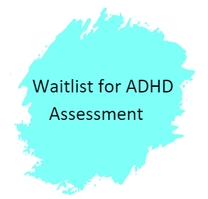


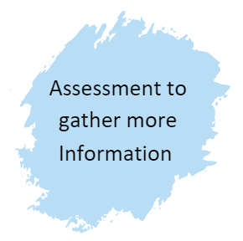
Referral into CAMHS
Who can refer:
Young person
Parents
School
GP
  Please note that we are experiencing significant numbers of referrals for ADHD assessment and therefore there are significant waiting times.
Notes:
Referrals into CAMHS can be made via the Hampshire CAMHS website and anyone is able to refer including parent/carer young person, school or GP.
Referrals are then screened by our Single Point of Access Team and urgency of referral made and a decision reached as to the most appropriate pathway:
CAMHS assessment if information received is unclear or requires more specialist assessment.
Added straight to ADHD pathway if information received is clear.
This information is widely available on the Hampshire CAMHS website.
Please note that we are experiencing significant numbers of referrals for ADHD assessment and therefore there are significant waiting times.

Slide 20
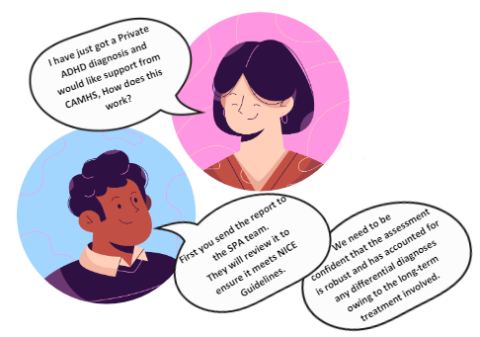
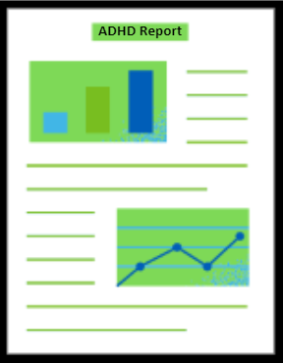
Private or Right to Choose Diagnoses
Notes:
Spell check – does
If you are referring into CAMHS for treatment following an external diagnosis we require a copy of the ADHD diagnostic report.
Once received, this report will be screened within our Single Point of Access Team alongside ADHD Team clinicians to ensure criteria is met in accordance with NICE Guidelines. You can find this information in your pack.
We need to be confident that the assessment is robust and has accounted for any differential diagnoses owing to the long-term treatment involved.
SCRIPT - Criteria for accepting ADHD diagnosis into CAMHS for ADHD Clinic (for medication)
When a referral to CAMHS is made requesting access to an ADHD Clinic appointment (for review and monitoring of ADHD medication), we require a copy of the full ADHD diagnostic report to be included with the referral. CAMHS follows NICE guidelines when considering whether an ADHD diagnostic report meets the criteria to accept for an ADHD Clinic appointment:
A diagnosis of ADHD should only be made by a specialist psychiatrist, paediatrician or other appropriately qualified healthcare professional with training and expertise in the diagnosis of ADHD*, on the basis of:
a full clinical and psychosocial assessment of the person; this should include discussion about behaviour and symptoms in the different domains and settings of the person's everyday life and
a full developmental and psychiatric history and
observer reports and assessment of the person's mental state.
From NICE Guidelines: https://www.nice.org.uk/guidance/ng87/chapter/Recommendations#diagnosis
*An appropriate professional can include: a registered health professional, for example: a medical practitioner registered with the GMC such as a psychiatrist, paediatrician specialist doctor. A specialist nurse registered with the NMC. A clinical/forensic psychologist, specialist speech and language therapist, occupational therapist registered with the HPCP.
The ADHD report must include:
A clear developmental history, which also considers family history and early development obtained from primary caregivers, as well as commentary on current presentation
A relevant medical and psychiatric history including any family history of neurodevelopmental problems
A detailed account of an observational study of the child/young person carried out using objective measures (for example use SNAPIV, Connors and DSM criteria). This can be in the form of an observational study using computerised methods (eg QBTest), or a 1:1 assessment between clinician and young person in clinic or an educational setting
A diagnosis with clinical rationale
CAMHS has recently received private ADHD reports that do not meet the NICE criteria in order to be accepted for an ADHD Clinic appointment. For example, we have received reports that state diagnostic tools have been used or full developmental interviews have been completed but no evidence or details of findings from these have been included within the diagnostic report. Where elements are missing from reports, referrals will be rejected, and it is the responsibility of the parent/carer to gather all missing information prior to submitting a new referral.
Where a young person is currently prescribed ADHD medication by a private provider, it remains the responsibility of the current prescriber to review and monitor medication until accepted into CAMHS and an appointment with the ADHD clinic is available.

Slide 21
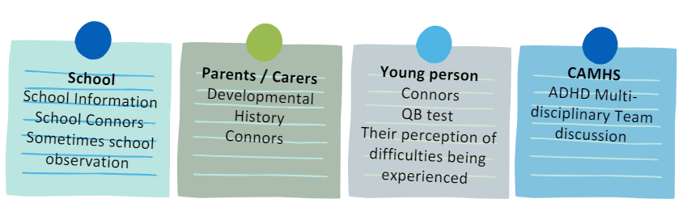
Assessment Process in CAMHS
Notes:
School information including Teacher SNAP ratings
Conners forms from Teachers and Parents
QB Test
Patient perception of difficulties being experienced
Developmental history from conception up until the age of the child/young person
ADHD Multi-disciplinary Team discussion
It is not standard practice to undertake a school observation, however in certain circumstances this may be required

Slide 22
What else could it be?
Anxiety and Depression
Speech and Language Disorder
Sleep Disorder
Substance Misuse
Behavioural
Sensory Processing Disorder
Auditory Processing Disorder
Trauma
Developmental Delay
Chromosomal Abnormalities
Specific learning difficulties
(Dyslexia)
Tics/
Tourette's
Notes:
Script:
When looking at ADHD some of the symptoms of can be present in other conditions as well, such as when you are struggling with anxiety it can be harder to concentrate and keep yourself organized. As part of an assessment, we need to rule out other potential conditions.
Talk through some of the alternative hypotheses.
Possible alternative diagnosis
Anxiety
Speech and Language Disorder
Sleep Disorder
Substance Misuse
Behavioural
Sensory Processing Disorder
Auditory Processing Disorder
Trauma
Developmental Delay
Chromosomal Abnormalities
Obsessive Compulsive Disorder
Oppositional Defiant Disorder
Conduct Disorder
Bi Polar
Dyslexia
Dyspraxia
Tics/Tourettes
Autistic Spectrum Condition
Attachment difficulties
Irlen Syndrome

Slide 23
Support Following Assessment
Assessment Feedback Meeting
Psychoeducation group
Assessment for medication
Medication stabilisation
Medication reviews
Medication Workshops
Barnardo’s Parenting Courses
Physical observation checks
Notes:
Assessment feedback appointment
CAMHS are commissioned to provide pharmacological management for ADHD
If medication is clinically required then parents/carers and young people (where appropriate) are invited to our Psychoeducation Group
Following the group if medication is wanted then they are offered a medication initiation appointment
Once medication dose is stable, we review 6-monthly
It is essential to monitor height, weight, blood pressure and pulse
Medication is continued for as long as parents / young person see significant benefits.
Medication “holidays” or breaks can be useful to understand symptoms as children age.
Please see the leaflet within your pack which has some useful signposting.

Slide 24
Please Fill in our Feedback Form
Any questions?
Place QR code hear

Slide 25
References
Antoniou, E., Rigas, N., Orovou, E., Papatrechas, A. and Sarella, A., 2021. ADHD symptoms in females of childhood, adolescent, reproductive and menopause period. Materia socio-medica, 33(2), p.114.
Danielson ML, Claussen AH, Bitsko RH, et al. ADHD Prevalence Among U.S. Children and Adolescents in 2022: Diagnosis, Severity, Co-Occurring Disorders, and Treatment. J Clin Child Adolesc Psychol. Published online May 22, 2024.
Eng, A.G. et al. (2024) ‘Attention-deficit/hyperactivity disorder and the menstrual cycle: Theory and evidence’, Hormones and Behavior, 158, p. 105466. doi:10.1016/j.yhbeh.2023.105466.
Lau, T.W.I., Lim, C.G., Acharryya, S. et al. Gender differences in externalizing and internalizing problems in Singaporean children and adolescents with attention-deficit/hyperactivity disorder. Child Adolesc Psychiatry Ment Health 15, 3 (2021). https://doi.org/10.1186/s13034-021-00356-8
Levy F, Hay DA, Bennett KS, McStephen M. Gender differences in ADHD subtype comorbidity. J Am Acad Child Adolesc Psychiatry. 2005;44:368–76.
Mowlem, F.D., Rosenqvist, M.A., Martin, J. et al. Sex differences in predicting ADHD clinical diagnosis and pharmacological treatment. Eur Child Adolesc Psychiatry 28, 481–489 (2019). https://doi.org/10.1007/s00787-018-1211-3
Mowlem, F.D., Rosenqvist, M.A., Martin, J. et al. Sex differences in predicting ADHD clinical diagnosis and pharmacological treatment. Eur Child Adolesc Psychiatry 28, 481–489 (2019). https://doi.org/10.1007/s00787-018-1211-3 https://link.springer.com/article/10.1007/s00787-018-1211-3
NICE (2024) Attention deficit hyperactivity disorder: How common is it? Available at: https://cks.nice.org.uk/topics/attention-deficit-hyperactivity-disorder/background-information/prevalence/#:~:text=In%20the%20UK%2C%20the%20prevalence,family%20income%20and%20social%20class. (Accessed: 25 October 2024).
NICE (2024) Attention deficit hyperactivity disorder: How common is it? Available at: https://cks.nice.org.uk/topics/attention-deficit-hyperactivity-disorder/background-information/prevalence/#:~:text=In%20the%20UK%2C%20the%20prevalence,family%20income%20and%20social%20class. (Accessed: 25 October 2024).
Núñez-Jaramillo, L., Herrera-Solís, A., & Herrera-Morales, W. V. (2021). ADHD: Reviewing the Causes and Evaluating Solutions. Journal of personalized medicine, 11(3), 166. https://doi.org/10.3390/jpm11030166
Skoglund, C. et al. (2023) ‘Time after time: Failure to identify and support females with ADHD – a Swedish population register study’, Journal of Child Psychology and Psychiatry, 65(6), pp. 832–844. doi:10.1111/jcpp.13920.

Slide 26
Websites
Where we got our information:
https://www.cdc.gov/adhd/data/?CDC_AAref_Val=https://www.cdc.gov/ncbddd/adhd/data.html
https://www.adhdcentre.co.uk/female-vs-male-adhd/
https://www.additudemag.com/gender-differences-in-adhd-women-vs-men/
https://neurodivergentinsights.com/misdiagnosis-monday/adhd-vs-adhd
Useful websites
Right to Choose - ADHD UK https://adhduk.co.uk/right-to-choose/

Slide 27
Video links
Video link: Let's talk about ADHD (youtube.com) https://www.youtube.com/watch?v=YeamHE6Kank&t=42s

